Slide 1
Onion Routing Security Analysis
Aaron Johnson
U.S. Naval Research Laboratory
DC-Area Anonymity, Privacy, and Security Seminar

Slide 2
Onion Routing
1
2
u
d
3
5
User u running client
Internet destination d
4
Onion routing relays
Encrypted onion-routing hop
Unencrypted onion-routing hop

Slide 3
Basic Onion Routing Security
u
1
2
d
v
3
e
5
w
4
f

Slide 4
Basic Onion Routing Security
u
1
2
d
v
3
e
5
w
4
f
First router compromised

Slide 5
Basic Onion Routing Security
u
1
2
d
v
3
e
5
w
4
f
First router compromised
Last router compromised

Slide 6
Basic Onion Routing Security
u
1
2
d
v
3
e
5
w
4
f
First router compromised
Last router compromised
First and last compromised

Slide 7
Basic Onion Routing Security
u
1
2
d
v
3
e
5
w
4
f
First router compromised
Last router compromised
First and last compromised
Neither first nor last compromised

Slide 8
Existing Metrics
Entropy / Gini coefficient of path distribution
Source entropy of given connection
Probability of selecting adversarial routers in a circuit
Probability of crossing an Autonomous System to entry and from exit

Slide 9
Analysis Ideas
Adversary-based
Defined over time
Probability distributions

Slide 10
Adversary-based Metrics
Resources
Bandwidth
Compromised relays
Money
Autonomous Systems
Locations (IXPs, NAPs, cable landing points)
Governments
Game structure
Actions
Resource reallocation
Blocking/modifying traffic
Move order
Strategy / Goal
Targeting users
Dragnet

Slide 11
Defined over time
Protocols have dependencies over time
Guards
User behavior has time dependencies
Patterns in long-term behavior
Short-term patterns (browsing, application sessions)
Adversaries have time dependencies
Control network resources over time

Slide 12
Onion Routing
1
2
u
d
3
5
User u running client
Internet destination d
4
Onion routing relays
Encrypted onion-routing hop
Unencrypted onion-routing hop

Slide 13
Onion Routing
1
2
u
d
3
5
User u running client
Internet destination d
4
Onion routing relays
Encrypted onion-routing hop
Unencrypted onion-routing hop

Slide 14
Onion Routing
1
2
u
d
3
5
User u running client
Internet destination d
4
Onion routing relays
Encrypted onion-routing hop
Unencrypted onion-routing hop

Slide 15
Probability distributions
Bad things happen with non-negligible probability
Average/worst-case analysis loses useful information
Experiments give samples, but generally lack statistical validity

Slide 16
Example Onion Routing Metrics
A runs m relays
PDF of number of compromised paths in a week
A controls a ASs
PDF of number of correct guesses about cxn source
A contributes b bandwidth
PDF of time until client chooses compromised path
A compromises k relays
PDF of number of destinations observed

Slide 17
Evaluation on Tor
April – November 2011
Observed BW avg: 4947442 KBps
Observed Guard BW avg 2697602 KBps
Observed Exit BW avg: 1333764 KBps
Adversary controls:
2/2 top guard/exit relays: (3.5/7% of guard/exit)
4/4 top guard/exit relays: (6.7/13% of guard/exit)
8/8 top guard/exit relays: (10/20% of guard/exit)
3000 clients

Slide 18
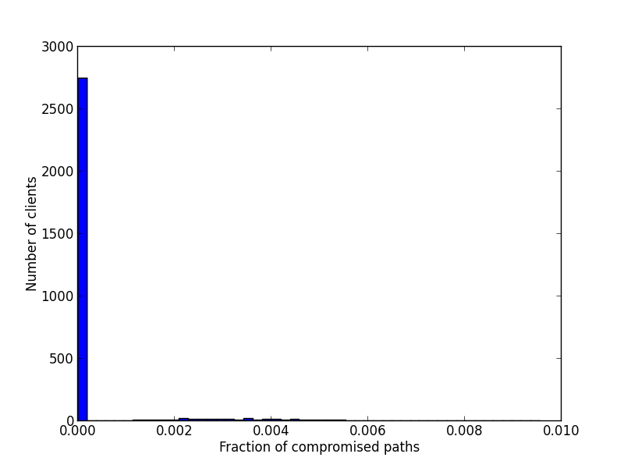
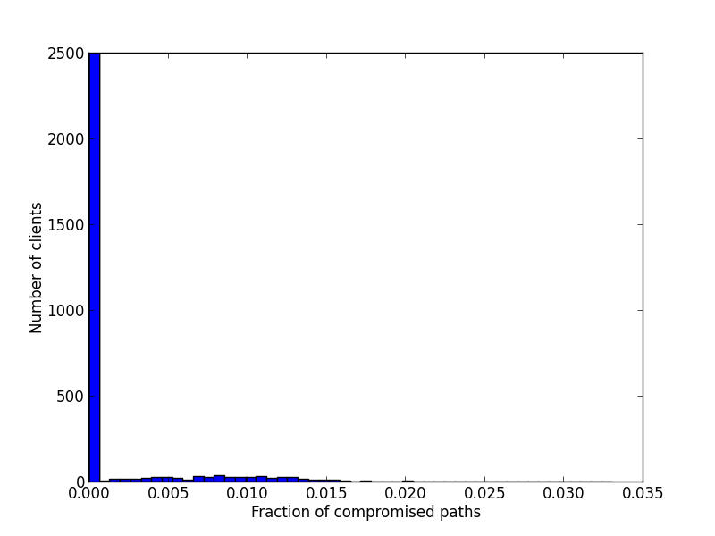
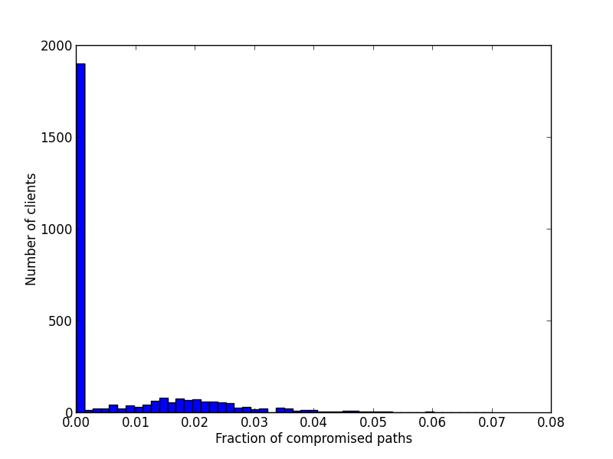
Adversary has 2/2 top guards/exits
Adversary has 4/4 top guards/exits
Adversary has 8/8 top guards/exits

Slide 19
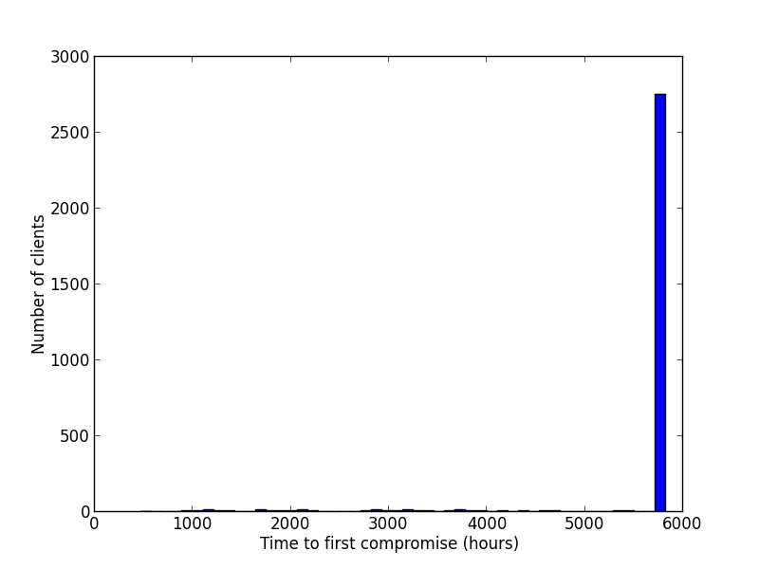
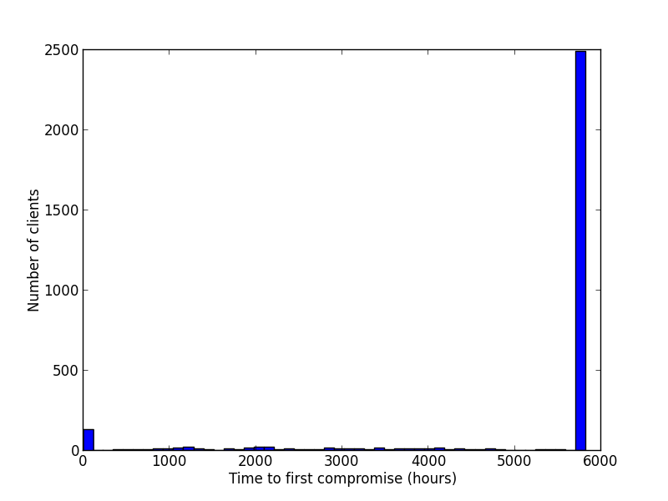
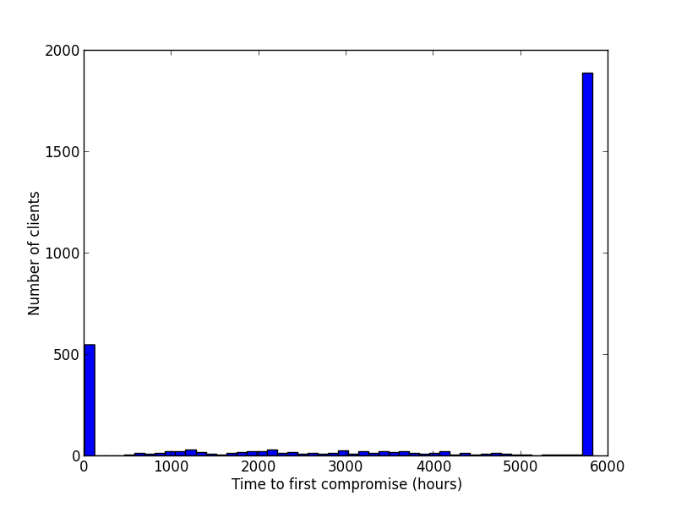
Adversary has 2/2 top guards/exits
Adversary has 4/4 top guards/exits
Adversary has 8/8 top guards/exits

Slide 20
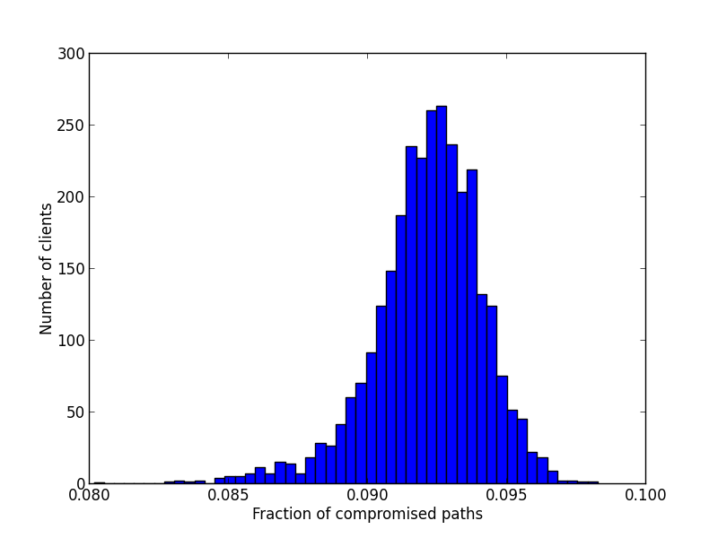
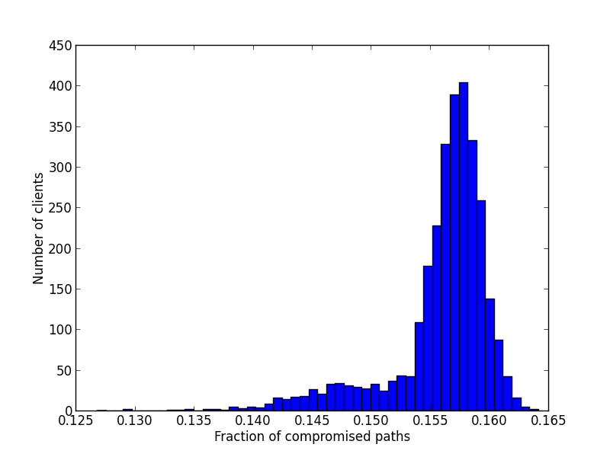
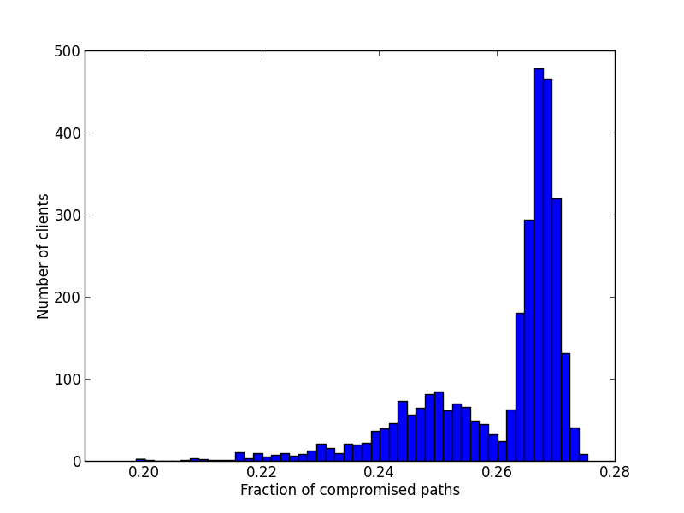
ISP adversary w/ 4 top exits
ISP adversary w/ 8 top exits
Adversary has 16 top exits

Slide 21
Challenges
Making good adversary models
What resources are limiting?
What strategies are the greatest threats?
Statistically-valid probability distributions
Sample space over time is huge
Protocols may depend on network dynamics
Virtual Coordinate Systems
Congestion-aware routing

