Slide 1
Preventing Active Timing Attacks in Low-Latency Anonymous Communication
Joan Feigenbaum
Yale University
Aaron Johnson
University of Texas
at Austin
Paul Syverson
Naval Research Laboratory
The 10th Privacy Enhancing Technologies Symposium
July 2010

Slide 2
Problem

Slide 3
Problem
Onion routing suffers from timing attacks.
Adversary
Users
Onion Routers
Destinations

Slide 4
Problem
Onion routing suffers from timing attacks.
Adversary
Encrypted
Unencrypted
Users
Onion Routers
Destinations

Slide 5
Problem
Onion routing suffers from timing attacks.
Adversary
Users
Onion Routers
Destinations

Slide 6
Problem
Onion routing suffers from timing attacks.
Adversary
Users
Onion Routers
Destinations

Slide 7
Problem
Onion routing suffers from timing attacks.
Adversary
Users
Onion Routers
Destinations

Slide 8
Problem
Onion routing suffers from timing attacks.
Adversary
Users
Onion Routers
Destinations

Slide 9
Problem
Onion routing suffers from timing attacks.
Passive timing attack
Adversary
Users
Onion Routers
Destinations

Slide 10
Problem
Padding Schemes
Constant-rate padding
Variable-rate padding¹
Minimal padding²
1. Timing analysis in low-latency mix networks: Attacks and defenses. Shmatikov & Wang, ESORICS 06.
2. Dependent link padding algorithms for low latency anonymity systems. Wang and Srinivasan, CCS 08.

Slide 11
Problem
Onion routing suffers from timing attacks.
Passive timing attack
Adversary
Users
Onion Routers
Destinations

Slide 12
Problem
Onion routing suffers from timing attacks.
Passive timing attack
Adversary
Users
Onion Routers
Destinations

Slide 13
Problem
Onion routing suffers from timing attacks.
Passive timing attack
Adversary
Users
Onion Routers
Destinations

Slide 14
Problem
Onion routing suffers from timing attacks.
Passive timing attack
Adversary
Users
Onion Routers
Destinations

Slide 15
Problem
Onion routing suffers from timing attacks.
Passive timing attack
Active timing attack
Adversary
Users
Onion Routers
Destinations

Slide 16
Problem
Onion routing suffers from timing attacks.
Passive timing attack
Active timing attack
Adversary
Users
Onion Routers
Destinations

Slide 17
Problem
Onion routing suffers from timing attacks.
Passive timing attack
Active timing attack
Adversary
Users
Onion Routers
Destinations

Slide 18
Problem
Onion routing suffers from timing attacks.
Passive timing attack
Active timing attack
Adversary
Users
Onion Routers
Destinations

Slide 19
Problem
Onion routing suffers from timing attacks.
How bad is it?
Tor: 250 guard routers
500 exit routers
7571 unique users daily per guard¹
Top 2% contribute 50% bandwidth¹
Case 1: Adversary runs one guard and one exit.
# comp. = 7571/500
≈ 15
Case 2: Adversary’s guard and exit are in top 2% of bandwidth.
# users = 7571*.5/.02
≈ 189275
# comp. = 189275*.5/(500*.02)
≈ 9464
1. McCoy, Bauer, Grunwald, Kohno, and Sicker. Shining light in dark places: Understanding the Tor network. PETS 2008.

Slide 20
Results

Slide 21
Results
Protocol for defeating active timing attacks given a padding scheme
  Reduces active timing attacks to passive timing attacks
  Uses redundancy and timestamps
Provides a tradeoff between anonymity and performance
Protects against adversaries smaller than half of the network. This is optimal.
Measurements on Tor suggest it may be usable in practice.

Slide 22
Model

Slide 23
Model
Users: U
Routers: R
Destinations: D
Adversary: A⊆R, b = |A|/|R|
Probabilistic delays
  Random link delay: d(r,s), r,s∈R
  Random processing delay: d(r), r∈R
Synchronized clocks with tolerance δ
Padding scheme P(x)
  Input: New connection information, x
  Output: Timing patterns in both directions, π₀, π₁
  Provides S_{u} ⊆U, users with the same timing as u

Slide 24
Protocol

Slide 25
Protocol
To the destination
Multiple entry points
One exit point
Entering data encrypted
Exiting data unencrypted
From the destination
Multiple exit points
One entrance point
Exiting data encrypted
Entering data unencrypted

Slide 26
Protocol
To the destination

Slide 27
Protocol
To the destination

Slide 28
Protocol
To the destination
Take 0 (onion routing):
Pr[compromised] = b²

Slide 29
Protocol
To the destination
Take 0 (onion routing):
Pr[compromised] = b²

Slide 30
Protocol
To the destination
Take 0 (onion routing):
Pr[compromised] = b²
Take 1 (two entry points):
Pr[compromised] = b³ (3-2b)

Slide 31
Protocol
To the destination
Take 0 (onion routing):
Pr[compromised] = b²
Take 1 (two entry points):
Pr[compromised] = b³ (3-2b)

Slide 32
Protocol
To the destination
Take 0 (onion routing):
Pr[compromised] = b²
Take 1 (two entry points):
Pr[compromised] = b³ (3-2b)

Slide 33
Protocol
To the destination
k
Take 0 (onion routing):
Pr[compromised] = b²
Take 1 (two entry points):
Pr[compromised] = b³ (3-2b)
Take 2 (k entry points):
Pr[compromised] = b² (1-(1-b)^{k}+(1-b)b^{k-1})→ b²

Slide 34
Protocol
To the destination
logl
l
Take 0 (onion routing):
Pr[compromised] = b²
Take 1 (two entry points):
Pr[compromised] = b³ (3-2b)
Take 2 (k entry points):
Pr[compromised] = b² (1-(1-b)^{k}+(1-b)b^{k-1})→ b²
Take 3 (layered mesh)

Slide 35
Protocol
To the destination
logl
l
Take 0 (onion routing):
Pr[compromised] = b²
Take 1 (two entry points):
Pr[compromised] = b³ (3-2b)
Take 2 (k entry points):
Pr[compromised] = b² (1-(1-b)^{k}+(1-b)b^{k-1})→ b²
Take 3 (layered mesh)

Slide 36
Protocol
To the destination
logl
l
Take 0 (onion routing):
Pr[compromised] = b²
Take 1 (two entry points):
Pr[compromised] = b³ (3-2b)
Take 2 (k entry points):
Pr[compromised] = b² (1-(1-b)^{k}+(1-b)b^{k-1})→ b²
Take 3 (layered mesh)

Slide 37
Protocol
To the destination
Problem: Adversary can make delays more likely even if not certain.
Solution: Use timestamps.
Arrival prob.: .95 = Pr[d(r,s) + d(s)≤ d*(r,s)]
ith send time: t_{i} = t_{i-1}+max_{j,k} d*(r_{(i-1)j},r_{i,k})+δ

Slide 38
Protocol
From the destination

Slide 39
Protocol
From the destination
Path of length k
Each router has and enforces timing pattern.

Slide 40
Protocol
From the destination
Path of length k
Each router has and enforces timing pattern.

Slide 41
Protocol
Setup (l,k,p,c)
Network
Randomly select the routers for c fixed l×logl meshes with k-length return paths.
Determine delays d*(r,s) such that
p = Pr[d(r,s) + d(r)≤ d*(r,s)]
User
Choose (mesh,path) pair (M,P).
Obtain padding (π₀, π₁) = P(x).
Randomly select identifiers n_{si}.
Generate private keys k_{si}.
Send O(π₁),n_{si}, n_{si}, k_{si} through M to s_{i}∈P.

Slide 42
Analysis

Slide 43
Analysis
Theorem 1:
lim_{l,k→∞} Pr[compromise] =
0 b < ½
¼ b = ½
b b > ½

Slide 44
Analysis
Theorem 1:
lim_{l,k→∞} Pr[compromise] =
0 b < ½
¼ b = ½
b b > ½
Theorem 2: Pr[compromise] = Θ(l ^{log(b)-log(1-b)})

Slide 45
Analysis
Theorem 1:
lim_{l,k→∞} Pr[compromise] =
0 b < ½
¼ b = ½
b b > ½
Theorem 2: Pr[compromise] = Θ(l ^{log(b)-log(1-b)})
Theorem 3: Let c(b) be the probability of compromise in some forwarding topology.
If b < ½, then c(b) < ε ⇒ c(1-b) > 1-b- ε(1-b)/b.

Slide 46
Analysis
Theorem 1:
lim_{l,k→∞} Pr[compromise] =
0 b < ½
¼ b = ½
b b > ½
Theorem 2: Pr[compromise] = Θ(l ^{log(b)-log(1-b)})
Theorem 3: Let c(b) be the probability of compromise in some forwarding topology.
If b < ½, then c(b) < ε ⇒ c(1-b) > 1-b- ε(1-b)/b.
Theorem 4:
Latency is (l+k+2).
# of messages is 2logl+(I-1)(logl)² +k+2.

Slide 47
Analysis
 |  |  | Mesh |  | Onion Routing
b | l | w | Pr[comp.] | Messages | Pr[comp.] | Messages
.05 | 3 | 3 | .0002 | 29 | .0025 | 8
.05 | 4 | 3 | .00003 | 39 | .0025 | 10
.1 | 4 | 3 | .0007 | 39 | .01 | 10
.25 | 4 | 2 | .0303 | 22 | .0625 | 10
Mesh routing vs. Onion routing

Slide 48
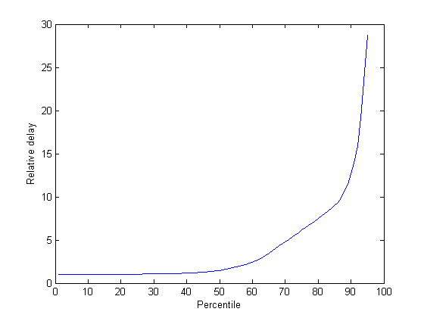
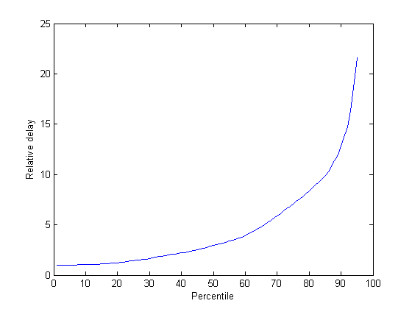
Tor Measurements
Analysis
Measured delays in Tor for a month (3/09).
Delays for new connections and 400-byte packets.
Used empirical measurements for delay distributions per router per 6hr. Period.
Relative added connection delays (p=.95)
Relative added packet delays (p=.95)
p(50) ≈ 1.48
p(50) ≈ 2.95

Slide 49
Conclusion
Reduced active timing attacks to designing padding schemes.
Protocol allows system to trade off anonymity and performance.
Future work
  Usable padding scheme
  Free routes
  Protection from DOS attacks

Slide 50
Protocol
To the destination
Message M
Random numbers n_{ri}, n_{si}
Private key k_{r}
{M}_{r} denotes encryption with r’s public key
Destination d
Message Onion
O(M) = {n_{r1}, t₁, {n_{r2}, t₂, …{n_{r}, d, n_{s1}, k_{r}, M}_{r} …}_{r2}}_{r1}

Slide 51
Protocol
To the destination
User
Let M be waiting message or dummy if none.
When pattern π₀ instructs, send O(M) to each router in first mesh layer.
Router r_{i}
On incoming {n_{ri}, t, M}_{ri},
if n_{ri} is previously unseen,
send M at time t to each router in next layer.

Slide 52
Protocol
From the destination
{M}_{k} denotes encryption with private key k.
n_{si,} n_{si+1} are identifiers given to s_{i} by user
k_{si} is private key given to s_{i} by user
π₁ is return pattern given by user
Router s_{i}
On incoming <n_{si},M>,
place <n_{si+1}, {n_{si},M}_{ksi}> into queue.
When pattern π₁ instructs,
take <n_{si+1}, M’> from queue (or dummy)
send to s_{i+1}.

