Slide 1
Privacy-Preserving Measurement of the Tor Network Aaron Johnson
May 30th, 2017
Center for Disclosure Avoidance Research, U.S. Census

Slide 2
Problem
Tor is a popular system for anonymous, censorship-resistant communication (includes client, server, and Web browser).

Slide 3
Problem
Tor is a popular system for anonymous, censorship-resistant communication (includes client, server, and Web browser).
What is going on inside Tor?
How many users?
How many connections?
How much traffic?
Secure multiparty computation

Slide 4
Background: Onion Routing
Users
Relays
Destinations
Circuit
Stream

Slide 5
Background: Onion Routing
Users
Relays
Destinations
Circuit
Stream

Slide 6
Background: Onion Routing
Users
Relays
Destinations
Circuit
Stream

Slide 7
Background: Onion Routing
Users
Relays
Destinations
Circuit
Stream

Slide 8
Background: Onion Routing
Users
Relays
Destinations
Circuit
Stream

Slide 9
Background: Using Circuits

Slide 10
Background: Using Circuits
Clients begin all circuits with a selected guard.

Slide 11
Background: Using Circuits
Clients begin all circuits with a selected guard.
Relays define individual exit policies.

Slide 12
Background: Using Circuits
Clients begin all circuits with a selected guard.
Relays define individual exit policies.
Clients multiplex streams over a circuit.

Slide 13
Background: Using Circuits
Clients begin all circuits with a selected guard.
Relays define individual exit policies.
Clients multiplex streams over a circuit.
New circuits replace existing ones periodically.

Slide 14
Background: Using Circuits
Clients begin all circuits with a selected guard.
Relays define individual exit policies.
Clients multiplex streams over a circuit.
New circuits replace existing ones periodically.
Clients randomly choose proportional to bandwidth.

Slide 15
Background: Onion Services
Onion Service

Slide 16
Background: Onion Services
Onion Service
IP
Onion services maintain circuits to Introduction Points (IPs).

Slide 17
Background: Onion Services
RP
Onion Service
IP
Onion services maintain circuits to Introduction Points (IPs).
User creates circuit to Rendezvous Point (RP) and IP and requests connection to RP.

Slide 18
Background: Onion Services
RP
Onion Service
IP
Onion services maintain circuits to Introduction Points (IPs).
User creates circuit to Rendezvous Point (RP) and IP and requests connection to RP.
Onion service connects to RP.

Slide 19
Background: Directory Authorities
Directory Authorities
Hourly network consensus by majority vote
Relays (IPs, public keys, bandwidths, etc.)
Parameters (performance thresholds, etc.)

Slide 20
Tor Measurement
Why measure Tor?
Guide network improvements (e.g. improving congestion)
Calibrate network operations (e.g. bandwidth weighting)
Inform policy discussions (e.g. popularity in various countries)

Slide 21
Tor Measurement
What to measure on Tor?
Users
Total # unique
Churn rate
Traffic distribution
Relays
Bandwidth
Congestion
Failures
Denial-of-service
Destinations
# onion services
Popular destinations
Popular applications

Slide 22
Tor Measurement
Example privacy risks of measuring Tor
Deanonymizing individual connections
Storing sensitive data at relays risks leaks from compromise
Revealing “interesting” users (e.g. from censored locations)
Revealing private onion services

Slide 23
Tor Measurement
https://metrics.torproject.org
Some current Tor measurements
Data | How measured | Privacy techniques
Relay bandwidth capacity | Self, BW Authorities | Test measurements
Relay used bandwidth | Per relay | Report every 4 hrs
Total daily users | Per relay | Inferred from consensus downloads
Users per country | Per relay | Report every 24 hrs, round, opt-in
# onion services | Per relay | Differential privacy, round
Exit traffic per port | Per relay | Report every 24 hrs, opt-in

Slide 24
Tor Measurement
https://metrics.torproject.org
Some current Tor measurements
Data | How measured | Privacy techniques
Relay bandwidth capacity | Self, BW Authorities | Test measurements
Relay used bandwidth | Per relay | Report every 4 hrs
Total daily users | Per relay | Inferred from consensus downloads
Users per country | Per relay | Report every 24 hrs, round, opt-in
# onion services | Per relay | Differential privacy, round
Exit traffic per port | Per relay | Report every 24 hrs, opt-in
Inaccurate

Slide 25
Tor Measurement
https://metrics.torproject.org
Some current Tor measurements
Data | How measured | Privacy techniques
Relay bandwidth capacity | Self, BW Authorities | Test measurements
Relay used bandwidth | Per relay | Report every 4 hrs
Total daily users | Per relay | Inferred from consensus downloads
Users per country | Per relay | Report every 24 hrs, round, opt-in
# onion services | Per relay | Differential privacy, round
Exit traffic per port | Per relay | Report every 24 hrs, opt-in
Unsafe

Slide 26
Tor Measurement
https://metrics.torproject.org
Some current Tor measurements
Data | How measured | Privacy techniques
Relay bandwidth capacity | Self, BW Authorities | Test measurements
Relay used bandwidth | Per relay | Report every 4 hrs
Total daily users | Per relay | Inferred from consensus downloads
Users per country | Per relay | Report every 24 hrs, round, opt-in
# onion services | Per relay | Differential privacy, round
Exit traffic per port | Per relay | Report every 24 hrs, opt-in
Incomplete

Slide 27
Tool: Differential Privacy
Differential Privacy
Mechanism M is (ε,δ)-differentially private if, for all databases D and D’ that differ only in the data of one individual, Pr[M(D)=r] ≤ Pr[M(D’)=r] e^{ε} + δ

Slide 28
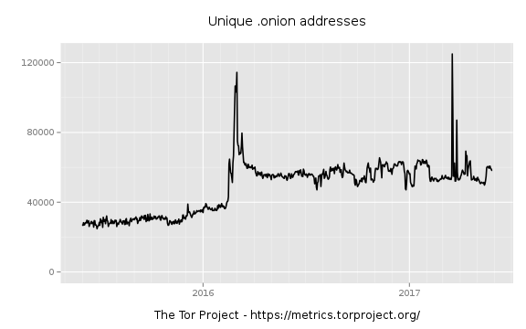
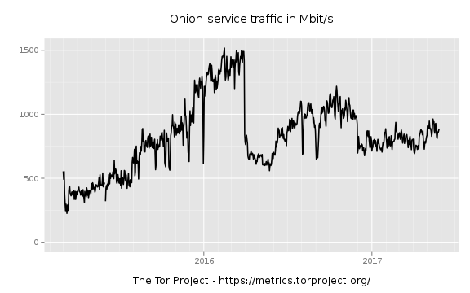
Onion service statistics
Tor publishes differentially-private onion-service statistics.
Hidden-service statistics reported by relays
By David Goulet, Aaron Johnson, George Kadianakis, and Karsten Loesing
Tor Technical Report 2015-04-001, April 2015.

Slide 29
Tool: Differential Privacy
Secure Multiparty Computation (MPC)
Party P_{i} has input x_{i}. An MPC protocol computes f(x₁,…, x_{n}) and only reveals it (doesn’t reveal the x_{i}).

Slide 30
Tor + Secure Multiparty Computation
Safe
Outputs can’t be attributed to a single relay
Outputs can be differentially private
Data can be secret-shared instead of stored locally
Accurate
Noise can be added globally, not per-relay
Data from all relays can be used
Robust statistics can limit effect of malicious inputs (e.g. median)

Slide 31
Tor + Secure Multiparty Computation
Deployment #1
Deployment #2
Secret
sharing
Statistics Authorities
Statistics Authorities get shares and compute outputs
Efficiency from fewer computation parties
StatAuths can be chosen for reliability
Random subset of relays get shares and compute outputs
Achieve security similar to overall network
No extra parties to run and maintain

Slide 32
Tor + Secure Multiparty Computation
Tor measurement MPC setting
General computation important as data/network change
Multiparty
Many entities must be required to compromise Tor
Tor has multiple, non-colluding entities available
Malicious security
Relays, clients, onion services can be run by anyone
Tor has active adversaries (e.g. governments,hackers)
Compromise threshold?
Dishonest majority requires fewer reliable, non-colluding entities
Honest majority already assumed by DirAuths
Fault tolerance critical in Tor, as a large, distributed, volunteer-run system

Slide 33
PrivCount
Designed and used system for secure aggregation
Sums only
Extremely efficient
Low bandwidth
No slow cryptographic operations during aggregation
Output is differentially private
Enables data exploration
Researcher can interactively schedule measurements base
Privacy still holds – researcher isn’t trusted
Safely Measuring Tor By Rob Jansen and Aaron Johnson
23rd ACM Conference on Computer and Communications Security (CCS 2016).

Slide 34
PrivCount
Data Collectors
(DCs) / Relays
PrivCount: Simple system for data aggregation in Tor
DCs update counts and histograms
TS runs measurement rounds to allow data exploration (untrusted)
SKs maintain additive shares (need one honest)
Tally Server (TS)
Share Keepers (SKs)
Data Collection
DC creates and increments counter.
DC shares random values with SKs for “blinding”, adds to counter.
DC samples Gaussian noise share for (ε,δ)-differential privacy, adds to counter.
Aggregation
DCs send counters to TS.
SKs add shares, send to TS.
TS subtracts SK shares from DC counters, outputs result.

Slide 35
PrivCount: Our Deployment
Data Collectors
4 exits, 3 guards
1.285% exit BW, 0.2% guard BW
3 machines
2 operators
Share Keepers
6 machines
6 operators
4 countries
Collected 13 statistics in 1-day rounds and 27 in 7-day rounds (May 2016)
Guard statistics
# unique clients in 10-minute slices
# active/inactive circuits per client
Exit statistics
# Circuits and streams per port class (Web, interactive, and other)
# bytes read or written per port class
Histograms: circuit lifetimes, bytes in & out per circuit

Slide 36
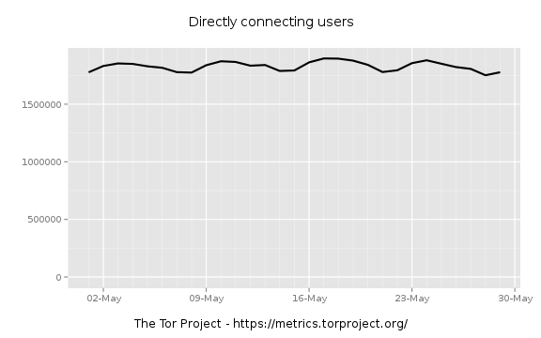
PrivCount: Some Results
Tor Metrics: users / day
PrivCount: users / 10 min

Slide 37
PrivCount: Some Results
PrivCount, 2016
Chaabane et al.*, 2010
Streams
Data
*Chaabane, A., Manils, P., AND Kaafar, M. Digging into anonymous traffic: A deep analysis of the tor anonymizing network. IEEE Network and System Security (2010).

Slide 38
Tor + Secure Multiparty Computation
Improving on PrivCount results with SMC
Count unique users over longer periods using secret-sharing to safely store IPs
Percentiles instead of histograms
Robust statistics to limit effect of malicious inputs (e.g. median) for operational outputs
Add minimum noise necessary
Detect ongoing behaviors
Denial of service attacks
Botnets over onion services

Slide 39
Tor + Secure Multiparty Computation
Future problems
Accountability needed for some applications (e.g. measurements to set operational parameters)
Efficient updates during data collection without storing sensitive data locally (e.g. IP addresses)
Find privacy-preserving functions that are robust to malicious inputs and efficient for SMC
Large numbers of parties (e.g. hundreds) may be necessary for honest-majority sampled relay subsets

