Slide 1
Bytes to Schlep? Use a FEP:
Hiding Protocol Metadata with Fully Encrypted Protocols
Ellis Fenske (U.S. Naval Academy)
Aaron Johnson (U.S. Naval Research Laboratory)
  May 26th, 2024
Cryptographic Applications Workshop (CAW 2024)
Notes:
Short paper
Work in progress
Some details deviate from paper

Slide 2


Fully Encrypted Protocols (FEPs)
What is a Fully Encrypted Protocol (FEP)?
Appclient
Appserver
  All bytes look random
  Message lengths variable
FEPclient
FEPserver
Real-world examples:
obfs4 / lyrebird (Tor)
shadowsocks (Outline VPN)
Obfuscated SSH (Psiphon)
OpenVPN + XOR patch
Vmess (V2Ray)

Slide 3
Summary of Our Work
Problem: No precise understanding of FEPs
  Goals not formalized mathematically
  Security cannot be proven
  Existing FEPs continually present security flaws
  IND$-CPA: similar goal but for atomic messaging
Solutions:
  New security definitions for FEPs
  Relations among new and existing security definitions
  Secure constructions of FEPs
  Analysis of existing FEPs

Slide 4
Status of this Work
Presented early version of this work at FOCI 2023
    Future Work from that talk:
        Proving security of our construction
        Deriving relations between the security definitions
        Addressing forward secrecy via key exchange in the protocol
        Extending our definitions to the datagram setting

Slide 5
Status of this Work
Presented early version of this work at FOCI 2023
    Future Work from that talk:
        Proving security of our construction
        Deriving relations between the security definitions
        Addressing forward secrecy via key exchange in the protocol
        Extending our definitions to the datagram setting

Slide 6
Status of this Work
Presented early version of this work at FOCI 2023
    Future Work from that talk:
        Proving security of our construction
        Deriving relations between the security definitions
        Addressing forward secrecy via key exchange in the protocol
        Extending our definitions to the datagram setting
    Added experimental analysis of existing FEP security

Slide 7
Status of this Work
Presented early version of this work at FOCI 2023
    Future Work from that talk:
        Proving security of our construction
        Deriving relations between the security definitions
        Addressing forward secrecy via key exchange in the protocol
        Extending our definitions to the datagram setting
    Added experimental analysis of existing FEP security
  Paper available:
    Ellis Fenske and Aaron Johnson. “Bytes to Schlep? Use a FEP: Hiding Protocol Metadata with Fully Encrypted Protocols”. May 2024.
    <https://arxiv.org/abs/2405.13310>

Slide 8
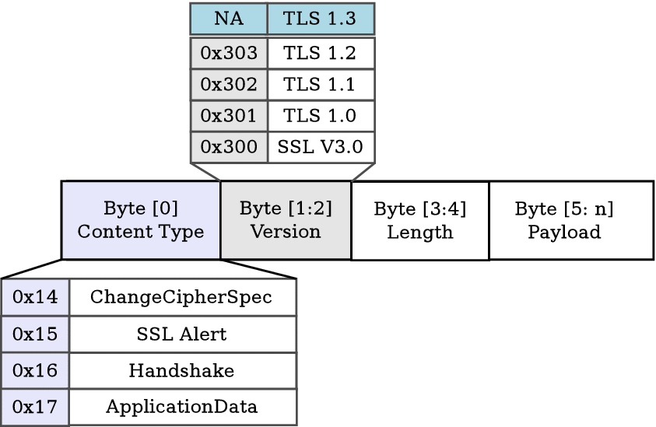
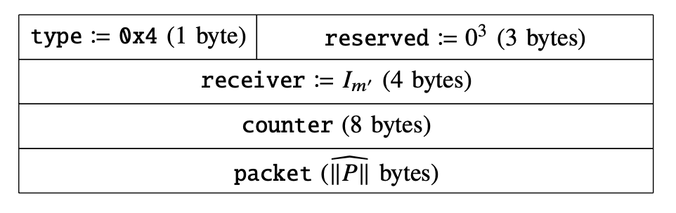
Why FEP?
Existing encrypted protocols reveal metadata
Protocol identity and version
Amount of payload data
Cryptographic primitives being used
Example 1:
TLS Record
Example 2:
WireGuard Datagram

Slide 9
Why FEP?
FEP Reason #1: Censorship circumvention
Typical VPN protocols can easily be identified and blocked
    e.g. OpenVPN, WireGuard, IPSec
    Censors have blocked VPN protocols (e.g. China, Russia)
FEPs have been invented multiple times to eliminate simple protocol fingerprints (e.g. obfs4, shadow socks, Obfuscated SSH, Vmess)
  China has blocked FEPs: Wu et al. “How the Great Firewall of China Detects and Blocks Fully Encrypted Traffic”. USENIX Security 2023.

Slide 10
Why FEP?
FEP Reason #2: Maximally protects metadata
  Protocols increasingly protect metadata
    QUIC
    TLS 1.3 Encrypted Client Hello
    Cryptocurrencies (Ethereum’s RPLx, Lightning’s Bolt)
  Metadata can be sensitive
    Application(e.g. application-specific protocols)
    Domain of the destination (e.g. SNI TLS extension)
    Ciphertext primitives in use (some might be vulnerable)

Slide 11
Why FEP?
FEP Reason #3: Prevents Internet ossification
  Middleboxes develop around observable protocol features
    Security firewalls
    Traffic shapers
  Alternate solution: David Benjamin. 2020. RFC 8701 Applying Generate Random Extensions And Sustain Extensibility (GREASE) to TLS Extensibility

Slide 12
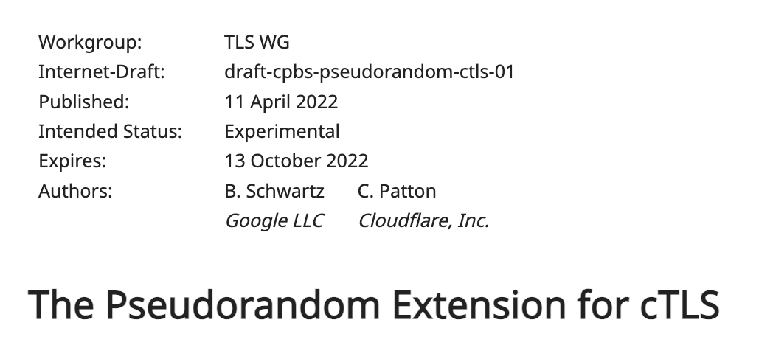
Why FEP?
      “Privacy: A third party… cannot tell whether two connections are using the same pseudorandom cTLS template”
      “Ossification risk”
      “TODO: More precise security properties and security proof. The goal we're after hasn't been widely considered in the literature so far, at least as far as we can tell.”

Slide 13
Encrypted Protocols
Non-FEP encrypted protocols innovation is still occurring:
      OSCORE: IoT-optimized (2019)
      NoiseSocket: generic framework (2017)
      WireGuard: VPN (2017)
      Bolt: Lightning network (2016)
      RLPx: Ethereum (2015)
Why couldn’t these all be FEPs?

Slide 14
FEPs in the Network Stack
Generally assume over TCP or UDP
Below transport layer limits developer agility
      Requires permissions for raw-socket access (e.g. iOS jailbreak)
  TCP and UDP are the common transport protocols
      New reliable transports over UDP
        e.g. QUIC, kcp
        Difficult to accomplish while protecting metadata
  FEP terms
    Datastream FEP (e.g. using TCP)
      Datagram FEP (e.g. using UDP)
FEP here
Application Layer
Transport Layer
Internet Layer
Data-Link Layer
Physical Layer

Slide 15
Looking at a FEP: obfs4
Tor’s obfs4 (aka lyrebird) is a sophisticated FEP
      Uses TCP
      Key exchange for forward secrecy
      Padding for message-length variation
  Handshake
      Client sends: Elligator-encoded key + random padding
      Server sends: Elligator-encoded key + random padding
  Data-phase messages
2 bytes
Frame length
16 bytes
MAC Tag
1 byte
Type
2 bytes
Payload length
(optional)
Payload
(optional)
Padding
XOR with PRG
Encrypted (Poly1305/XSalsa20)

Slide 16
Looking at a FEP: obfs4
2 bytes
Frame length
16 bytes
MAC Tag
1 byte
Type
2 bytes
Payload length
(optional)
Payload
(optional)
Padding
XOR with PRG
Encrypted (Poly1305/XSalsa20)
Security issues
      Length field is malleable
      obfs4 closes connection upon decryption error
      #1 + #2 = active attack reveals obfs4 message structure
      Specific minimum message length despite padding
Let’s define FEP security to rule out such issues.

Slide 17
New FEP Security Definitions
  Passive security:
    Datastream: FEP-CPFA
    (FEP under Chosen Plaintext-Fragment Attacks)
    Datagram: FEP-CPA
    (FEP under Chosen Plaintext Attacks)
  Active security:
    Datastream: FEP-CCFA
    (FEP under Chosen Ciphertext-Fragment Attacks)
    Datagram: FEP-CCA
    (FEP under Chosen Ciphertext Attacks)
  Message sizes: Traffic Shaping

Slide 18

Datastream Setting
    Unidirectional channel
    Model allows pre-shared state
      Datastream semantics*
        Inputs and outputs treated as byte streams
        Reliable, in-order delivery
        Models TCP
Appclient
Appserver
SEND
RECV
Plaintext fragmentation
Ciphertext fragmentation
*Marc Fischlin, Felix Günther, Giorgia Azzurra Marson, and Kenneth G. Paterson.
“Data is a stream: Security of stream-based channels”. CRYPTO 2015.

Slide 19
Datagram Setting
    Unidirectional channel
    Model allows pre-shared state
      Datagram semantics*
        Inputs and outputs treated as atomic messages
        Messages may be dropped or reordered
        Models UDP
Appclient
Appserver
SEND
RECV
*Similar to: Mihir Bellare, Tadayoshi Kohno, and Chanathip Namprempre. “Authenticated
encryption in SSH: provably fixing the SSH binary packet protocol”. ACM CCS 2002.

Slide 20
Protocol Model
SEND
RECV
Input
Input
m : plaintext message
p : packet length
f : flush flag (datastream)
c : ciphertext
Output
Output
m : plaintext message
C : channel close flag
(datastream)
c : ciphertext
In implementation, SEND and RECV would interact with sockets.

Slide 21
Passive FEP Security (datagram and datastream)
Security experiment
Real World
Random World
  Challenger chooses bit b.
  Adversary can query stateful oracle O^{b}_{SEND}.
  Adversary outputs guess b’.
  Success if b’=b.
O⁰_{SEND}(m,p,[f])
O¹_{SEND}(m,p,[f])
  Outputs SEND(m,p,[f])
  Outputs
  |SEND(m,p,[f])| random bytes
Definition: Protocol is passively FEP secure if advantage over random guessing is negligible.

Slide 22
Active security (datastream):
FEP-CCFA (Chosen Ciphertext-Fragment Attacks)
Security experiment
Real World
Random World
  CLOSE(||CS, CR): Secure close function
  ||CS: concatenated O^{b}_{SEND} outputs
  CR: O^{b}_{RECV} inputs
O⁰_{SEND}(m,p,f)
O¹_{SEND}(m,p,f)
  Outputs SEND(m,p,f)
  Outputs
  |SEND(m,p,f)| random bytes
  Challenger chooses bit b.
  Adversary can query stateful oracles O^{b}_{SEND} and O^{b}_{RECV}.
  Adversary outputs guess b’.
  Success if b’=b.
O⁰_{RECV}(c)
O¹_{RECV}(c)
  Always returns channel close flag C.
  Does not return output message m unless out of sync.
  Returns channel close flag CLOSE(||CS, CR).
  Does not return output message m.
Definition: Protocol is FEP-CCFA if advantage over random guessing is negligible.

Slide 23
Active security (datagram):
FEP-CCA (Chosen Ciphertext Attacks)
Security experiment
Real World
Random World
  null message output allowed to be ignored to enable short chaff messages w/o MAC
O⁰_{SEND}(m,p)
O¹_{SEND}(m,p)
  Outputs SEND(m,p)
  Outputs
  |SEND(m,p)| random bytes
  Challenger chooses bit b.
  Adversary can query stateful oracles O^{b}_{SEND} and O^{b}_{RECV}.
  Adversary outputs guess b’.
  Success if b’=b.
O⁰_{RECV}(c)
O¹_{RECV}(c)
  Output m returned if:
  c not Send output,
  m not error, and
  m not null
  Does not return output m.
Definition: Protocol is FEP-CCA if advantage over random guessing is negligible.

Slide 24
Secure Close Functions
Secure close function CLOSE(||CS, CR)
    ||CS: concatenated SEND outputs
    CR: RECV inputs
    Ensures closures give no more information than network observations
        E.g. No closure based on plaintext value
      Rules out obfs4 behavior because length fields cannot be identified in concatenated byte sequence
Examples of secure close functions
    Never close (e.g. shadowsocks requests)
    Close after timeout
    Close at first “sync” byte position after modified byte

Slide 25
Traffic Shaping
  Definition (datastream): Protocol satisfies Traffic Shaping if, for all messages m and p ≥ 0,
  |SEND(m,p,f=0)| = p, and
  |SEND(m,p,f=1)| ≥ p.
  Definition (datagram): Protocol satisfies Traffic Shaping if, for all messages m and L≥p≥0, with c ← SEND(m,p),
  If 𝑐 is not an error, then |c| = p, and
  If 𝑚 is null, then c is not an error.
Enables arbitrary-length messages
Generalizes padding functionality of existing FEPs
Avoids protocol-specific minimum-message sizes

Slide 26
Other FEP security requirements*
Confidentiality
    IND-CCFA/IND-CCA (Datastream/Datagram)
    Not implied by FEP-CCFA/CCA because ciphertext lengths can leak plaintexts
    With length regularity, implied by FEP-CCFA/CCA
  Integrity
    INT-CST/INT-CTXT (Datastream/Datagram)
    Implied by FEP-CCFA/CCA

Slide 27
Experimental Analysis of Datastream FEPs
Datastream Protocol | Close Behavior | FEP-CPFA | FEP-CCFA | Length Obfuscation | Minimum Message Size
Shadowsocks-libev (request/response) | Never / Auth Fail | ✅ | ✅ / ❌ | None | 35
V2Ray-Shadowsocks (request/response) | Drain / Auth Fail | ✅ | ❌ | None | 35
V2Ray-VMess | Drain | ✅ | ❌ | Padding | 18
Obfs4/Lyrebird | Auth Fail | ✅ | ❌ | Padding | 44
OpenVPN-XOR | Auth Fail | ❌ | ❌ | None | 42
Obfuscated-OpenSSH (-PSK) | Auth Fail | ❌ (✅) | ❌ | None | 16
kcptun | Never | ✅ | ❌ | None | 52
Our construction | Never | ✅ | ✅ | Traffic Shaping | 1
  Generally close behavior is identifying, even when they tried to avoid that
  Minimum message size may not appear in practice, although protocols with keepalives do generate them
  Our experiments uncovered an integrity attack in VMess (now fixed)

Slide 28
Experimental Analysis of Datagram FEPs
Datagram Protocol | FEP-CPA | FEP-CCA | Length Obfuscation | Minimum Message Size
Shadowsocks-libev | ✅ | ✅ | None | 55
WireGuard-SWGP | ✅ | ✅ | Padding | 75
OpenVPN-XOR | ❌ | ❌ | None | 40
Our construction | ✅ | ✅ | Traffic Shaping | 0
  FEP security easier to achieve without closures
  We observe larger minimum message size due to more required metadata in the datagram setting.

Slide 29
Future Work
FEP research ideas
    Forward secrecy
    Forward metadata secrecy
    High-performance FEPs
    Other TCP metadata leaks (e.g. congestion window)
    Versioning / protocol negotiation
  Paper available:
    Ellis Fenske and Aaron Johnson. “Bytes to Schlep? Use a FEP: Hiding Protocol Metadata with Fully Encrypted Protocols”. May 2024.
    <https://arxiv.org/abs/2405.13310>

