Slide 1
Client-Location-Aware Path Selection in Tor
Aaron Johnson
  September 29th, 2021
Computer Science Colloquium, George Washington University

Slide 2
Overview
Tor background
Location-aware path selection
Client-location-aware path selection (CLAPS)

Slide 3
Tor background

Slide 4



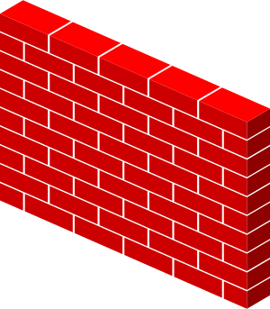
What is Tor?
Users
Destinations
Tor is a popular system for anonymous, censorship-resistant Internet communication.
Connection-oriented bidirectional communication
Makes arbitrary TCP connections
Standard SOCKS interface for applications
Major application: Tor Browser

Slide 5


How does Tor work?
Unencrypted
Users
Relays
Destinations
Circuit
Stream
Key
Tor is based on onion routing.

Slide 6

How does Tor work?
Guard
Users
Relays
Destinations
Circuit
Stream
Key
A client creates all circuits through the same guard.

Slide 7
How does Tor work?
Guard
Users
Relays
Destinations
Circuit
Stream
Key
A client creates all circuits through the same guard.

Slide 8
How does Tor work?
Low BW
High BW
Users
Relays
Destinations
Circuit
Stream
Key
Relays are selected randomly with probability proportional to bandwidth.

Slide 9
Threat Model
Adversary is local and active.

Slide 10

Threat Model
Adversary is local and active.
Adversary may run relays

Slide 11
Threat Model
Adversary is local and active.
Adversary may run relays
Destination may be malicious

Slide 12
Threat Model
Adversary is local and active.
Adversary may run relays
Destination may be malicious
Adversary may observe some ISPs

Slide 13
Why use Tor?
Protect journalistic sources
Circumvent censorship
Investigate crimes undercover
Evade surveillance
Gather intelligence covertly
Report crimes (whistleblowing)

Slide 14

Who Uses Tor?
2 million daily users
6,800 relays in 77 countries
250 Gbps aggregate traffic

Slide 15
Network attacks on Tor
  Passive traffic observation
  Correlation attack
  Website fingerprinting
  Active traffic gathering
  BGP hijack (RAPTOR)
  Selective denial of service
  Speed-measurement manipulation
  Targeted compromise
  Active traffic manipulation
  Congestion attack
  Flow watermarking
  Latency attack
  Throughput fingerprinting

Slide 16
Correlation attack
Possible when:
Adversary controls first and last relays, or
Adversary observes entry and exit ISPs

Slide 17
Correlation attack
Possible when:
Adversary controls first and last relays, or
Adversary observes entry and exit ISPs

Slide 18
Correlation attack
Possible when:
Adversary controls first and last relays, or
Adversary observes entry and exit ISPs

Slide 19
Correlation attack
Possible when:
Adversary controls first and last relays, or
Adversary observes entry and exit ISPs

Slide 20
Website fingerprinting attack
Possible when:
Adversary controls first relay, or
Adversary observes entry ISP

Slide 21
Website fingerprinting attack
Possible when:
Adversary controls first relay, or
Adversary observes entry ISP

Slide 22
Website fingerprinting attack
Possible when:
Adversary controls first relay, or
Adversary observes entry ISP

Slide 23
Website fingerprinting attack
Possible when:
Adversary controls first relay, or
Adversary observes entry ISP

Slide 24
Website fingerprinting attack
I recognize that traffic pattern
Possible when:
Adversary controls first relay, or
Adversary observes entry ISP

Slide 25
Location-aware path selection

Slide 26
Location-aware path selection
Algorithm | Goal
Edman-Syverson (CCS 2009) | Prevent traffic analysis
DeNASA (PETS 2016) | Prevent traffic analysis
Astoria (NDSS 2016) | Prevent traffic analysis
TAPS (NDSS 2017) | Prevent traffic analysis
DeTor (USENIX Sec 2017) | Avoid transiting certain regions
Counter-RAPTOR (S&P 2017) | Prevent BGP hijacks
TrilateraTor (NDSS 2019) | Avoid transiting certain regions
LASTor (S&P 2012) | Improve latency, prevent traffic analysis
Panchenko (IPCCC 2012) | Improve load balancing
NavigaTor (EuroS&P 2016) | Improve latency
Security focus
Performance focus

Slide 27
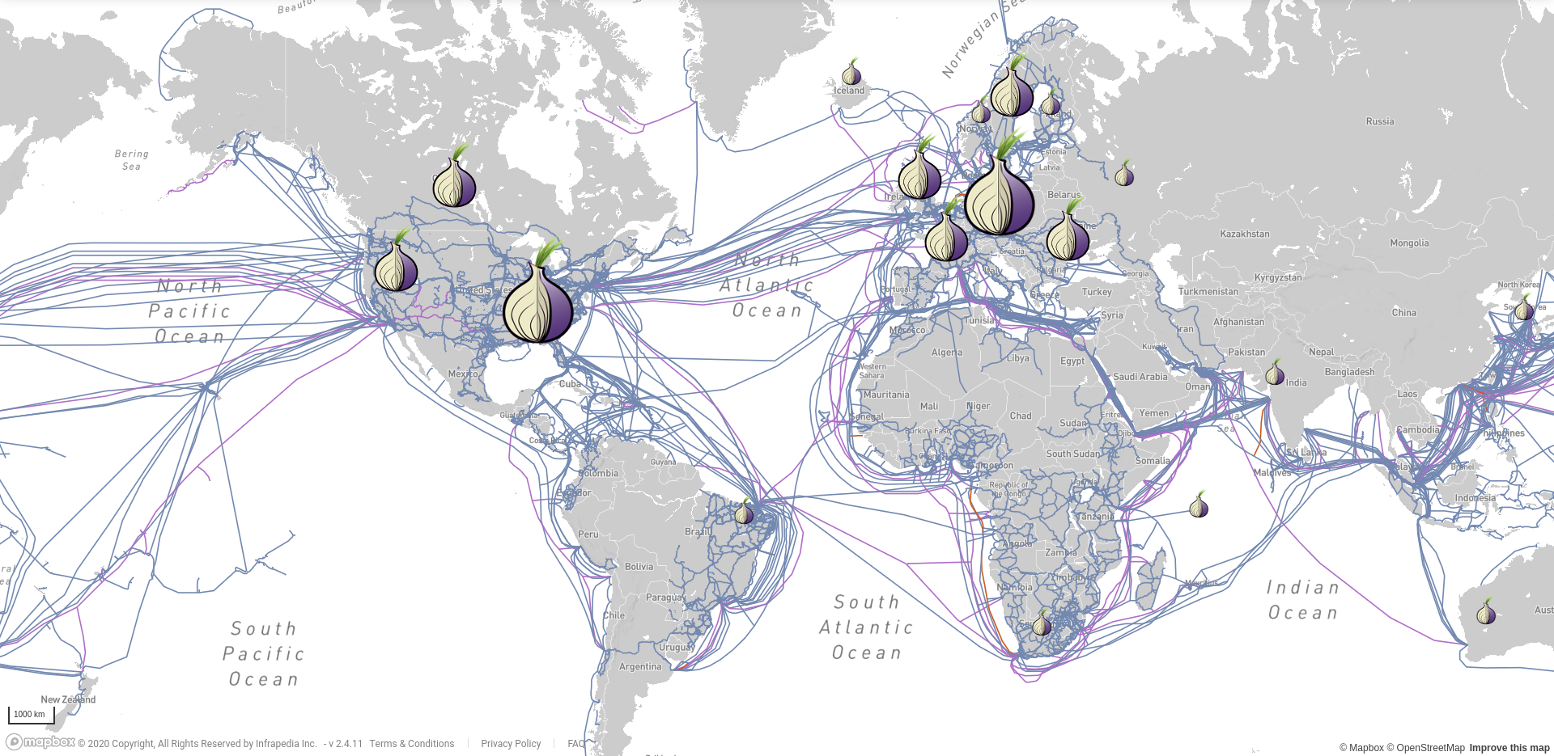
Location-aware path selection
Tor chooses relays independently of the location of the client and server.

Slide 28
Location-aware path selection
Location-aware path selection could improve performance and security.

Slide 29
DeNASA: Destination-Naïve AS Awareness
DeNASA: g-select algorithm
Identify Top 2 Suspect ASes frequently capable of correlation attacks: AS3356, AS1299
Do not choose guard g if a Suspect AS exists between client and g
DeNASA: e-select algorithm
Identify Top 8 Suspect ASes frequently capable of correlation attacks: AS1299, AS3356, AS6939, AS174, AS2914, AS3257, AS6453, AS9002
Do not choose guard e if a Suspect AS between client and g also exists between e and more than τ fraction of common destinations

Slide 30











DeNASA
❌
$$\operatorname{Pr}\left(g_{1}\right)=\frac{1}{4}$$
$$\operatorname{Pr}\left(g_{1}\right)=0$$
AS3356
$$g_{1}$$
✅
$$\operatorname{Pr}\left(g_{2}\right)=\frac{1}{4}$$
$$\operatorname{Pr}\left(g_{2}\right)=\frac{1}{3}$$
AS48
Suspect-Free
$$g_{2}$$
Suspect-Free
✅
$$\operatorname{Pr}\left(g_{3}\right)=\frac{1}{2}$$
$$\operatorname{Pr}\left(g_{3}\right)=\frac{2}{3}$$
$$g_{3}$$

Slide 31
Attacks on location-aware path selection
Information leakage increases over time
Multiple path-selection criteria
    Multiple adversary types (e.g. relays, ASes)
    Multiple security goals (e.g. anonymity,
    unlinkability)
    Performance (e.g. load balancing)

Slide 32
Attacks on location-aware path selection
Information leakage increases over time
Multiple path-selection criteria
    Multiple adversary types (e.g. relays, ASes)
    Multiple security goals (e.g. anonymity,
    unlinkability)
    Performance (e.g. load balancing)

Slide 33

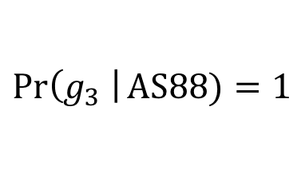

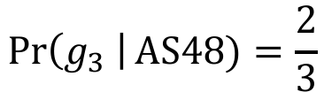

DeNASA leaks information
❌
❌
$$\operatorname{Pr}\left(g_{1}\right)=0$$
AS3356
$$g_{1}$$
AS1299
✅
❌
$$\operatorname{Pr}\left(g_{2}\right)=0$$
AS3356
AS48
Suspect-Free
AS88
$$g_{2}$$
Suspect-Free
✅
✅
Suspect-Free
$$\operatorname{Pr}\left(g_{3} \right|\text{AS}48)=\frac{2}{3}$$
$$\operatorname{Pr}\left(g_{3}\right)=1$$
$$\operatorname{Pr}\left(g_{3} \right|\text{AS}88)=1$$
$$g_{3}$$

Slide 34
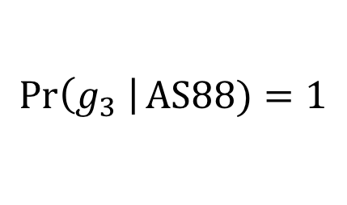

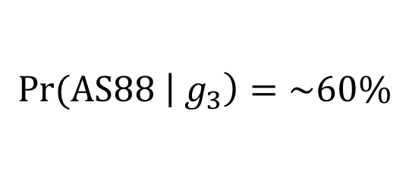
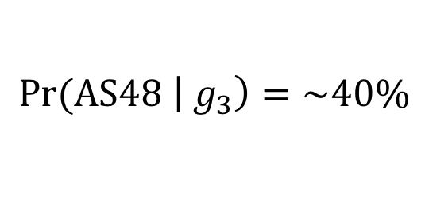
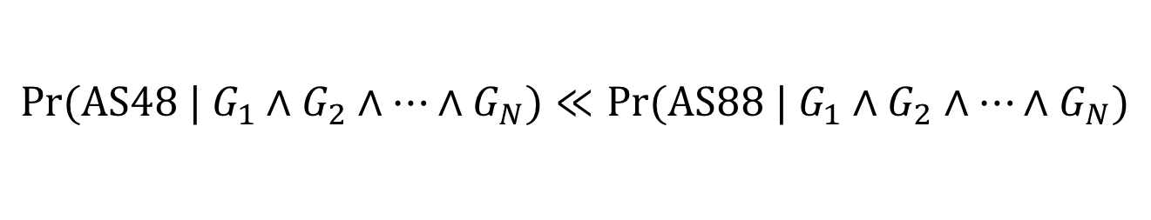
DeNASA leaks information
$$\operatorname{Pr}\left(g_{3} \right| \text{AS}48)=2/3$$
$$\operatorname{Pr}\left(g_{3} \right|\text{AS}88)=1$$
$$\text{Pr}\text{(}\text{AS}48 \left|{ g}_{3}\right)=\sim 40\%$$
$$\text{Pr}\text{(}\text{AS}88 \left|{ g}_{3}\right)=\sim 60\%$$
Leak can worsen over time!
$$\text{Pr}\text{(}\text{AS}48 | G_{1}∧G_{2}∧…∧G_{N})≪\text{Pr}\text{(}\text{AS}88 | G_{1}∧G_{2}∧…∧G_{N})$$

Slide 35
DeNASA attack
How might an adversary learn a user’s guards
and perform this attack?

Slide 36
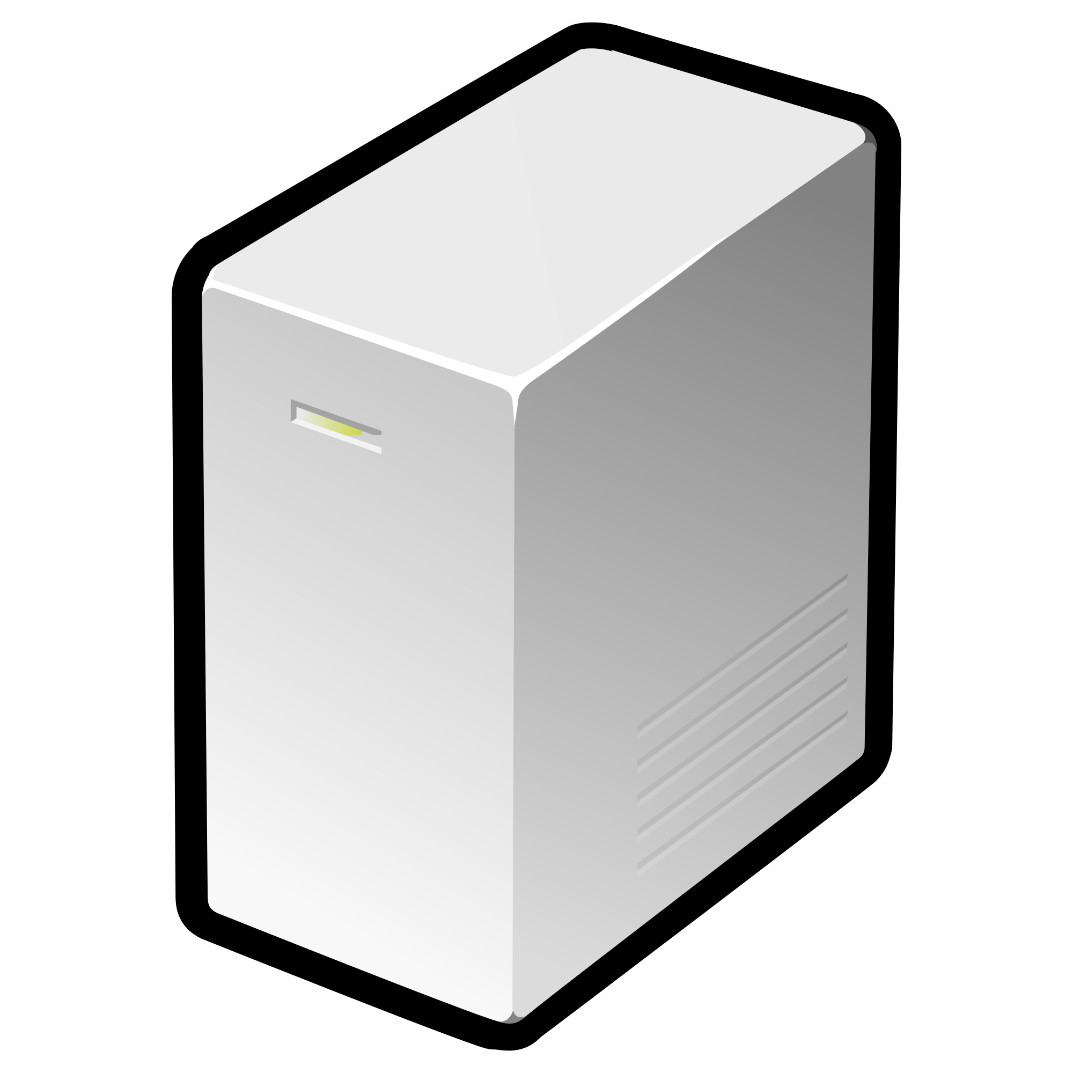








DeNASA attack
$$m_{1}$$
$$g_{1}$$
$$e_{1}$$
$$m_{2}$$
<batman>
$$g_{2}$$
AS ???
Web Forum
$$m_{3}$$
$$g_{3}$$
$$e_{2}$$
$$m_{4}$$

Slide 37
DeNASA attack
$$m_{1}$$
$$g_{1}$$
$$e_{1}$$
$$m_{2}$$
<batman>
$$g_{2}$$
AS ???
Web Forum
$$m_{3}$$
$$g_{3}$$
$$e_{2}$$
$$m_{4}$$

Slide 38
DeNASA attack
Day 1
$$m_{1}$$
$$g_{1}$$
$$e_{1}$$
$$m_{2}$$
<batman>
$$g_{2}$$
AS ???
Web Forum
$$m_{3}$$
$$g_{3}$$
$$e_{2}$$
$$m_{4}$$

Slide 39
DeNASA attack
Day 2
$$m_{1}$$
$$g_{1}$$
$$e_{1}$$
$$m_{2}$$
<batman>
$$g_{2}$$
AS ???
Web Forum
$$m_{3}$$
$$g_{3}$$
$$e_{2}$$
$$m_{4}$$

Slide 40

DeNASA attack
Day 3
The pseudonymous client is using $g_{1}!$
$$m_{1}$$
$$g_{1}$$
$$e_{1}$$
$$m_{2}$$
<batman>
$$g_{2}$$
AS ???
Web Forum
$$m_{3}$$
$$g_{3}$$
$$e_{2}$$
$$m_{4}$$

Slide 41
DeNASA attack
Day 4
$$m_{1}$$
$$g_{1}$$
$$e_{1}$$
$$m_{2}$$
<batman>
$$g_{2}$$
AS ???
Web Forum
$$m_{3}$$
$$g_{3}$$
$$e_{2}$$
$$m_{4}$$

Slide 42
DeNASA attack
Day 5
$$m_{1}$$
$$e_{1}$$
$$m_{2}$$
<batman>
$$g_{2}$$
AS ???
Web Forum
$$m_{3}$$
$$g_{3}$$
$$e_{2}$$
$$m_{4}$$

Slide 43

DeNASA attack
Day 6
The pseudonymous client is now using $g_{3}!$
$$m_{1}$$
$$e_{1}$$
$$m_{2}$$
<batman>
$$g_{2}$$
AS ???
Web Forum
$$m_{3}$$
$$g_{3}$$
$$e_{2}$$
$$m_{4}$$

Slide 44
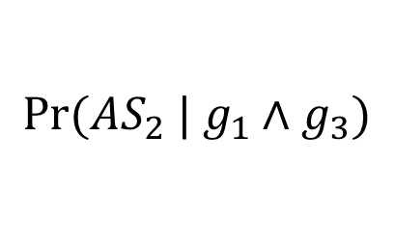
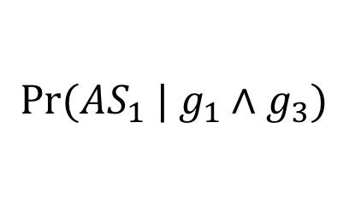

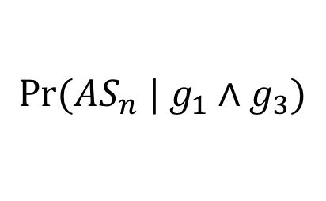
DeNASA attack
The adversary then computes posterior distribution:
$$\text{Pr}\text{(}{AS}_{1} | g_{1}∧g_{3})$$
$$\text{Pr}\text{(}{AS}_{2} | g_{1}∧g_{3})$$
$$…$$
$$\text{Pr}\text{(}{AS}_{n} | g_{1}∧g_{3})$$

Slide 45
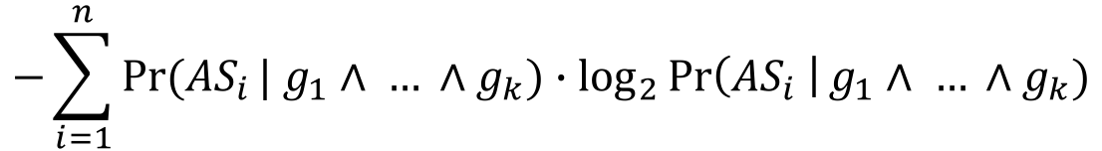
DeNASA attack
Experimental Methodology
Simulate clients from four vulnerable client ASes
Run 100 simulations per client AS
Assume adversary makes up to six guard observations
Measure client’s anonymity after observations using
posterior entropy
Assume uniform prior
$$−\sum_{i=1}^{n}{Pr⁡({AS}_{i}}| g_{1}∧ … ∧g_{k})∙\log_{2}{\operatorname{Pr}\left({AS}_{i} \right|g_{1}∧ … ∧g_{k})}$$

Slide 46
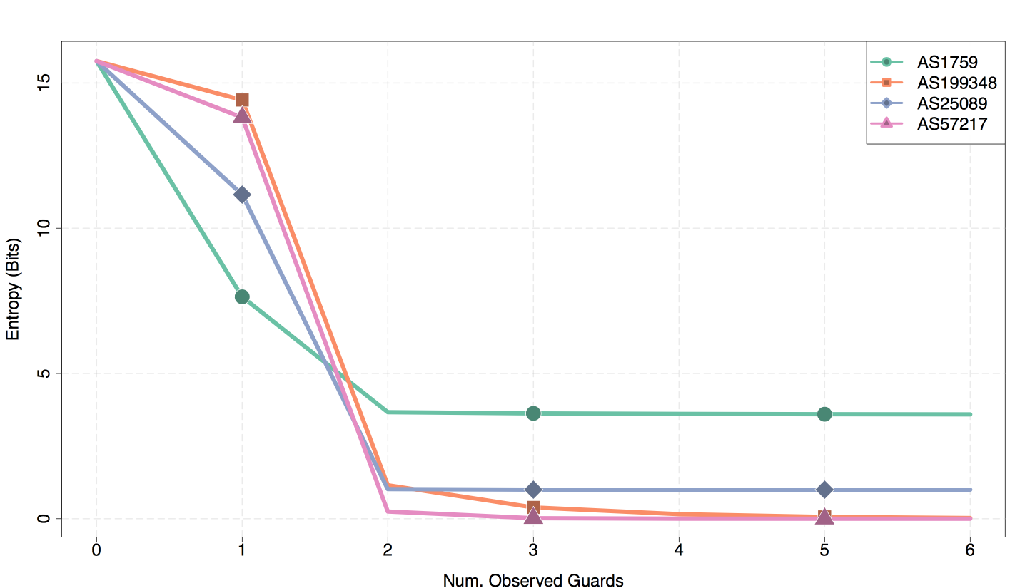
DeNASA attack

Slide 47
Challenges to path-selection defenses
Information leakage increases over time
Multiple path-selection criteria
    Multiple adversary types (e.g. relays, ASes)
    Multiple security goals (e.g. anonymity,
    unlinkability)
    Performance (e.g. load balancing)

Slide 48
Guard Placement Attack
Several proposed systems are vulnerable
to malicious guard placement.

Slide 49
Guard Placement Attack
Several proposed systems are vulnerable
to malicious guard placement.
Example: Place guard near client, reducing transit ASes and vulnerability to BGP hijack.

Slide 50
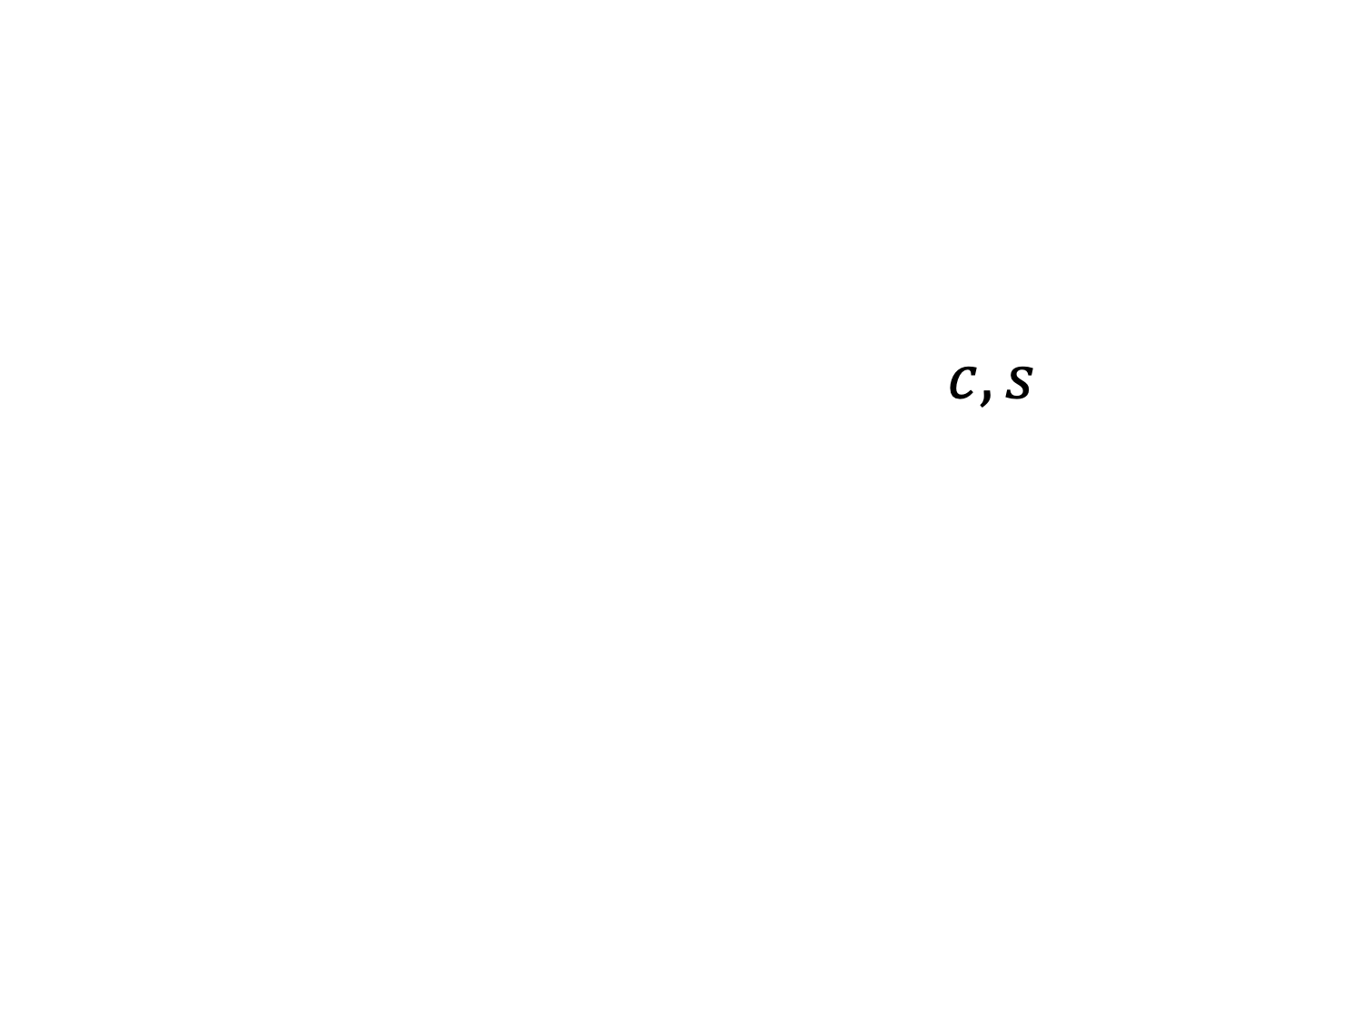
Guard Placement Attack
$$σ\left(A,C,s\right)={\frac{1}{|C|}\sum_{c∈C}{p_{A}(c,s)}}$$
Client location c, Attack strategy s
s is location-bandwidth pairs of malicious guards

Slide 51
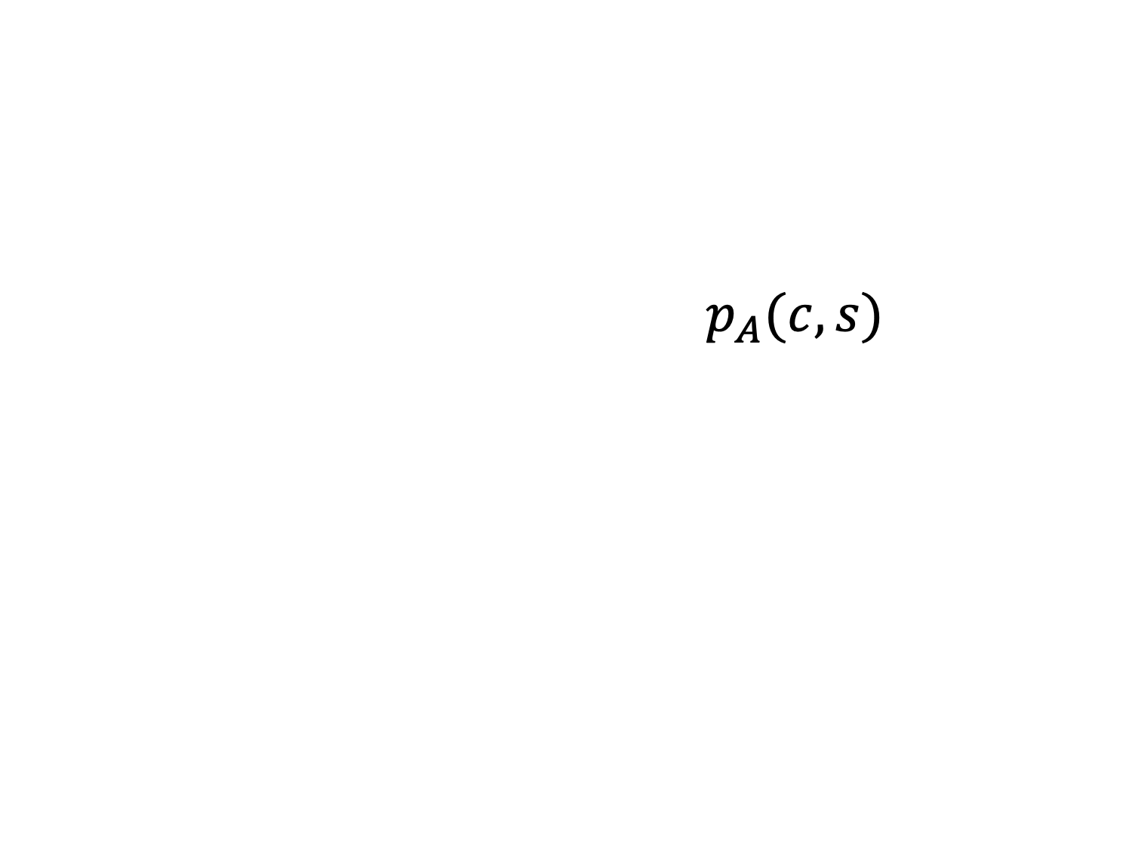
Guard Placement Attack
$$σ\left(A,C,s\right)={\frac{1}{|C|}\sum_{c∈C}{p_{A}(c,s)}}$$
Probability that c selects a malicious guard using algorithm A

Slide 52
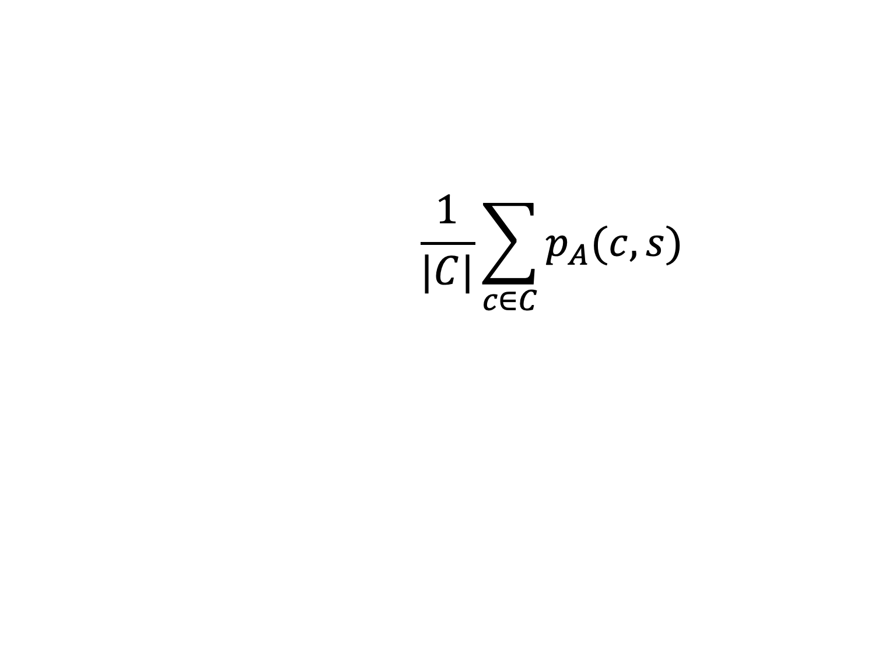
Guard Placement Attack
$$σ\left(A,C,s\right)={\frac{1}{|C|}\sum_{c∈C}{p_{A}(c,s)}}$$
Average success probability over all attacked client locations C

Slide 53
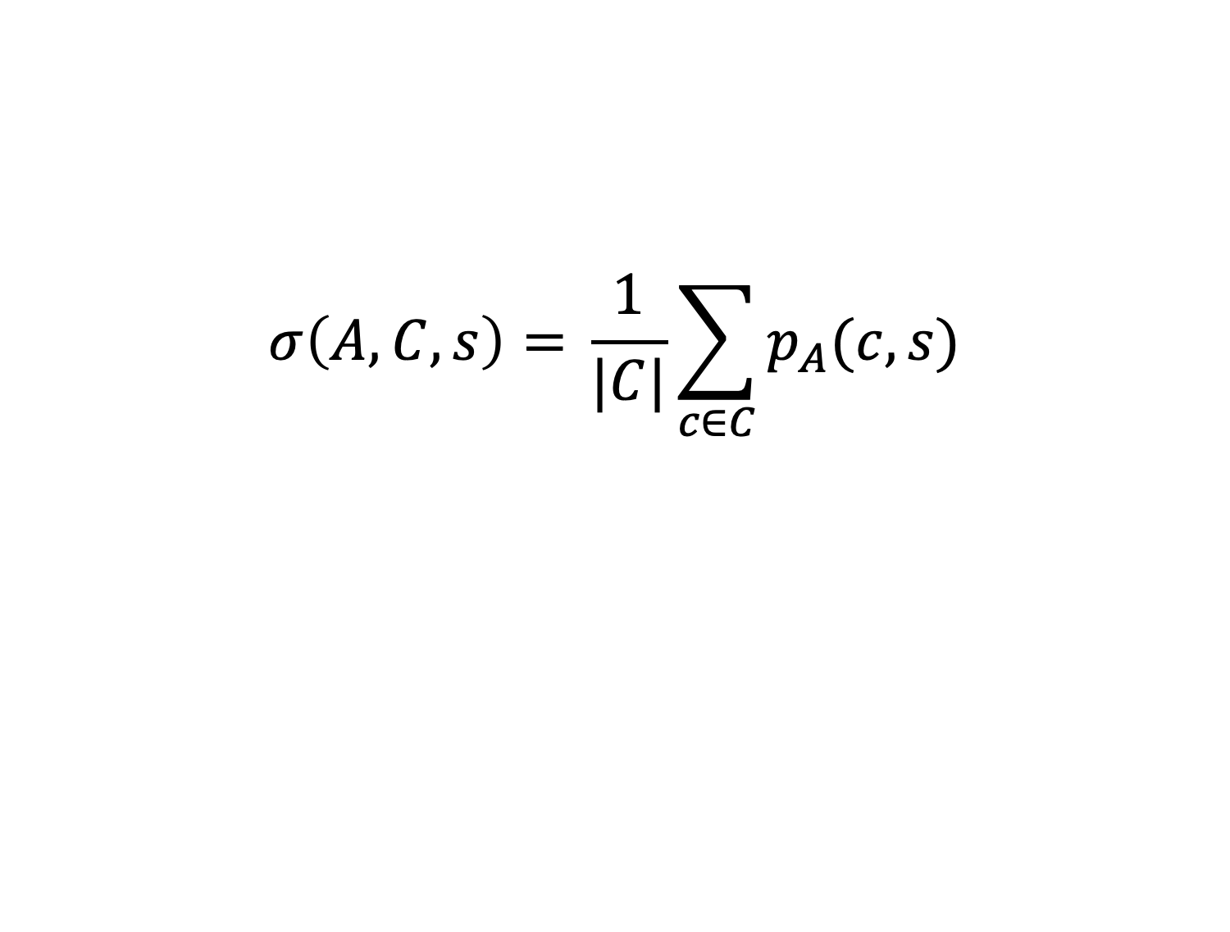
Guard Placement Attack
$$σ\left(A,C,s\right)={\frac{1}{|C|}\sum_{c∈C}{p_{A}(c,s)}}$$
Attack success metric

Slide 54

Guard Placement Attack
$$\max_{s∈S}{σ\left(A,C,s\right)}$$
Attack goal is to maximize average success probability

Slide 55
Guard Placement Attack
Number of Guards | Avg Success Probability (%) | Max Success Probability (%)
1 | 0.522 | 4.896
2 | 0.555 | 54.16
5 | 0.535 | 58.64
10 | 0.544 | 62.32
20 | 0.531 | 62.32
Vanilla Tor | 0.216 | 0.216
Untargeted attack on DeNASA using 40,000 total weight (0.216% of guard weight), varying the number of guards

Slide 56
Client-location-aware path selection (CLAPS)

Slide 57
Client-location-aware path selection
Information leakage increases over time
Solution: Location masking
Multiple path-selection criteria
Solution: Compute positional weights using
linear program (LP).
CLAPS can be used for varying location-aware goals.
CLAPS is only aware of client location.

Slide 58
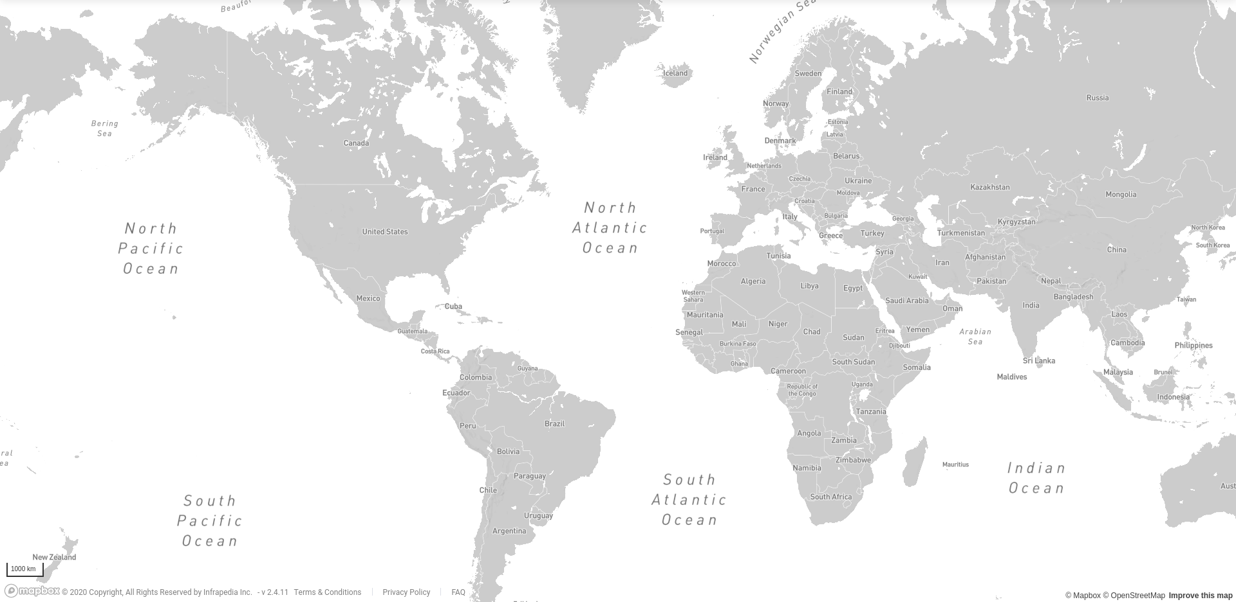

Location masking
Copenhagen
Chicago
Seoul
Lagos
Cluster locations by distance (e.g. geographic, AS graph)
Assign mask as central location of each cluster.

Slide 59
Location masking
Copenhagen
Chicago
Seoul
Lagos
Client uses location-aware path selection (e.g. DeNASA) as if in mask location
Long-term guard masks used if clusters change over time.

Slide 60
Location masking
Clustering process
Guarantees minimum anonymity levels across several dimensions (e.g. number of countries, ASes, and users)
Heuristically minimizes intra-cluster distances
Anonymity dimensions and distance function depend on location-aware goal
Clustering is updated if the “world” changes sufficiently (e.g. new ASes)

Slide 61
Client-location-aware path selection
Information leakage increases over time
Solution: Location masking
Multiple path-selection criteria
Solution: Compute positional weights using
linear program (LP).

Slide 62
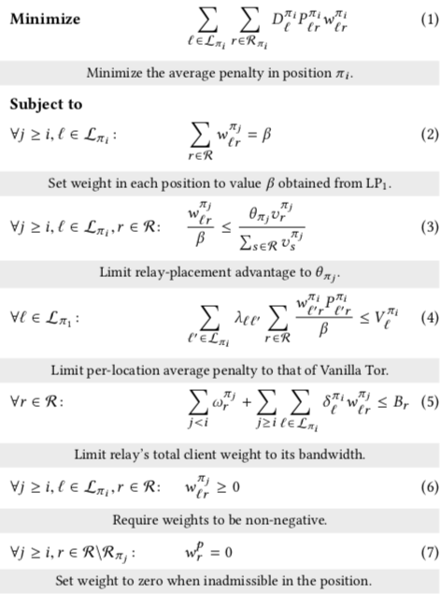
Client-location-aware path selection
Relay Weight LP
Computed for each position
in π order (e.g. guard, middle, exit)
Outputs weights w_{lr}
Clients in location l chooses relay r with probability w_{lr}
Some inputs:
  D_{l} : client density in
  location l
  P_{lr}: location penalty for
  relay r and location l
  θ: limit on relay-placement
  advantage

Slide 63
CLAPS experimental results
 | Min | Q₁ | Q₂ | Q₃ | Max
Client Density | 5.2% | 5.2% | 5.3% | 8.7% | 14%
# ASes | 2267 | 3348 | 4381 | 5196 | 6898
# Countries | 74 | 89 | 107 | 119 | 137
Clustering for CLAPS-DN
CLAPS+DeNASA: minimize correlation attacks from Suspect ASes
16 clusters produced
Allowed anonymity reduction by 20x in each dimension

Slide 64
CLAPS experimental results
Security for CLAPS-DN
Reduces potential for correlation attacks from Suspect ASes.
Limits advantage of guard placement attack.

Slide 65
CLAPS experimental results
Performance for CLAPS-DN
Shadow-simulated 2 MiB download times in exit-scarce network (June 2017)
Shadow-simulated 2 MiB download times in exit-sufficient network (March 2015)

Slide 66
Questions?
References
Ryan Wails, Yixin Sun, Aaron Johnson, Mung Chiang, and Prateek Mittal. “Tempest: Temporal Dynamics in Anonymity Systems”. In Proceedings on Privacy Enhancing Technologies (PoPETs 2018).
Gerry Wan, Aaron Johnson, Ryan Wails, Sameer Wagh, and Prateek Mittal. “Guard Placement Attacks on Path Selection Algorithms for Tor”. In Proceedings on Privacy Enhancing Technologies (PoPETs 2019).
Florentin Rochet, Ryan Wails, Aaron Johnson, Prateek Mittal, and Olivier Pereira. “CLAPS: Client-Location-Aware Path Selection in Tor”. In Proceedings of the 27th ACM Conference on Computer and Communications Security (CCS 2020).

