Slide 1

LIRA: Lightweight Incentivized Routing for Anonymity
20th Annual Network & Distributed System Security Symposium
February 27, 2013
Rob Jansen
Aaron Johnson
Paul Syverson
U.S. Naval Research Laboratory

Slide 2
Problem

Slide 3



Onion Routing
encrypted
unencrypted
User
Destination
Onion Routers

Slide 4
Onion Routing
encrypted
unencrypted
User
Destination
Onion Routers

Slide 5
Onion Routing
encrypted
unencrypted
User
Destination
Onion Routers

Slide 6

Onion Routing
encrypted
unencrypted
User
Destination
Onion Routers
torproject.org

Slide 7

Onion Routing
encrypted
unencrypted
User
Destination
Onion Routers
torproject.org

Slide 8
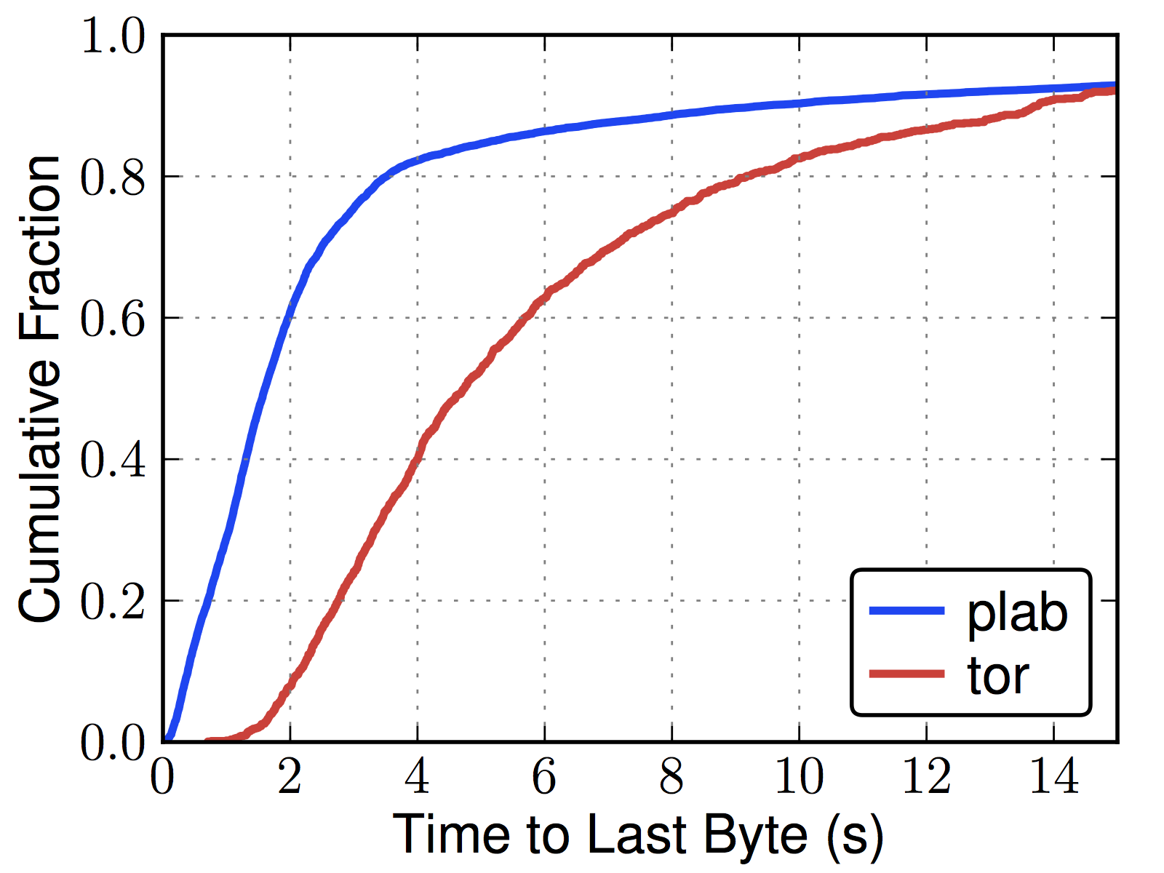
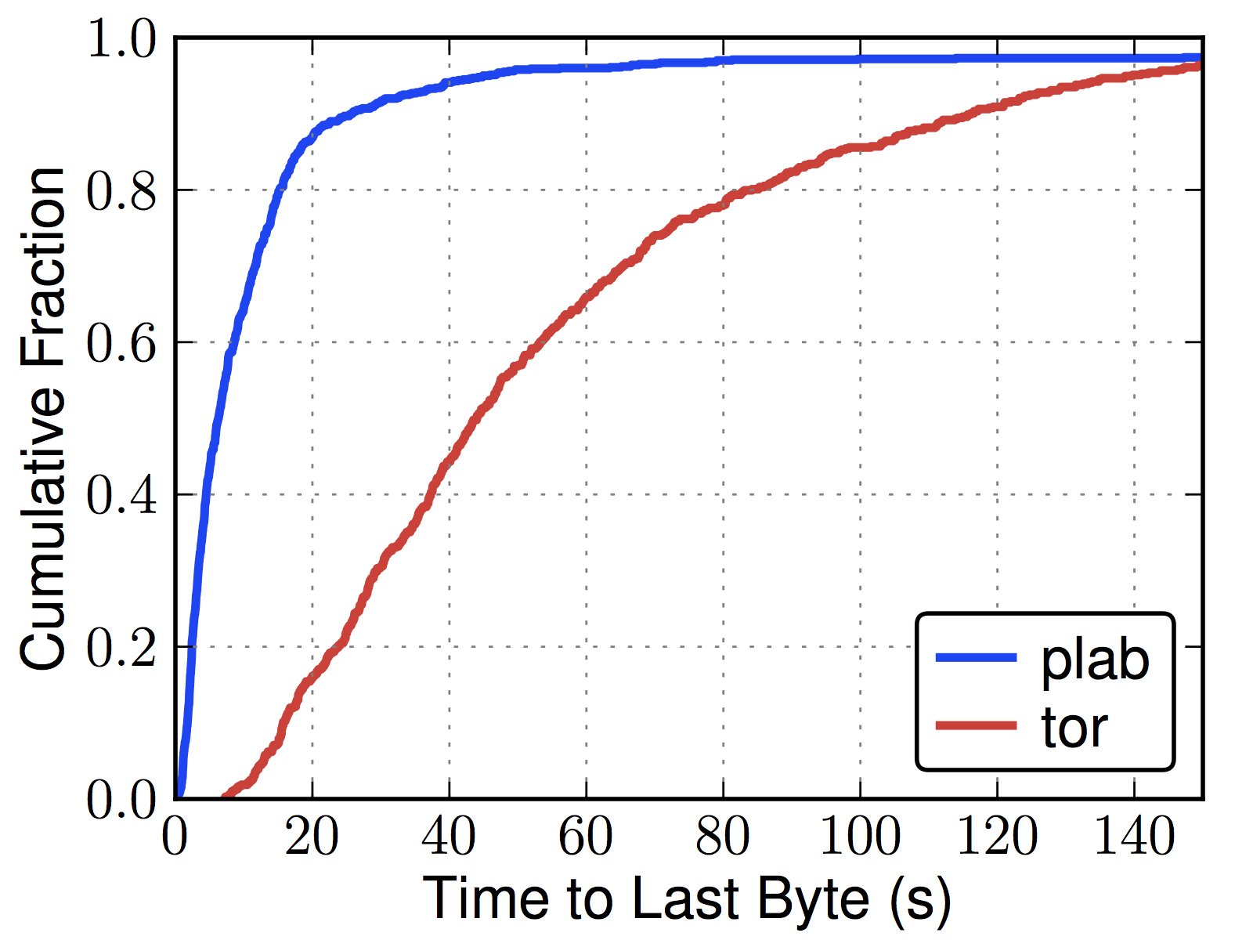
Tor is Slow
Web (320 KiB)
Bulk (5 MiB)

Slide 9
Tor Utilization
~3000 relays

Slide 10
Tor Utilization
~500,000 users/day
~3000 relays

Slide 11
Tor Utilization

Slide 12
Tor’s Top 20 Exit Relays
Exit Probability | Advertised Bandwidth | Nickname | Country
7.25% | 0.87% | chaoscomputerclub18 | DE
6.35% | 0.93% | chaoscomputerclub20 | DE
5.92% | 1.48% | herngaard | US
3.60% | 0.66% | chomsky | NL
3.35% | 1.17% | dorrisdeebrown | DE
3.32% | 1.18% | bolobolo1 | DE
3.26% | 0.65% | rainbowwarrior | NL
2.32% | 0.36% | sdnettor01 | SE
2.23% | 0.69% | TheSignul | RO
2.22% | 0.41% | raskin | DE
2.05% | 0.40% | bouazizi | DE
1.93% | 0.65% | assk | SE
1.82% | 0.39% | kramse | DK
1.67% | 0.35% | BostonUCompSci | US
1.53% | 0.40% | bach | DE
1.31% | 0.73% | DFRI0 | SE
1.26% | 0.31% | Amunet2 | US
1.13% | 0.27% | Amunet8 | US
0.84% | 0.27% | chaoscomputerclub28 | DE
0.76% | 0.37% | DFRI3 | SE
Total: 54.14%
compass.torproject.org

Slide 13
Bytes
Flows
3%
40%
2008*
58%
92%
11%
2010**
52%
36%
69%
*McCoy et al. PETS 2008, **Chaabane et al. NSS 2010

Slide 14
Our Solution

Slide 15
Incentive Scheme
LIRA
Relays’ own traffic gets better performance

Slide 16
Incentive Schemes
LIRA
Gold star
Tortoise
BRAIDS
Freedom
PAR
XPay
Relays’ own traffic gets better performance
Charge users, pay relays

Slide 17
Incentive Schemes
 | External payment | Non-relays pay | Efficiency concerns | Anonymity concerns
Freedom
PAR
XPay
Gold star
Tortoise
BRAIDS

Slide 18
Anonymous Incentives
prioritized
normal
Problem: Priority identifies user as a relay

Slide 19
Anonymous Incentives
prioritized
normal
Problem: Priority identifies user as a relay
Solutions
  Give some priority “tickets” to all users (BRAIDS).

Slide 20
Anonymous Incentives
prioritized
normal
Problem: Priority identifies user as a relay
Solutions
  Give some priority “tickets” to all users (BRAIDS).
  Cryptographic lottery gives priority; winning tickets can be (secretly) bought (LIRA).

Slide 21





LIRA Design
Bank

Slide 22

LIRA Design
Bank gives anonymous
coins to relays based on
amount of traffic forwarded

Slide 23



LIRA Design
Bank sets up lottery with
each relay

Slide 24

LIRA Design
Buy “winners”
with coins

Slide 25

LIRA Design
Clients guess
winners

Slide 26






LIRA Design
Priority scheduling

Slide 27

Cryptographic Lotteries
Lottery at relay r
g_{r}: {0,1}^{2L} ➔ {0,1}^{2L}
x wins if
  g_{r}(x) = y₀ || y₁
  0 ≤ y₀ y₁ < p 2^{L}

Slide 28
Cryptographic Lotteries
Lottery at relay r
g_{r}: {0,1}^{2L} ➔ {0,1}^{2L}
x wins if
  g_{r}(x) = y₀ || y₁
  0 ≤ y₀ y₁ < p 2^{L}
g_{r} defined from PRF f_{r} using a Luby-Rackoff-like construction
  y₀ = f_{r}(x₁) x₀
  y₁ = f_{r}(y₀) x₁
  g_{r}(x) = y₀ || y₁

Slide 29
Cryptographic Lotteries
Lottery at relay r
g_{r}: {0,1}^{2L} ➔ {0,1}^{2L}
x wins if
  g_{r}(x) = y₀ || y₁
  0 ≤ y₀ y₁ < p 2^{L}
g_{r} defined from PRF f_{r} using a Luby-Rackoff-like construction
  y₀ = f_{r}(x₁) x₀
  y₁ = f_{r}(y₀) x₁
  g_{r}(x) = y₀ || y₁
f_{r}(x) = H(x(H(H(x) x_{r}^{d})))
  H is a hash function
  x_{r} is public; bank gives x_{r}^{d} to r during setup,
  d is bank’s private RSA key

Slide 30
Analysis

Slide 31
Efficiency
 | LIRA | BRAIDS
Blind signatures/s | 127.5+127.5f (256B/sig) | 637.5 (488 B/sig)
Bank
Relay
Priority verification | 6 hashes (18 us) | PBS verify (1500 us)
Normal
Client
Tickets / connection | 0 | 1
f is fraction of credit redeemed.
Entire network is transferring 1700 MiB/s.
Signature size: 1024 bits. Ticket size: 320 bits.
Linux OpenSSL benchmarks on Intel Core2 Duo 2.67 GHz

Slide 32
Anonymity
With m buyers and n guessers, the probability that a prioritized circuit source is a given buyer is
1 / (m + np³)
compared to 1/(m+n) without priority.
Linked priority degrades anonymity exponentially to 1/m.

Slide 33
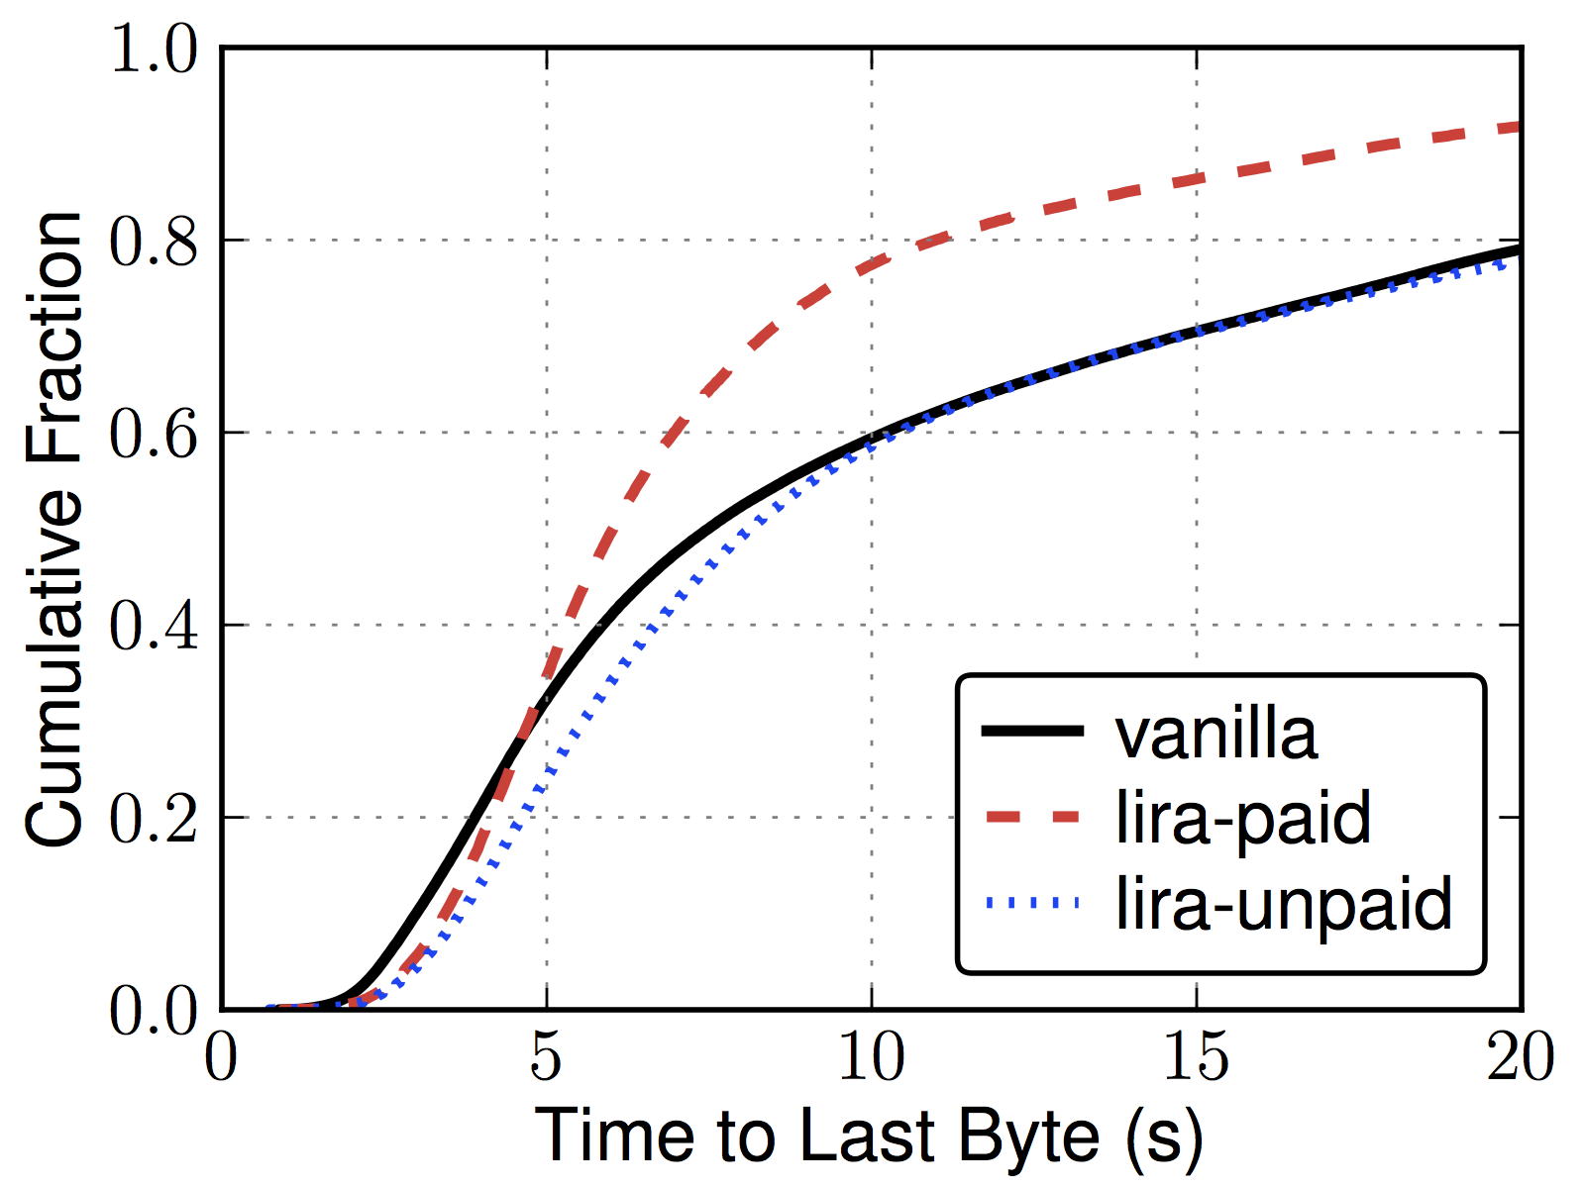
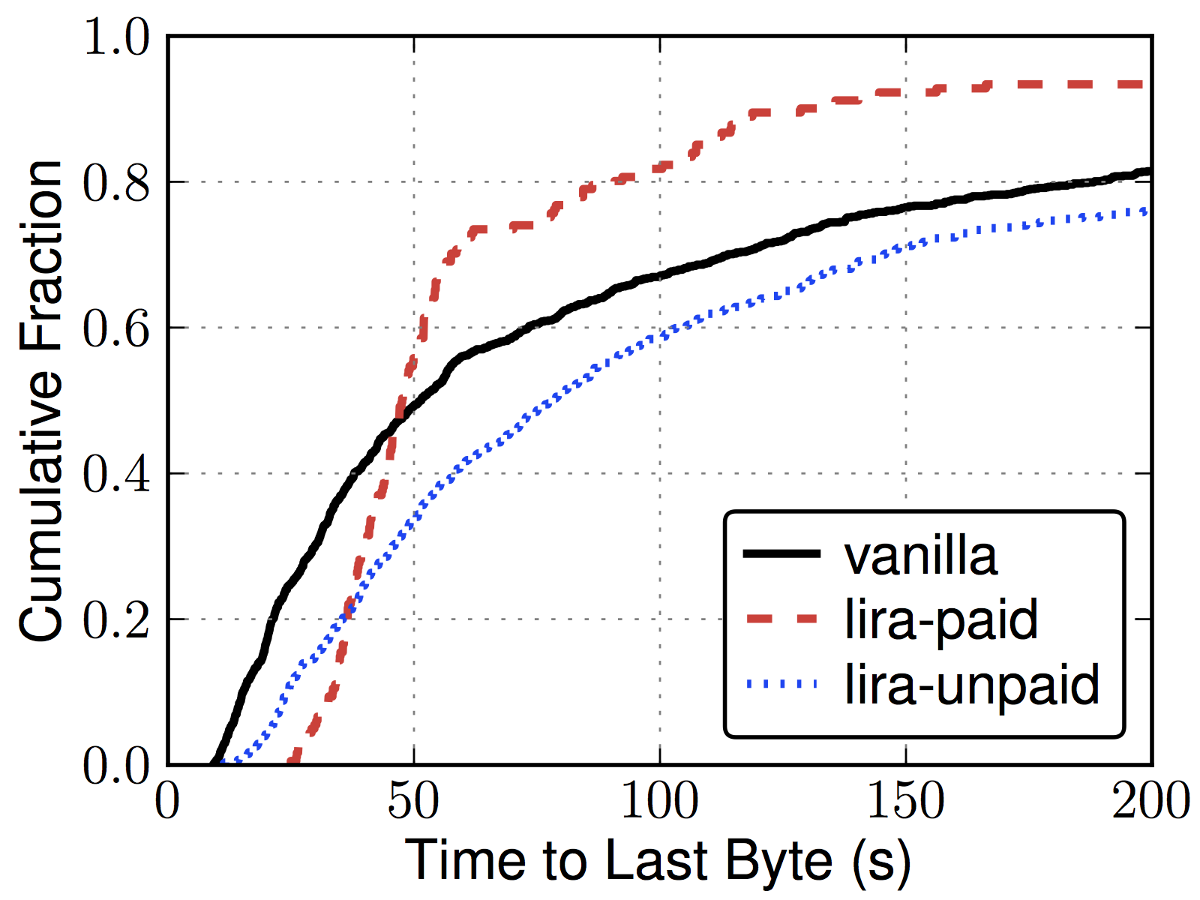
Performance
Web (320 KiB)
Bulk (5 MiB)

Slide 34
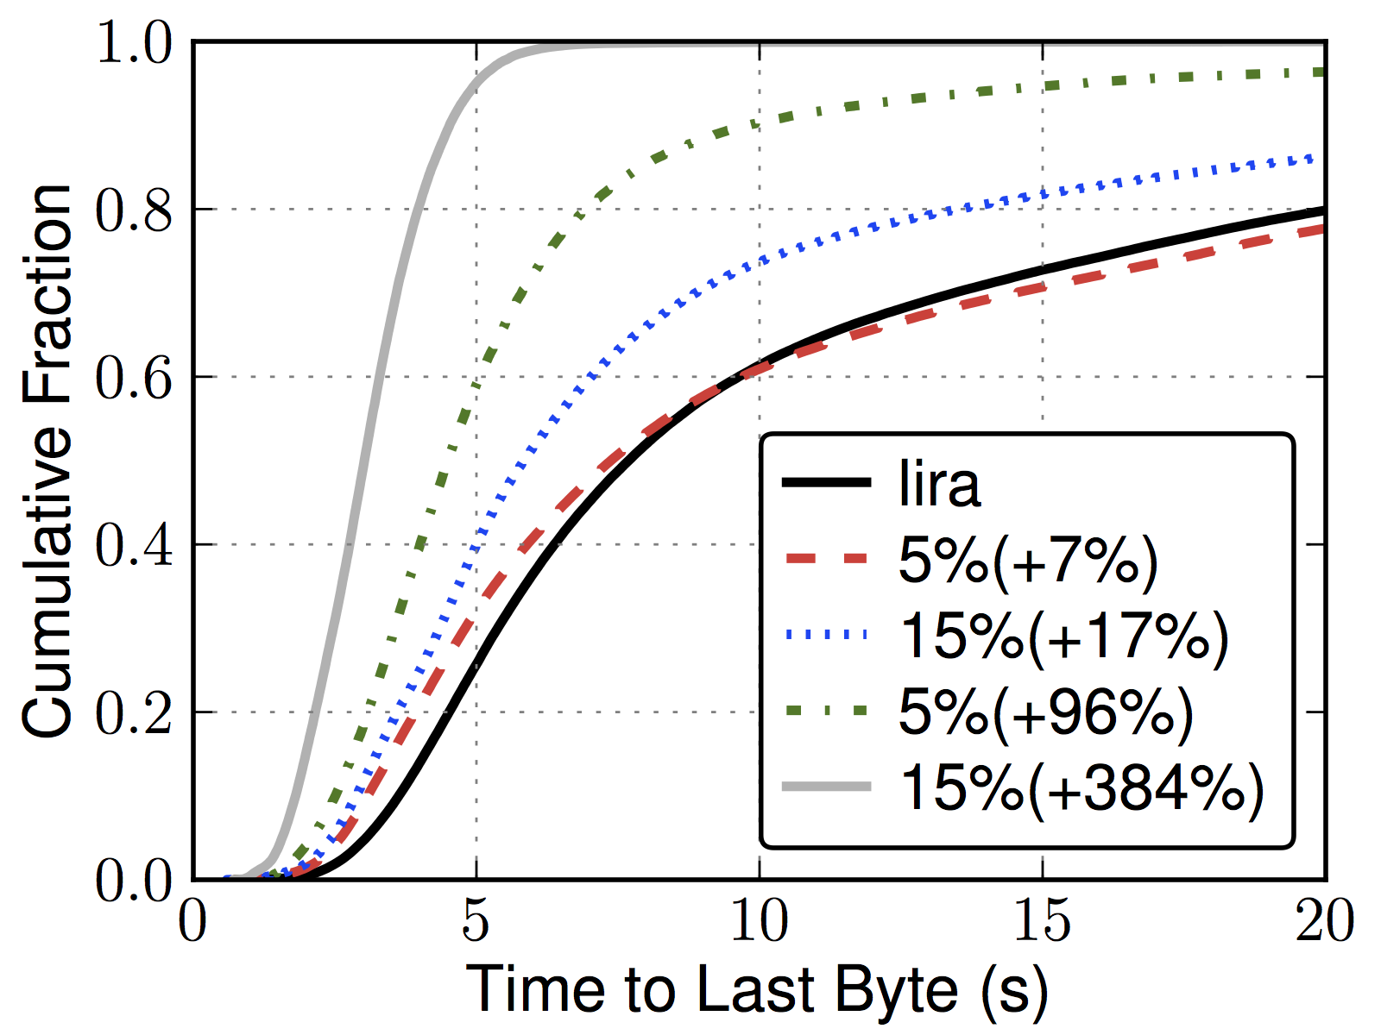
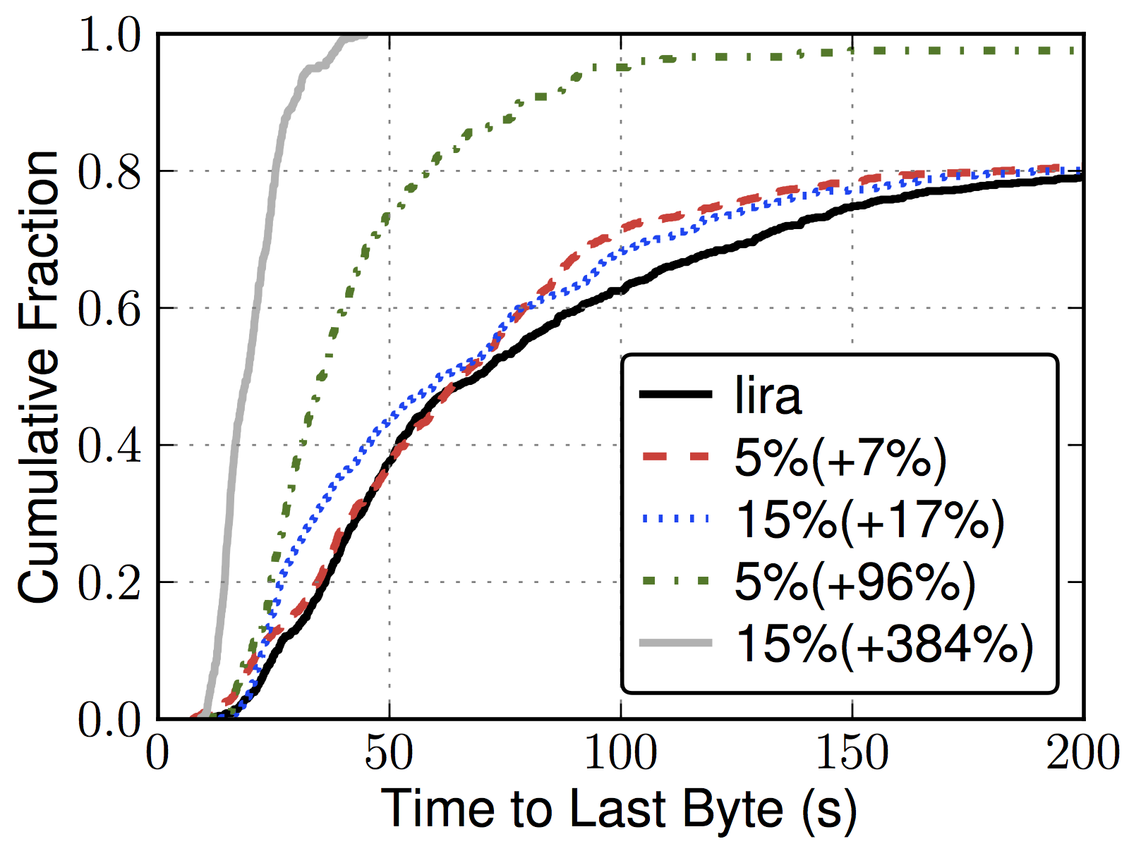
Performance, More Capacity
Web (320 KiB)
Bulk (5 MiB)

Slide 35
Conclusion
Volunteer-run Tor network is overloaded.
LIRA provides incentives to contribute by rewards with better network performance.
LIRA is more efficient than previous schemes while maintaining anonymity.
Full-network experiments demonstrate better performance and scalability.

Slide 36
Buying winning tickets
Client chooses y₀, y₁, 0 ≤ y₀ XOR y₁ < p2^{L}
Using using PRF protocol, client reverses Luby-Rackoff process to get g_{r}⁻¹(y₀ || y₁).
Client c and bank B evaluate f_{r}(x)
C sends a^{e}x_{r}^{d} to B, a random.
B returns abx_{r}^{d}, b random.
c sends b H(x)x_{r}^{d} to B.
B returns H(H(x)x_{r}^{d}) to c.
c outputs f_{r}(x) = H(x H(H(x)x_{r}^{d})).
PRF Protocol

Slide 37
Winning circuits are prioritized
Client sends tickets to each relay in circuit.
Relays evaluate tickets. Winners must have unseen PRF inputs. Neighbors sent results.
If ticket wins and neighbors report wins, circuit is prioritized for next β bytes.

Slide 38
Priority Scheduling
Proportional Differentiated Services
  Split traffic into “paid” and “unpaid” classes
  Prioritize classes using quality differentiation parameters p_{i} and quality measure Q (EWMA)
p₁/p₂ = Q₁(Δt) / Q₂(Δt)

Slide 39
Bank secrecy (honest-but-curious)
Clients oblivious to x_{r}^{d}.
B cannot produce r, input x, or output f_{r}(x).
Relay purchases are batched, preventing bank from knowing when prioritized circuits are constructed.
c and B evaluate f_{r}(x)
c obtains bx_{r}^{d}.
c sends b H(x)x_{r}^{d} to B.
B sends H(H(x)x_{r}^{d}) to c.
c outputs H(x(H(H(x)x_{r}^{d}))).
PRF Protocol

Slide 40
Creating winning tickets
f_{r} is random in ROM when x_{r}^{d} unknown.
y₀ XOR y₁ is random. for y₀ or y₁ unknown
One-time-use inputs to f_{r} prevent double spending.
Tickets not fully purchased win with probability p.
  f_{r}(x) = H(x(H(H(x) x_{r}^{d})))
  y₀ = f_{r}(x₁) x₀
  y₁ = f_{r}(y₀) x₁
  g_{r}(x) = y₀ || y₁
  0 ≤ y₀ y₁ < p 2^{L}
Cryptographic Lottery

