Slide 1


Onions for Sale:
Putting Privacy on the Market
Rob Jansen
Aaron Johnson
Paul Syverson
U.S. Naval Research Laboratory
Presented by: Alessandro Acquisti
Financial Cryptography 2013

Slide 2
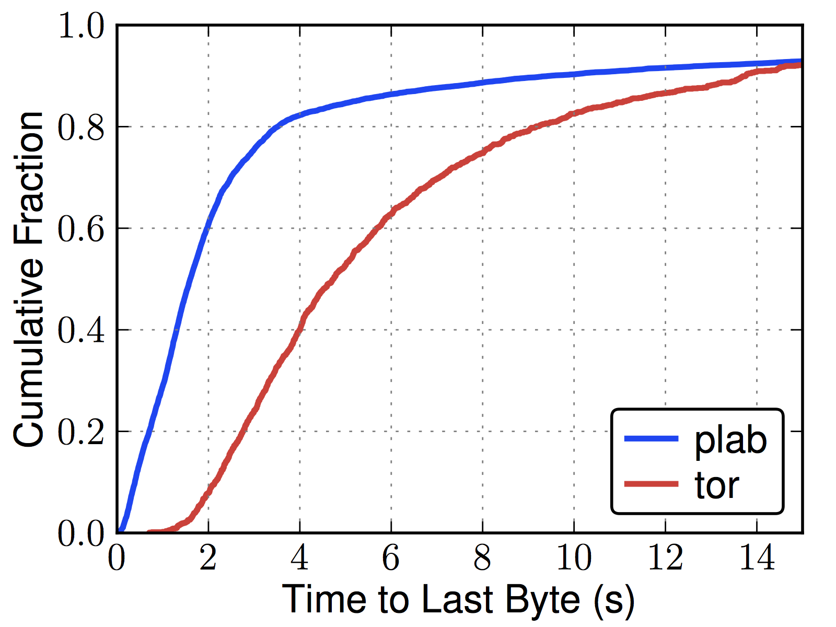
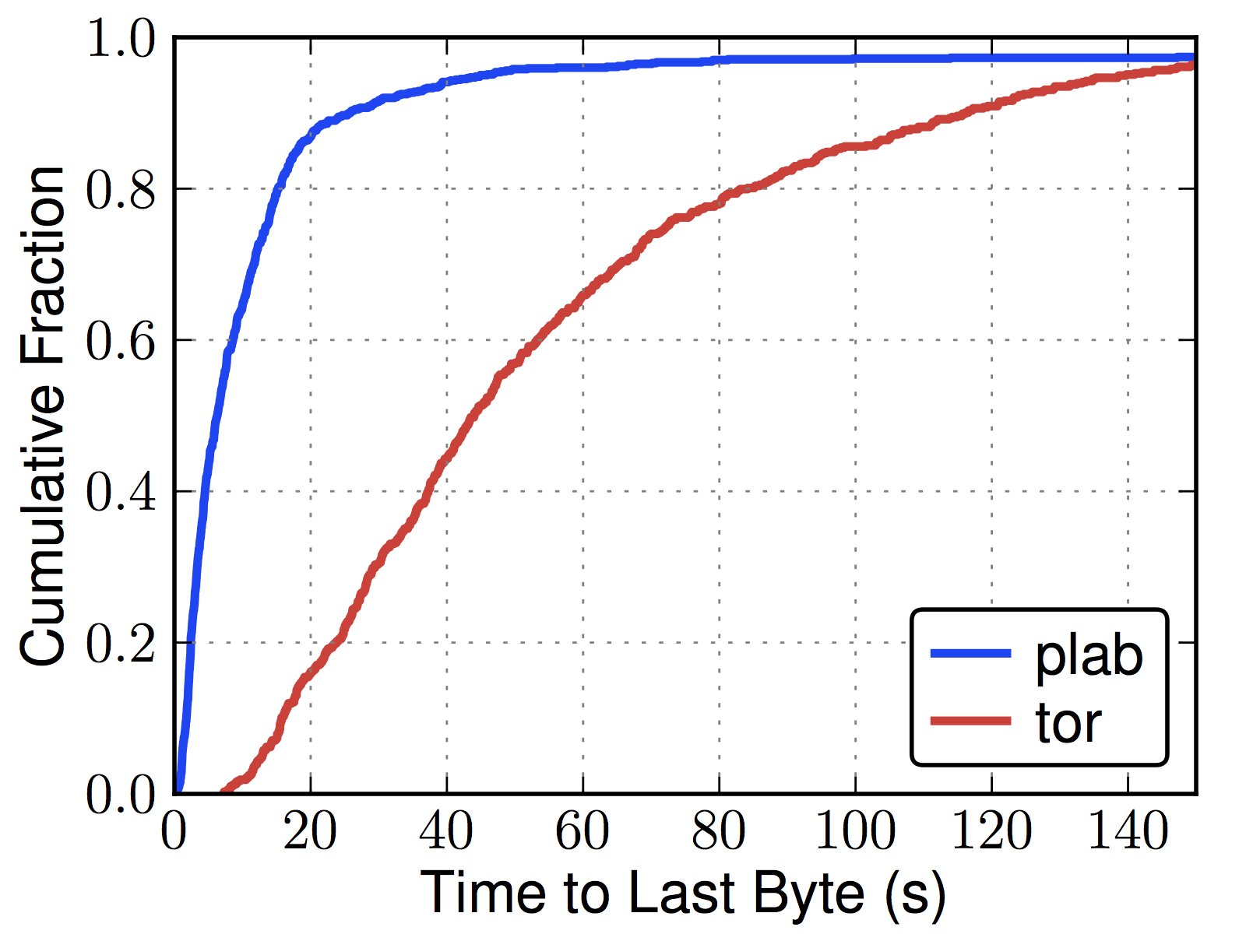
Problem: Tor is slow
Web (320 KiB)
Bulk (5 MiB)
File download distributions over Tor and PlanetLab

Slide 3
Problem: Few, overloaded Tor relays
Top 15 Exit Relays
Exit Probability | Advertised Bandwidth | Nickname
7.25% | 0.87% | chaoscomputerclub18
6.35% | 0.93% | chaoscomputerclub20
5.92% | 1.48% | herngaard
3.60% | 0.66% | chomsky
3.35% | 1.17% | dorrisdeebrown
3.32% | 1.18% | bolobolo1
3.26% | 0.65% | rainbowwarrior
2.32% | 0.36% | sdnettor01
2.23% | 0.69% | TheSignul
2.22% | 0.41% | raskin
2.05% | 0.40% | bouazizi
1.93% | 0.65% | assk
1.82% | 0.39% | kramse
1.67% | 0.35% | BostonUCompSci
1.53% | 0.40% | bach
Total 48.82%

Slide 4
Problem: Other solutions often provide weak traffic security
Examples
  Virtual Private Networks
    Often leak communication partners [1]
    Not designed for a strong adversary
    Single point of trust
  File upload sites
    Inherently reveal connection with upload site
    Single point of trust
  Filesharing seedboxes
    Connections to seedboxes are observed
    Single point of trust

Slide 5





Solution: Allow users to pay Tor for preferential network service. Use the money to grow the Tor network.
$
$
1. User pays for e-cash.
2. Payment funds relay.
prioritized
normal
3. User sends relays on onion-routing circuit e-cash to obtain priority.

Slide 6
$
Tor has an estimated 500,000 unique users per day. How many new and existing users would pay for better performance?
SSL VPN: $506 million business in 2008 [2]
File upload sites: estimated 7% of Internet traffic in 2011 [3]
BitTorrent: estimated 14.3% of Internet traffic in 2011 [3] and 52% of Tor traffic in 2010 [4].

Slide 7
prioritized
normal
How to prioritize?
Proportional Differentiated Services [5]
Why prioritize?
Requiring all users to pay hasn’t worked in the past [6].
Prioritizing traffic ensures users with little money or low risk will continue using Tor.

Slide 8
Anonymity
Users identify themselves as paying or non-paying to relays on the circuit.
An exit can link the destination to a the paying or non-paying group of users.
Users must be aware of the risk of joining the new “paying” group. As more join, it becomes more anonymous.
Paying users
Tor
Non-paying users

Slide 9
Technical challenge: Accepting payments
Payments should be possible without requiring user identification or traceability to Tor.
  Third-party payment processor
    Google Wallet
    PayPal
    Amazon Payments
  Bitcoin
Tor currently accepts donations in such forms (excepting Bitcoin)

Slide 10
Technical challenge: growing the Tor network
$
Added capacity should offset the relative slowdown of non-paying users.
Tor should not centralize control and liability of relays.
Torservers.net – a separate non-profit that takes money to run relays - provides a model for using payments.
How will existing relay operators respond to new monetary incentives?

Slide 11
References
Appelbaum, J., Ray, M., Koscher, K., Finder, I., “vpwns: Virtual pwned networks”. FOCI, 2012.
Girard, J., “Magic Quadrant for SSL VPNs”. Gartner Research, 2008.
“Technical report: An Estimate of Infringing Use of the Internet”. Envisional, 2011.
Abdelberi, C. et al., “Digging into Anonymous Traffic: A Deep Analysis of the Tor Anonymizing Network”. NSS 2010.
Jansen, R., Johnson, A., and Syverson, P., “LIRA: Lightweight Incentivized Routing for Anonymity”. NDSS, 2013.
Boucher, P., Shostack, A., and Goldberg, I., “Freedom Systems 2.0 Architecture” by Zero Knowledge Systems, Inc. White Paper , 2000.

