Slide 1
PeerFlow: Secure Load Balancing in Tor
Aaron Johnson¹ Rob Jansen¹ Aaron Segal²
Nicholas Hopper³ Paul Syverson¹
¹U.S. Naval Research Laboratory
²Yale University
³University of Minnesota
  July 18th, 2017
Privacy Enhancing Technologies Symposiu

Slide 2
Overview
Problem: Secure load-balancing in Tor
Existing Solutions
    TorFlow
    EigenSpeed
New Solution: PeerFlow
    Prove security against bandwidth-limited adversary
    Experiments show similar performance to TorFlow
Demonstrate attacks

Slide 3
Overview
Problem: Secure load-balancing in Tor
Existing Solutions
    TorFlow
    EigenSpeed
New Solution: PeerFlow
    Prove security against bandwidth-limited adversary
    Experiments show similar performance to TorFlow
Demonstrate attacks

Slide 4





Problem
Guards
Exits
Clients
Relays
Destinations

Slide 5
Problem
Guards
Exits
Clients
Relays
Destinations
Tor relays have varying unknown capacities

Slide 6
Problem
Guards
Exits
Clients
Relays
Destinations
Tor relays have varying unknown capacities
Clients must balance load

Slide 7
Problem
Guards
Exits
Clients
Relays
Destinations
Tor relays have varying unknown capacities
Clients must balance load
Insecure load balancing allows adversary to attack more client traffic

Slide 8
Problem
Guards
Exits
Clients
Relays
Destinations
Tor relays have varying unknown capacities
Clients must balance load
Insecure load balancing allows adversary to attack more client traffic

Slide 9
Problem
Guards
Exits
Clients
Relays
Destinations
Tor relays have varying unknown capacities
Clients must balance load
Insecure load balancing allows adversary to attack more client traffic

Slide 10
Problem
Guards
Exits
Clients
Relays
Destinations
Tor relays have varying unknown capacities
Clients must balance load
Insecure load balancing allows adversary to attack more client traffic

Slide 11
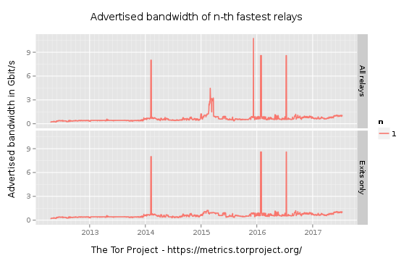
Problem
The threat is real: relay falsely advertise bandwidth.

Slide 12
Overview
Problem: Secure load-balancing in Tor
Existing Solutions
    TorFlow
    EigenSpeed
New Solution: PeerFlow
    Prove security against bandwidth-limited adversary
    Experiments show similar performance to TorFlow
Demonstrate attacks

Slide 13
Overview
Problem: Secure load-balancing in Tor
Existing Solutions
    TorFlow
    EigenSpeed
New Solution: PeerFlow
    Prove security against bandwidth-limited adversary
    Experiments show similar performance to TorFlow
Demonstrate attacks

Slide 14

TorFlow
Design
Relays are divided into 50-relay slices by estimated capacity.
Bandwidth Authorities (BWAuths) time fetching test files through pairs of relay in each slice.
Relays given capacities by multiplying self-reported bandwidth by test speed divided by average speed.

Slide 15
TorFlow
Design
Relays are divided into 50-relay slices by estimated capacity.
Bandwidth Authorities (BWAuths) time fetching test files through pairs of relay in each slice.
Relays given capacities by multiplying self-reported bandwidth by test speed divided by average speed.
Attacks
Self-reported bandwidth can be set arbitrarily high.
Relays can recognize test downloads and relay data only in those cases
Malicious pairs need not actually download the file (no validation).

Slide 16
TorFlow
Design
Relays are divided into 50-relay slices by estimated capacity.
Bandwidth Authorities (BWAuths) time fetching test files through pairs of relay in each slice.
Relays given capacities by multiplying self-reported bandwidth by test speed divided by average speed.
Attacks
Self-reported bandwidth can be set arbitrarily high.
Relays can recognize test downloads and relay data only in those cases
Malicious pairs need not actually download the file (no validation).
Shadow experiments w/ #1&#2:
- Goodput: 22.5➔0.2
- Weight: 7➔11

Slide 17
EigenSpeed
(Snader and Borisov, IPTPS 2009)
Design
Relays periodically send max speed of other relays to a BWAuth.
Aggregator calculates capacities as eigenvector of largest connected component with trusted relays.
Exclude as “liars” relays w/ reports
    Changing too quickly during computation, or
    Too different from eigenvector
0 | s₁₂ | s₁₃ | s₁₄
s₂₁ | 0 | s₂₃ | s₂₄
s₃₁ | s₃₂ | 0 | s₃₄
s₄₁ | s₄₂ | s₄₃ | 0
T=
Normalize T: T’
Output v*: v*T’=λT’, λ≥1

Slide 18
EigenSpeed
(Snader and Borisov, IPTPS 2009)
Design
Relays periodically send max speed of other relays to a BWAuth.
Aggregator calculates capacities as eigenvector of largest connected component with trusted relays.
Exclude as “liars” relays w/ reports
    Changing too quickly during computation, or
    Too different from eigenvector
Fat-pipe attack: Large false speeds among malicious relays, small elsewhere. EigenSpeed’s liar detection is designed to prevent this.

Slide 19
EigenSpeed
(Snader and Borisov, IPTPS 2009)
Design
Relays periodically send max speed of other relays to a BWAuth.
Aggregator calculates capacities as eigenvector of largest connected component with trusted relays.
Exclude as “liars” relays w/ reports
    Changing too quickly during computation, or
    Too different from eigenvector
  Attack
  “Frame” some honest non-trusted relays under liar metric #1 with avg speeds with all but framed relays.
Framing attack: With 1118 trusted relays and 2.83% malicious BW, and 558 malicious relays, 559 of 5000 honest relays are framed.

Slide 20
Overview
Problem: Secure load-balancing in Tor
Existing Solutions
    TorFlow
    EigenSpeed
New Solution: PeerFlow
    Prove security against bandwidth-limited adversary
    Experiments show similar performance to TorFlow
Demonstrate attacks

Slide 21
PeerFlow: Design

Slide 22

PeerFlow: Design
Measuring relays (largest by capacity) record total bytes transferred with all other relays.
ρ₂
ρ₁
ρ₃

Slide 23
PeerFlow: Design
Measuring relays (largest by capacity) record total bytes transferred with all other relays
Measurements added to random noise and divided by position probabilities. Result (ρ_{i}) submitted to BW Authorities (BWAuths).
ρ₂
ρ₁
ρ₃

Slide 24
PeerFlow: Design
Measuring relays (largest by capacity) record total bytes transferred with all other relays
Measurements added to random noise and divided by position probabilities. Result (ρ_{i}) submitted to BW Authorities (BWAuths).
BWAuths estimate the total bytes relayed ρ’ as the windowed, trimmed mean, trimming fractions by current capacity and windowing from trusted measurements.
ρ₂
ρ₁
ρ₃
Measured capacities
0
0.258
0.742
1
Measuring relay weights

Slide 25
PeerFlow: Design
Measuring relays (largest by capacity) record total bytes transferred with all other relays
Measurements added to random noise and divided by position probabilities. Result (ρ_{i}) submitted to BW Authorities (BWAuths).
BWAuths estimate the total bytes relayed ρ’ as the windowed, trimmed mean, trimming fractions by current capacity and windowing from trusted measurements.
ρ₂
ρ₁
ρ₃
Measured capacities
ρ’
0
0.258
0.742
1
Measuring relay weights

Slide 26
PeerFlow: Design
Measuring relays (largest by capacity) record total bytes transferred with all other relays
Measurements added to random noise and divided by position probabilities. Result (ρ_{i}) submitted to BW Authorities (BWAuths).
BWAuths estimate the total bytes relayed ρ’ as the windowed, trimmed mean, trimming fractions by current capacity and windowing from trusted measurements.
If ρ’ is comparable to that of peers, capacity updated using ρ’, else relay enters probation.
ρ₂
ρ₁
ρ₃
Measured capacities
ρ’
0
0.258
0.742
1
Measuring relay weights

Slide 27
PeerFlow: Design
Measuring relays (largest by capacity) record total bytes transferred with all other relays
Measurements added to random noise and divided by position probabilities. Result (ρ_{i}) submitted to BW Authorities (BWAuths).
BWAuths estimate the total bytes relayed ρ’ as the windowed, trimmed mean, trimming fractions by current capacity and windowing from trusted measurements.
If ρ’ is comparable to that of peers, capacity updated using ρ’, else relay enters probation.
New relays only selected for middle position
ρ₂
ρ₁
ρ₃
Measured capacities
ρ’
0
0.258
0.742
1
Measuring relay weights

Slide 28
PeerFlow: Security
Attack | Weight multiple
Only carry traffic in one direction | 2
Only exchange traffic with measuring relays | 1.33
Do not exchange traffic with the lower trimmed fraction of relays | 1.34
Single-round capacity inflation
Multiple-round capacity inflation

Slide 29
PeerFlow: Performance
Shadow experiments comparing PeerFlow, TorFlow, and Ideal
  4 Tor directory authorities
  498 Tor relays
  7,500 Tor clients
  1,000 servers
Aggregate relay goodput per second
Time to last byte of 320KiB file

Slide 30
Conclusion
Tor needs secure load balancing
Demonstrated attacks on existing solutions
    TorFlow
    EigenSpeed
  Presented PeerFlow
    Demonstrated secure against bandwidth-limited adversary
    Experimentally showed performance is similar to current Tor performance

Slide 31
Backup slides

Slide 32
Problem
How can a small malicious relay attack many clients?

Slide 33
Problem
How can a small malicious relay attack many clients?

Slide 34
Problem
How can a small malicious relay attack many clients?

Slide 35
Problem
How can a small malicious relay attack many clients?
Each client need be attacked only once.
Attack traffic speed can be sent at the adversary’s desired speed.
TCP congestion windows can slow incoming traffic.

Slide 36
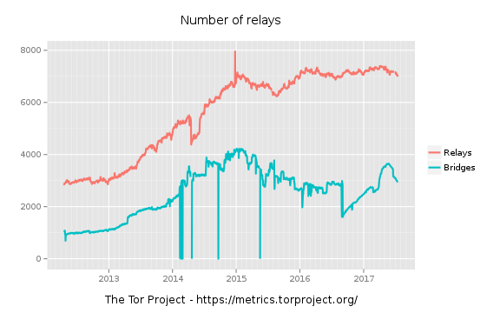
Problem
The threat is real: attacks have failed due to low weight.

Slide 37
EigenSpeed
(Snader and Borisov, IPTPS 2009)
Design
Relays periodically send max speed of other relays to a BWAuth.
Aggregator calculates capacities as eigenvector of largest connected component with trusted relays.
Exclude as “liars” relays w/ reports
    Changing too quickly during computation, or
    Too different from eigenvector
  Attacks
  “Frame” some honest non-trusted relays under liar metric #1 with avg speeds with all but framed relays.
  Inflate capacity with normal speeds with trusted and lies with malicious.
Targeted lie attack: With 1118 trusted relays, 3.70% malicious BW, and 1117 malicious relays, adversary achieves 79.5% of capacity.

