Slide 1




TEEMS: A Trusted Execution Environment based Metadata-protected Messaging System
Sajin Sasy, Aaron Johnson, Ian Goldberg
(slides courtesy of Sajin Sasy)
Notes:
1

Slide 2



Communication Privacy
We expect privacy from our online conversations
2
Notes:
2

Slide 3

Communication Privacy
We expect privacy from our online conversations
End-to-end encryption has been widely adopted
3
Notes:
3

Slide 4
Is End-to-End encryption sufficient? No
4
Notes:
4

Slide 5
Is End-to-End encryption sufficient? No
End-to-End encryption protects data, but does not protect metadata
Metadata alone can often be harmful
5
Notes:
5

Slide 6



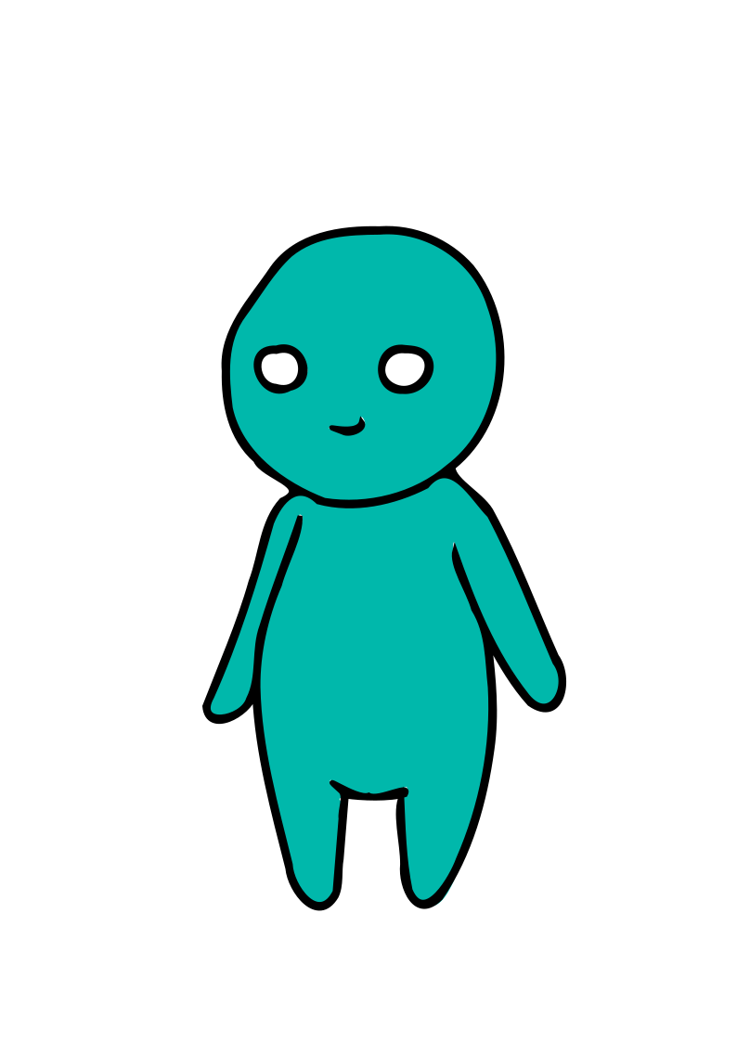
Is End-to-End encryption sufficient? No
End-to-End encryption protects data, but does not protect metadata
Metadata alone can often be harmful
Evil Corp HQ
6
Notes:
6

Slide 7

Is End-to-End encryption sufficient? No
End-to-End encryption protects data, but does not protect metadata
Metadata alone can often be harmful
Evil Corp HQ
7
Notes:
7

Slide 8

Is End-to-End encryption sufficient? No
End-to-End encryption protects data, but does not protect metadata
Metadata alone can often be harmful
Evil Corp HQ
Journalist
8
Notes:
8

Slide 9
Is End-to-End encryption sufficient? No
End-to-End encryption protects data, but does not protect metadata
Metadata alone can often be harmful
Evil Corp HQ
Journalist
9
Notes:
9

Slide 10
Protecting Communication Metadata
This line of research originates with David Chaum’s work from 1981
Several different forms of “anonymous communications networks” proposed over the last 40+ years with varying functionality and metadata protections
Metadata-Protecting Communication Systems: Systems that protect their users’ communications from a global network adversary observing all network communications [1].
Systematized existing MPCS and provided two taxonomies for them:
i) six different families, and ii) four different categories
10
[1] – Sajin Sasy and Ian Goldberg. “SoK: Metadata-Protecting Communication Systems” PoPETs, 2024.
Notes:
10

Slide 11
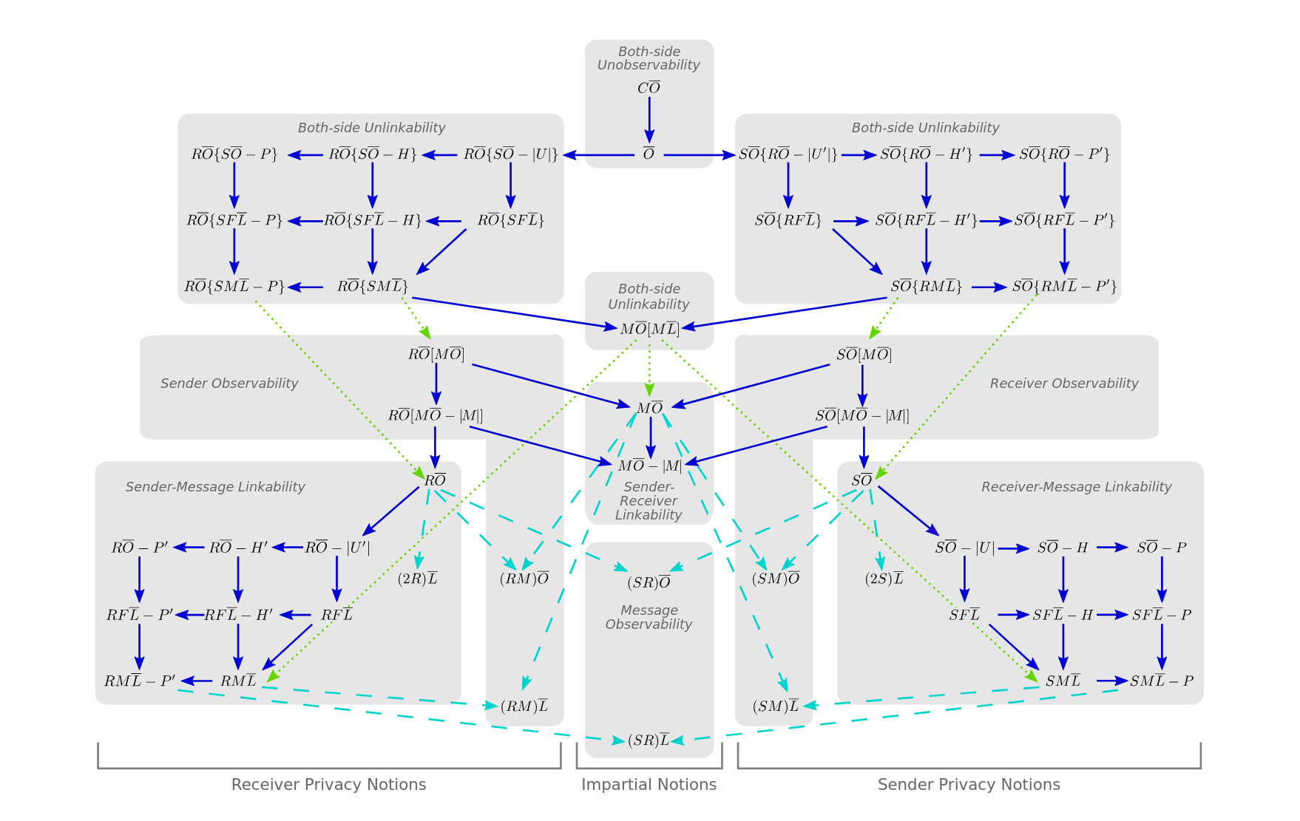
Privacy Notions
[2] – Christiane Kuhn, Martin Beck, Stefan Schiffner, Eduard Jorswieck, Thorsten Strufe.
“On Privacy Notions in Anonymous Communication” PoPETs, 2019.
11
Notes:
11

Slide 12


Current state of MPCS
Lack of MPCS designs that can support 4 fundamental desirable properties:
Family | Low Latency | High Throughput | Horizontal Scalability | Async
DC-Nets
Mixnets
(Mixnets+) DP
PIR / RPIR
SMC
12
Notes:
12

Slide 13
Our Contributions
We present TEEMS (Trusted Execution Environment based Metadata-protected Messaging System), a novel design for MPCS using the oblivious mailbox paradigm.
TEEMS is a Communication Unobservable System (CUS).
TEEMS is the first MPCS design to simultaneously achieve low latency, high throughput, horizontal scalability, and asynchronicity.
Introduces the notion of ID and token channels for MPCS, which circumvents the rigid mechanisms of dialing protocols from the literature
Implement a prototype of TEEMS and demonstrate its practicality; more than an order of magnitude improvement in latency and throughput.
13
Notes:
13

Slide 14

TEEMS
The system operates in synchronous rounds, but provides asynchronous communications to users.
TEEMS uses TEEs on its servers for metadata protection.
All of TEEMS servers can be run in the same data center with servers having high-bandwidth and low-latency connections among them.
TEEMS remains secure against an adversary that controls the servers, some of the clients, and the network communications among servers and with clients.
TEEMS
14
Notes:
14

Slide 15





TEE time
Processor
PRM
Rest of memory
Memory
15
Notes:
15

Slide 16

TEE time
if (secret==1): Branch A
else:
Branch B
Software
Side-channels
(1) Control Flow
Processor
PRM
Rest of memory
Memory
16
Notes:
16

Slide 17
TEE time
if (secret==1): Branch A
else:
Branch B
Software
Side-channels
(1) Control Flow
(2) Memory Access Patterns
X = A[secret]
Processor
PRM
Rest of memory
Memory
17
Notes:
17

Slide 18

TEE time
Microarchitectural
side-channels like:
Speculative execution
Voltage Interface
if (secret==1): Branch A
else:
Branch B
Software
Side-channels
(1) Control Flow
(2) Memory Access Patterns
X = A[secret]
Processor
PRM
Rest of memory
Memory
18
Notes:
18

Slide 19
TEE time
Microarchitectural
side-channels like:
Speculative execution
Voltage Interface
if (secret==1): Branch A
else:
Branch B
Software
Side-channels
(1) Control Flow
(2) Memory Access Patterns
X = A[secret]
Programs executed in TEEs need to have control flow and memory access patterns independent of the data:
Oblivious Algorithms
Processor
PRM
Rest of memory
Memory
19
Notes:
19

Slide 20
The TEEMS Oblivous Mailbox Design
1
2
3
4
5
6
7
8
TEEMS
20
Notes:
20

Slide 21
The TEEMS Oblivous Mailbox Design
1
8
2
3
4
2
5
6
7
5
8
TEEMS
21
Notes:
21

Slide 22
The TEEMS Oblivous Mailbox Design
1
8
2
3
4
2
5
6
7
5
8
TEEMS
Any subset of users can submit messages in a given round.
At the end of each round, every mailbox receives a message.
An adversary cannot distinguish between real or dummy messages.
22
Notes:
22

Slide 23
The TEEMS Oblivous Mailbox Design
1
8
2
3
4
2
5
6
7
5
8
TEEMS
Any subset of users can submit messages in a given round.
At the end of each round, every mailbox receives a message.
An adversary cannot distinguish between real or dummy messages.
TEEMS presents ColumnRoute an oblivious-route-and-pad protocol to facilitate this.
23
Notes:
23

Slide 24
TEEMS Architecture
Ingestion Servers
Routing Servers
Storage Servers
24
Notes:
24

Slide 25
TEEMS Architecture
2
Ingestion Servers
Routing Servers
Storage Servers
1
25
Notes:
25

Slide 26
TEEMS Architecture
Ingestion Servers
Routing Servers
Storage Servers
Token Channel
ID Channel
26
Notes:
26

Slide 27
TEEMS Architecture
3
4
Ingestion Servers
Routing Servers
Storage Servers
2
1
Token Channel
ID Channel
27
Notes:
27

Slide 28
TEEMS Architecture
3
4
Ingestion Servers
Routing Servers
Storage Servers
2
1
Token Channel
ID Channel
Guaranteed delivery, but senders selected in advance
Clients must have tokens for sending messages on this channel
Guaranteed delivery, but senders selected in advance
Clients must have tokens for sending messages on this channel
28
Notes:
28

Slide 29
TEEMS Architecture
3
4
Ingestion Servers
Routing Servers
Storage Servers
2
1
Token Channel
ID Channel
Guaranteed delivery, but senders selected in advance
Clients must have tokens for sending messages on this channel
Guaranteed delivery, but senders selected in advance
Clients must have tokens for sending messages on this channel
Not guaranteed delivery, but requires no prior coordination
Can be used to set up private channels
29
Notes:
29

Slide 30
TEE Tools: Oblivious Algorithms
Oblivious Shuffle / Sort [2]: O(n log n) ( O(n log³ n + n ß log n) )
Oblivious Tight Compaction [3]: O(n log n)
Oblivious Reverse Compaction or Expansion: O(n log n)
A | B | C | D | E | F | G | H
B | D | E | F | H | G | A | C
0 | 1 | 0 | 1 | 1 | 1 | 0 | 1
1 | 1 | 1 | 1 | 1 | 0 | 0 | 0
B | D | E | F | H | G | A | C
H | G | B | F | D | G | A | E
2 | 4 | 7 | 0 | 0 | 0 | 0 | 0
0 | 0 | 2 | 0 | 4 | 0 | 0 | 7
[2] – Sasy et al.. “Waks-On/Waks-Off: Fast Oblivious Offline/Online Shuffling and Sorting with Waksman Networks”. ACM CCS, 2023.
[3] – Sasy et al.. “Fast Fully Oblivious Shuffling and Sorting”. ACM CCS, 2022.
30
Notes:
30

Slide 31
Comparing Performance
Family | Clients | Servers (Total cores) | Msg size (bytes) | Latency (s) | Throughput (msgs/sec)
Clarion (MPC, 2022) | 10⁶ | 3 (48) | 160 | 80 | 12.5 K
Karaoke (Mix/DP, 2018) | 10⁶ | 100 (3600) | 256 | 6 | 166 K
Sabre (DPF, 2022) | 2¹⁸ | 3 (48) | 1000 | 0.05 | 20
Boomerang (TEE, 2023) | 2²⁰ | 32 (256) | 256 | 7.8 | 134 K
Sparta (TEE, 2025) | 2²⁰ | 1 (72) | 128 | 25.9 | 41 K
TEEMS | 2²⁰ | 64 (205) | 256 | 0.98 | 2.14 M
31
Notes:
31

Slide 32
Comparing Properties
System | Low Latency | High Throughput | Horizontal Scalability | Async
Clarion (MPC, 2022)
Karaoke (Mix/DP, 2018)
Sabre (DPF, 2022)
Boomerang (TEE, 2023)
Sparta (TEE, 2025)
TEEMS
32
Notes:
32

Slide 33
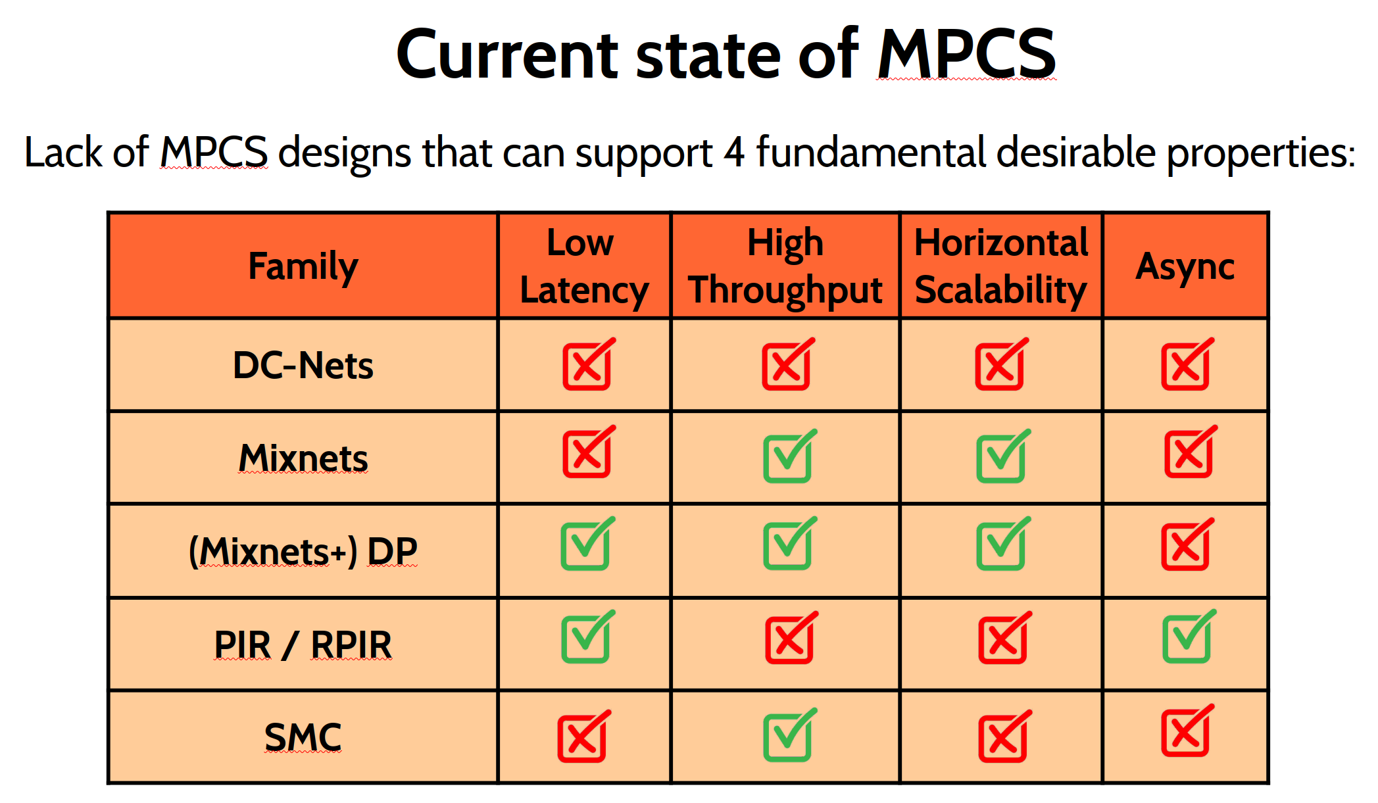
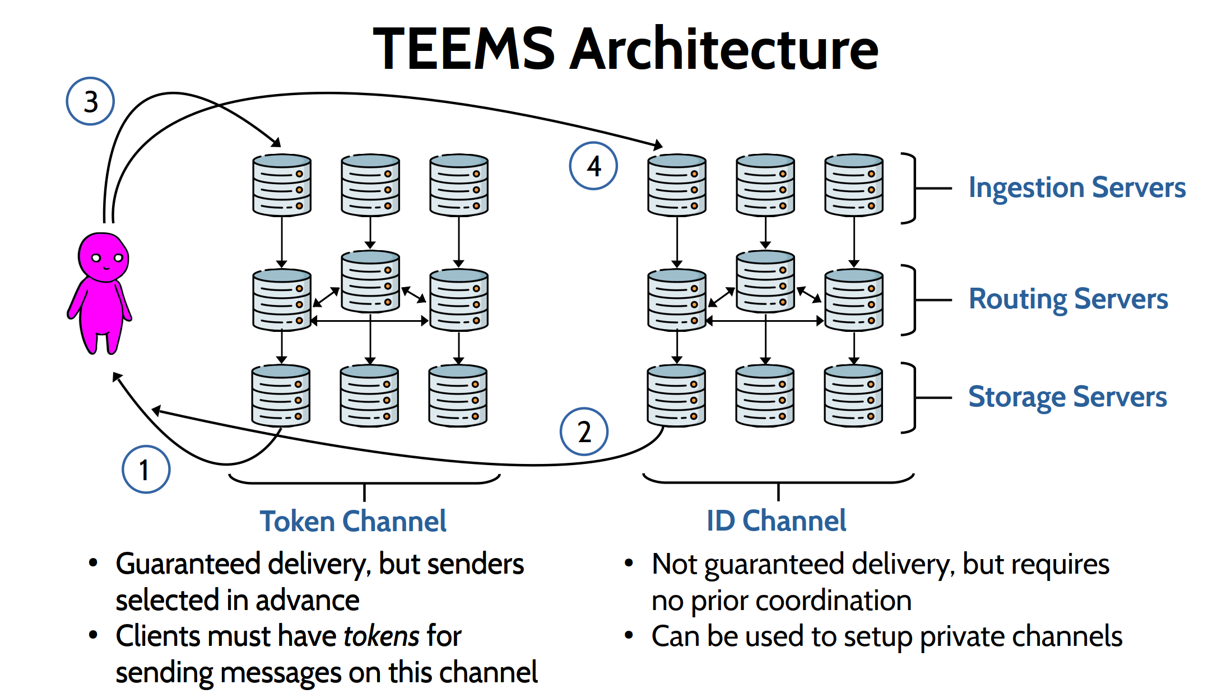
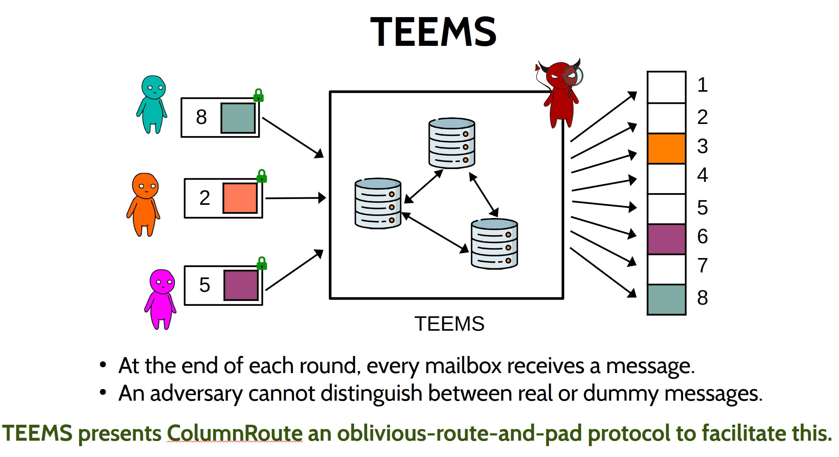
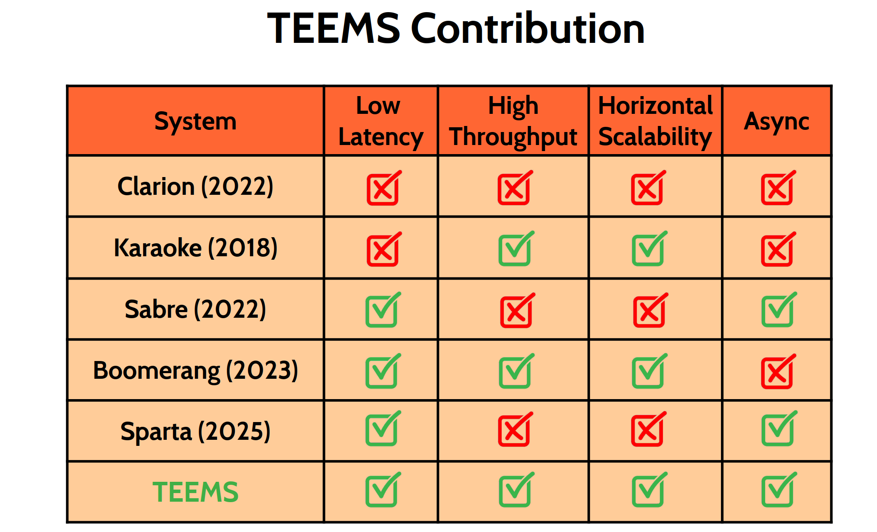
Summary
33
Notes:
33

