Slide 1
Throwing Your Weight Around: Fixing Tor’s Positional Weighting Aaron Johnson (U.S. Naval Research Laboratory)
Aaron D. Jaggard (U.S. Naval Research Laboratory)
Paul Syverson (U.S. Naval Research Laboratory)
July 12th, 2023
Privacy Enhancing Technologies Symposium (PETS ’23)
Notes:
Short paper
Work in progress
Some details deviate from paper

Slide 2
The Tor Network
Encrypted connection
Unencrypted connection
Can be a guard
Can be an exit
Clients
Destination
Servers
Relays
Tor clients create circuits to anonymize connections
Circuits typically use 3 relays: guard, middle, then exit
Relays need high uptime and bandwidth to be guards
Relays need to allow connections outside Tor to be exits

Slide 3
The Tor Network
Encrypted connection
Unencrypted connection
Can be a guard
Can be an exit
Clients
Destination
Servers
Relays
Relay have different bandwidths
Clients choose relays randomly proportional to bandwidths to load-balance traffic (in expectation)
Clients must also balance load across positions

Slide 4
Tor Positional Weights
Class G: Relays that can be guards but not exits
Class M: Relays that cannot be guards or exits
Class E: Relays that can be exits but not guards
Class D: Relays that can be guards and exits
Positional weights W_{xy} balance load across positions:
 | Guard | Middle | Exit
G | W_{gG} | W_{mG}
M |  | W_{mM}
E |  | W_{mE} | W_{eE}
D | W_{gD} | W_{mD} | W_{eD}
Relay r in class x with bandwidth b_{r} is chosen for position y with probability proportional to W_{xy}b_{r} .

Slide 5
Tor Positional Weights
G: Total bandwidth of class G
M: Total bandwidth of class M
E: Total bandwidth of class E
D: Total bandwidth of class D
T = G + M + E + D (T/3 is maximum throughput)
Positional weight equations given for 13 possible cases (bold):
E≥T/3 ∧ G≥T/3
E<T/3 ∧ G<T/3
min(G,E)+D < max(G,E)
G > E
G ≤ E
min(G,E)+D ≥ max(G,E)
G≥M ∧ E≥G−M
(G<M∨E<G−M)∧(M≤T/3)
(G<M∨E<G−M)∧(M>T/3)
T/3−E ≤ D
T/3−E > D
E<T/3 ⊕ G<T/3
min(G,E)+D < T/3
G < E
E < M
E ≥ M
G ≥ E
G < M
G ≥ M
min(G,E)+D ≥ T/3
G < E
G ≥ E

Slide 6
Past Tor network states
# of consensuses in Tor network state cases, 2009–2021
 | 1 | 2.a.i | 2.a.ii | 2.b.i | 2.b.ii | 2.b.iii.A | 2.b.iii.B | 3.a.i.A | 3.a.i.B | 3.a.ii.A | 3.a.ii.B | 3.b.i | 3.b.ii
2021 |  |  |  |  |  |  |  |  |  |  | 8369 |  | 353
2020 |  |  |  |  |  |  |  |  |  |  | 8465 |  | 315
2019 |  |  |  |  |  |  |  |  |  |  | 8754
2018 |  |  |  |  |  |  |  |  |  |  | 8760
2017 |  |  |  |  |  |  |  |  |  |  | 8756
2016 |  |  |  |  |  |  |  |  |  |  | 8773
2015 |  |  |  |  |  |  |  |  |  |  | 8632 |  | 119
2014 |  |  |  |  |  |  |  |  |  |  | 467 |  | 8281
2013 |  |  |  | 739 | 561 |  |  |  |  |  | 13 | 12 | 7424
2012 |  |  |  | 993 | 1379 |  |  |  |  |  |  |  | 6336
2011 |  |  |  | 1182 | 1149 | 36 |  |  |  |  | 7 | 2 | 6332
2010 | 119 | 11 | 3 | 430 | 701 | 83 | 1 |  |  | 40 | 1912 |  | 5448
2009 | 167 |  |  | 63 | 3 |  |  |  |  |  | 5956 |  | 2561

Slide 7
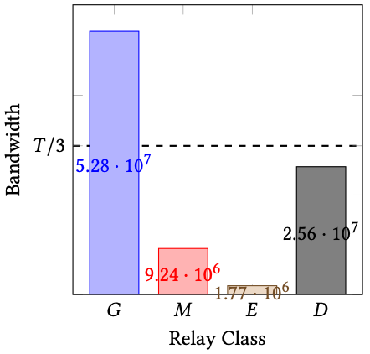
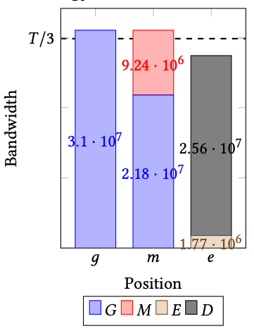
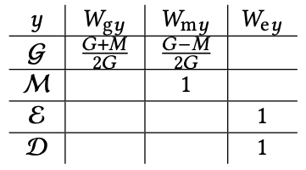
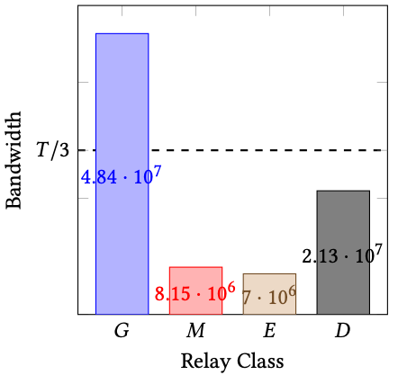
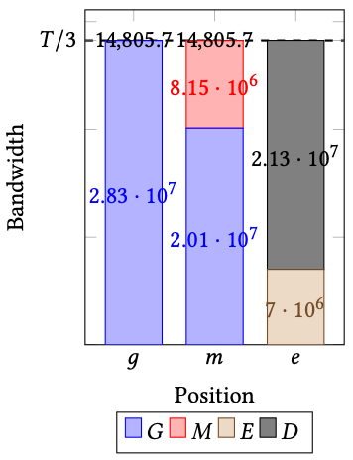
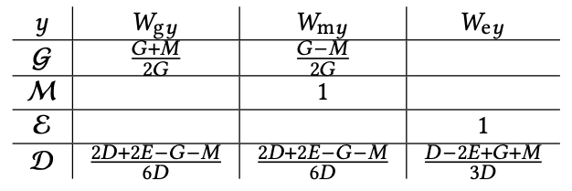
Tor’s current positional weights
Relay-class bandwidths 2021-12-31 23:00
Positional bandwidth allocation 2021-12-31 23:00
Case 3.a.ii.B: 3. 𝐸 < 𝑇/3 ⊕ 𝐺 < 𝑇/3 a. min(𝐺, 𝐸) + 𝐷 < 𝑇/3 ii. 𝐺 ≥ 𝐸 B. 𝐺 ≥ 𝑀
Case 3.b.ii: 3. 𝐸 < 𝑇 /3 ⊕ 𝐺 < 𝑇/3 b. min(𝐺, 𝐸) + 𝐷 ≥ 𝑇/3 ii. 𝐺 ≥ 𝐸
Relay-class bandwidths 2021-12-05 19:00
Positional bandwidth allocation
2021-12-05 19:00
Notes:
No content
No metadata
- No observable length indicator
- No version indicator

Slide 8
Tor Positional Weights Deficiencies
Deficiency #1: Case 2.b.iii.A does not maximize throughput.
Deficiency #2: Case 2.b.iii.B yields invalid weights.
Deficiency #3: Weights are discontinuous.

Slide 9
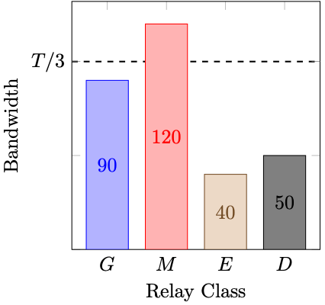
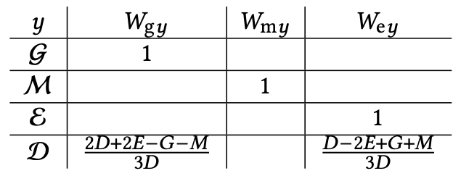
Tor Positional Weights Deficiencies
Deficiency #2: Case 2.b.iii.B yields invalid weights.
Relay-class bandwidths
Case 2.b.iii.B: 2. (𝐸 < 𝑇/3) ∧ (𝐺 < 𝑇/3) b. min(𝐺,𝐸)+𝐷 ≥ max(𝐺,𝐸) iii. 𝑀 > 𝑇/3 A. 𝑇/3 − 𝐸 > 𝐷
W_{gD} = -0.2
W_{eD} = 1.2
DirAuths check that 0≤W_{xy}≤1.
When check fails, set all W_{xy}=1.
D bandwidth is consumed at 46.3.
Optimal is 90.

Slide 10
Tor Positional Weights Deficiencies
Deficiencies #1 and #2 can be resolved with simple fix:
However, simple fix
Does not resolve deficiency #3 (continuity issue).
Does not take advantage of multiple potential solutions.

Slide 11
Attacks on Positional Weights
Attack #1: Reduce throughput by adding relays to induce positional-weight errors.
Attack #2: Reduce throughput by shifting relays across classes to induce positional-weight errors (faster, more surreptitious).
Attack #3: Exploit discontinuity by adding relay bandwidth, causing much of D to start/stop being used as guards.

Slide 12
Attacks on Positional Weights
Attack #1: Add relays to induce positional-weight errors.
Example attack
Pre-attack:
G=98.75, M=103, E=0, and D=98.25 (Case 2.a.i) Throughput: 98.25
Attack: Attacker adds one relay to D of bandwidth 1.
Post-attack:
G=98.75, M=103, E=0, and D=99.25 (Case 2.b.iii.B)
Throughput: D bandwidth is consumed at 54.21 (44.8% reduction).

Slide 13
Attacks on Positional Weights
Attack #1: Add relays to induce positional-weight errors.
Attack analysis of past Tor networks
Adding relays to shift to Case 2.b.iii.B (invalid weights)

Slide 14
Alternative weights
V_{C}: probability new relay added to C bandwidth is selected as guard or exit.
Alt1 goals
Maximize the smallest position bandwidth.
Maximize the amount of D bandwidth put into exit position.
Minimize the maximum V_{C} value.
Minimize the second-largest V_{C} value.
Maximize the second-smallest position bandwidth.
Alt2 goals
Maximize the smallest position bandwidth.
Minimize the maximum V_{C} value.
Maximize the second-smallest position bandwidth.

Slide 15
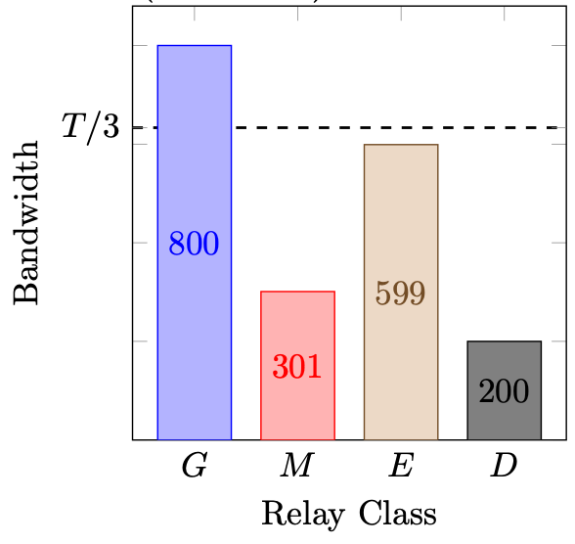
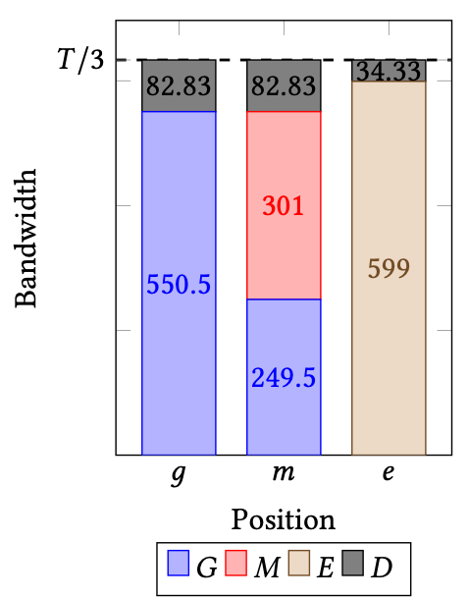
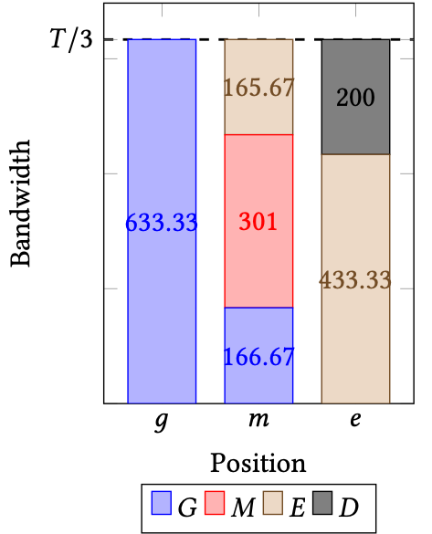
Alt1 weights
Alt1 weights
Given in 13 cases.
Proven to be unique solution satisfying Alt1 goals in order.
Same as current weights in most-common Case 3.a.ii.B.
Different from current weights in second-most-common Case 3.b.ii.
Example class bandwidths (Case 3.b.ii)
Current Tor weights
Alt1 weights

Slide 16
Discussion
Disclosed weight deficiencies to Tor in April 2022 (they had already observed a failing test case).
We recommend Tor adopt Alt1 weights.
Changing positional weights requires a new consensus version.
Our goal-based approach is compatible with planned “overhead” design (Tor Proposal 265).
Similar anonymity systems (Loki, Orchid, I2P) would have similar issues if they attempted to load balance across positions.

Slide 17
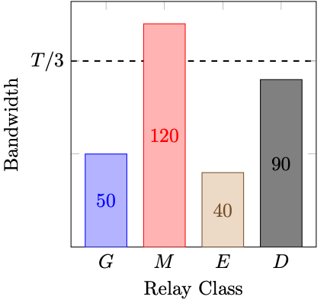
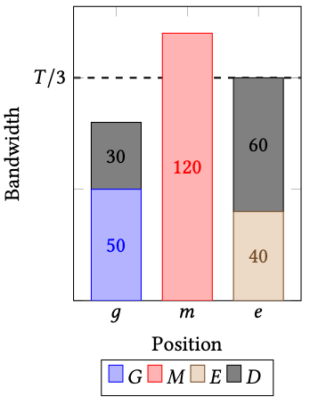
Tor Positional Weights Deficiencies
Deficiency #1: Case 2.b.iii.A does not maximize throughput.
Relay-class bandwidths
Case 2.b.iii.A: 2. (𝐸 < 𝑇/3) ∧ (𝐺 < 𝑇/3) b. min(𝐺,𝐸)+𝐷 ≥ max(𝐺,𝐸) iii. 𝑀 > 𝑇/3 A. 𝑇/3 − 𝐸 ≤ 𝐷
Positional bandwidth allocation
Bottleneck should be at 90 instead of 80

