Slide 1
Improving Tor’s Security with Trust-Aware Path Selection Aaron Johnson
January 30th, 2017
Computer Science Colloquium, Tulane University

Slide 2
Talk Overview
Background
Tor’s Big Problem
Attacks on Prior Approach
Solution 1: Use Trust
Solution 2: Cluster
Trust-Aware Path Selection
Future Work

Slide 3



Tor
Tor is a popular system for anonymous, censorship-resistant communication (includes client, server, and Web browser).

Slide 4
Tor
Tor is a popular system for anonymous, censorship-resistant communication (includes client, server, and Web browser).
Users include:
Individuals avoiding censorship
Individuals avoiding surveillance
Journalists protecting themselves or sources
Law enforcement during investigations
Intelligence analysts for gathering data

Slide 5

Tor
> 2 million daily users
> 80 Gbit/s aggregate traffic
> 7000 relays in > 80 countries

Slide 6
Tor History
1996: “Hiding Routing Information” by David M. Goldschlag, Michael G. Reed, and Paul F. Syverson. Information Hiding: First International Workshop.
1997: "Anonymous Connections and Onion Routing," Paul F. Syverson, David M. Goldschlag, and Michael G. Reed. IEEE Security & Privacy Symposium.
1998: Distributed network of 13 nodes at NRL, NRAD, and UMD.
2000: “Towards an Analysis of Onion Routing Security” by Paul Syverson, Gene Tsudik, Michael Reed, and Carl Landwehr. Designing Privacy Enhancing Technologies: Workshop on Design Issues in Anonymity and Unobservability.
2003: Tor network is deployed (12 US nodes, 1 German), and Tor code is released by Roger Dingledine and Nick Mathewson under the free and open MIT license.
2004: “Tor: The Second-Generation Onion Router” by Roger Dingledine, Nick Mathewson, and Paul Syverson. USENIX Security Symposium.
2006: The Tor Project, Inc. incorporated as a non-profit.

Slide 7
Tor Today
Funding levels at $2-3 million (current and former funders include DARPA, NSF, US State Dept., SIDA, BBG, Knight Foundation, individuals)
The Tor Project, Inc. employs a small team for software development, research, management, funding, community outreach, and user support
Much bandwidth, research, development, and outreach contributed by third parties

Slide 8
Anonymous Communication Designs
Single-hop anonymous proxies: anonymizer.com, anonymouse.org, many VPNs
Dining Cryptographers networks: Dissent, Herbivore
Mix networks: MixMinion, MixMaster, BitLaundry, Riffle, Vuvuzela
Onion routing: Tor, Crowds, Java Anon Proxy, I2P, Aqua, PipeNet, Freedom
Others: Anonymous buses, XOR trees, Riposte

Slide 9

Background: Onion Routing
Users
Relays
Destinations
Circuit
Stream

Slide 10

Background: Onion Routing
Users
Relays
Destinations
Circuit
Stream

Slide 11
Background: Onion Routing
Users
Relays
Destinations
Circuit
Stream

Slide 12
Background: Onion Routing
Users
Relays
Destinations
Circuit
Stream

Slide 13
Background: Onion Routing
Users
Relays
Destinations
Circuit
Stream

Slide 14
Background: Using Circuits

Slide 15

Background: Using Circuits
Clients begin all circuits with a selected guard.

Slide 16

Background: Using Circuits
Clients begin all circuits with a selected guard.
Relays define individual exit policies.

Slide 17
Background: Using Circuits
Clients begin all circuits with a selected guard.
Relays define individual exit policies.
Clients multiplex streams over a circuit.

Slide 18
Background: Using Circuits
Clients begin all circuits with a selected guard.
Relays define individual exit policies.
Clients multiplex streams over a circuit.
New circuits replace existing ones periodically.

Slide 19
Background: Using Circuits
Clients begin all circuits with a selected guard.
Relays define individual exit policies.
Clients multiplex streams over a circuit.
New circuits replace existing ones periodically.
Clients randomly choose proportional to bandwidth.

Slide 20

Background: Onion Services
Onion Service

Slide 21
Background: Onion Services
Onion Service
IP
Onion services maintain circuits to Introduction Points (IPs).

Slide 22
Background: Onion Services
RP
Onion Service
IP
Onion services maintain circuits to Introduction Points (IPs).
User creates circuit to Rendezvous Point (RP) and IP and requests connection to RP.

Slide 23
Background: Onion Services
RP
Onion Service
IP
Onion services maintain circuits to Introduction Points (IPs).
User creates circuit to Rendezvous Point (RP) and IP and requests connection to RP.
Onion service connects to RP.

Slide 24


Background: Directory Authorities
Directory Authorities
Hourly network consensus by majority vote
Relays (IPs, public keys, bandwidths…)
Parameters (performance thresholds…)

Slide 25
Background: Threat Model
Adversary is local and active.

Slide 26

Background: Threat Model
Adversary is local and active.
Adversary may run relays

Slide 27
Background: Threat Model
Adversary is local and active.
Adversary may run relays
Adversary may run destination

Slide 28
Background: Threat Model
Adversary is local and active.
Adversary may run relays
Adversary may run destination
Adversary may observe subnetworks

Slide 29
Background: Security Definitions
104.37.233.2
129.81.226.25
Identity is primarily IP address

Slide 30
Background: Security Definitions
104.37.233.2
129.81.226.25
Identity is primarily IP address
Sender anonymity: Connection initiator unknown

Slide 31
Background: Security Definitions
104.37.233.2
129.81.226.25
Identity is primarily IP address
Sender anonymity: Connection initiator unknown
Receiver anonymity: Connection recipient unknown

Slide 32
Background: Security Definitions
104.37.233.2
129.81.226.25
Identity is primarily IP address
Sender anonymity: Connection initiator unknown
Receiver anonymity: Connection recipient unknown
Unlinkability: Connection initiator or recipient unknown

Slide 33
Talk Overview
Background
Tor’s Big Problem
Attacks on Prior Approach
Solution 1: Use Trust
Solution 2: Cluster
Trust-Aware Path Selection
Future Work

Slide 34
Tor’s Big Problem

Slide 35
Tor’s Big Problem

Slide 36
Tor’s Big Problem

Slide 37
Tor’s Big Problem

Slide 38
Tor’s Big Problem
Traffic Correlation Attack

Slide 39
Tor’s Big Problem
Traffic Correlation Attack
Website fingerprinting
Application-layer leaks
Hidden service discovery
Latency leaks
Congestion attacks
Throughput attacks
Denial-of-Service attacks

Slide 40
Tor’s Big Problem
Traffic Correlation Attack
Website fingerprinting
Application-layer leaks
Hidden service discovery
Latency leaks
Congestion attacks
Throughput attacks
Denial-of-Service attacks

Slide 41
Tor’s Big Problem
Traffic Correlation Attack
Website fingerprinting
Application-layer leaks
Hidden service discovery
Latency leaks
Congestion attacks
Throughput attacks
Denial-of-Service attacks

Slide 42
Traffic Correlation Attack
How often can an adversary perform a correlation attack on a Tor user?
Node adversary: adversary runs some relays
Link adversary: adversary observes an Autonomous System or Internet Exchange Point
User repeatedly performs activity
Web (typical and using best/worst TCP port)
Internet Relay Chat (IRC)
BitTorrent

Slide 43
Autonomous Systems and Internet Exchange Points
Autonomous Systems (ASes): the networks that compose the Internet
Internet Exchange Points (IXPs): facilities at which many ASes simultaneously connect

Slide 44
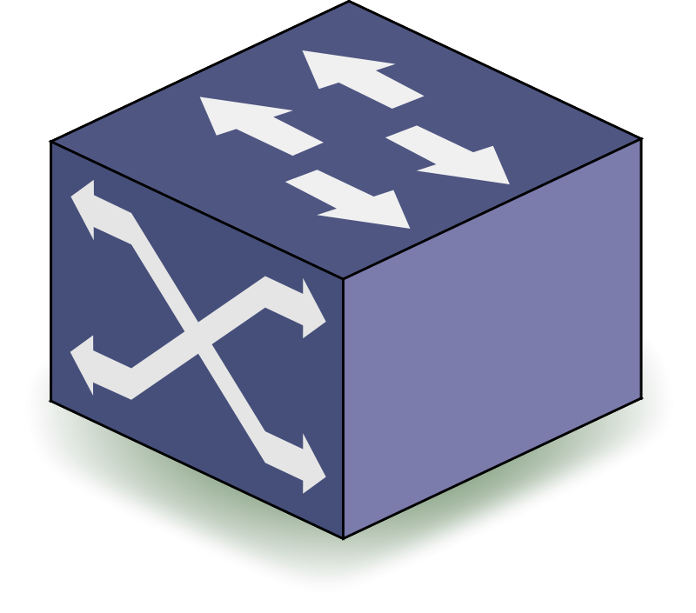
Autonomous Systems and Internet Exchange Points
AS9
AS6
AS7
AS8
AS1
AS2
AS3
AS4
AS5
IXP1
IXP2
Autonomous Systems (ASes): the networks that compose the Internet
Internet Exchange Points (IXPs): facilities at which many ASes simultaneously connect

Slide 45
Autonomous Systems and Internet Exchange Points
AS9
AS6
AS7
AS8
AS1
AS2
AS3
AS4
AS5
IXP1
IXP2
Autonomous Systems (ASes): the networks that compose the Internet
Internet Exchange Points (IXPs): facilities at which many ASes simultaneously connect

Slide 46
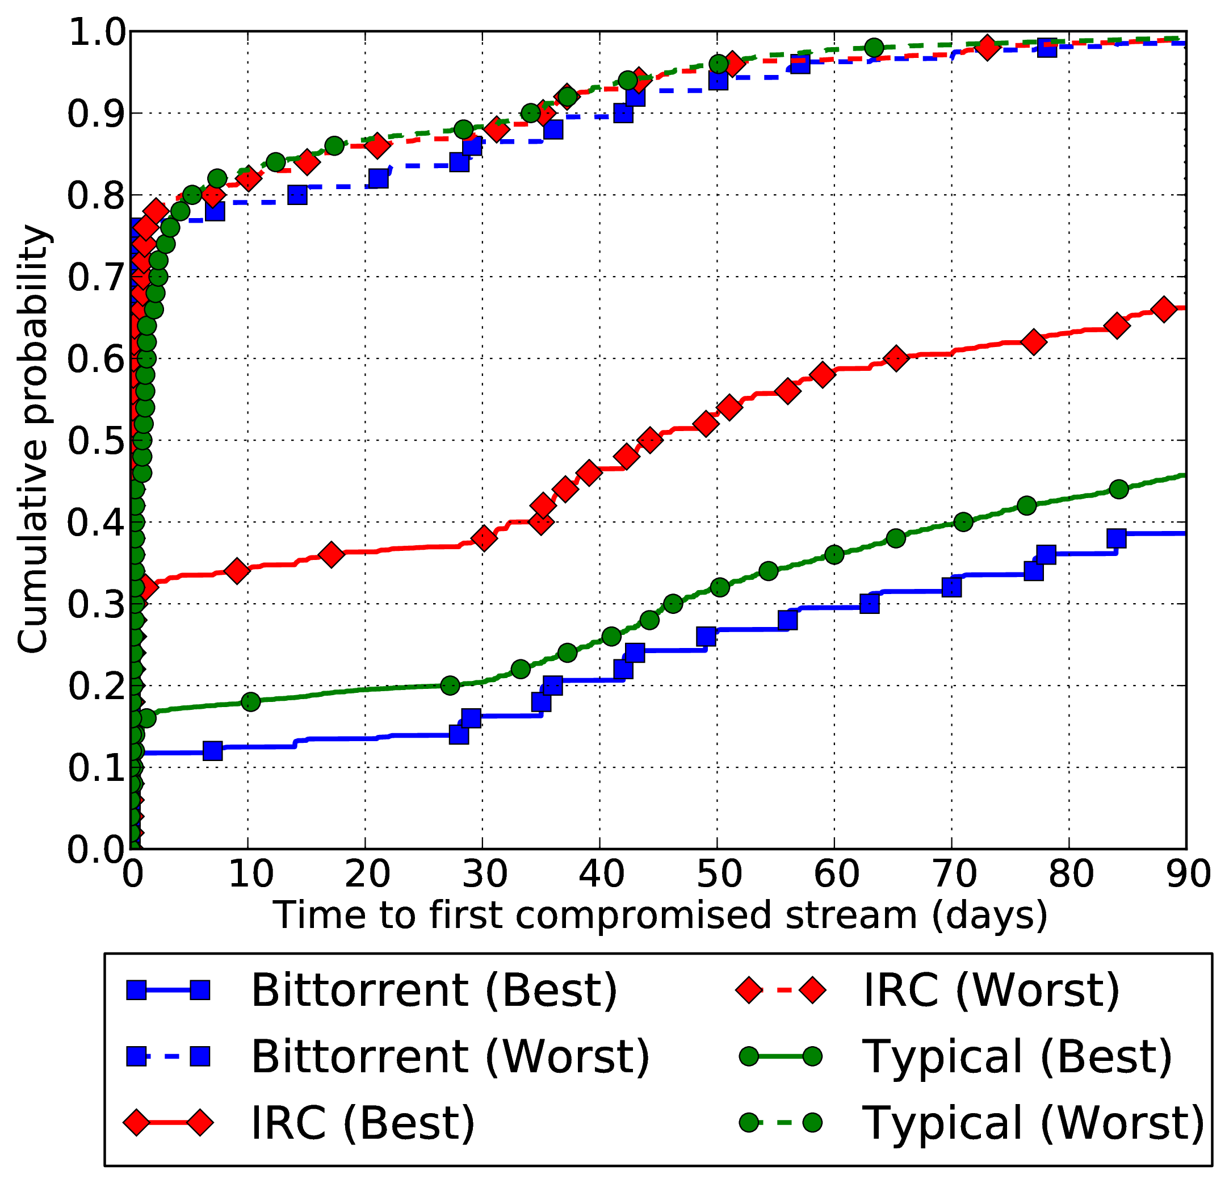
Node Adversary
Malicious guard/exit, 83.3/16.7 MiB/s
Time to compromised stream, 10/12 – 3/13
Malicious Autonomous System (worst AS for each of 5 client locations)
Time to first compromised stream, 10/12 – 1/13

Slide 47
Talk Overview
Background
Tor’s Big Problem
Attacks on Prior Approach
Solution 1: Use Trust
Solution 2: Cluster
Trust-Aware Path Selection
Future Work

Slide 48
Prior Approach to Prevent Traffic Correlation
Idea: Choose Tor circuits so that no single AS or IXP appears between client and guard and between exit and destination.

Slide 49
Prior Approach to Prevent Traffic Correlation
Idea: Choose Tor circuits so that no single AS or IXP appears between client and guard and between exit and destination.
N. Feamster and R. Dingledine, “Location diversity in anonymity networks,” in Workshop on Privacy in the Electronic Society, 2004.
M. Edman and P. Syverson, “AS-awareness in Tor path selection,” in ACM Conference on Computer and Communications Security, 2009.
M. Akhoondi, C. Yu, and H. V. Madhyastha, “LASTor: A low-latency AS-aware Tor client,” in IEEE Symposium on Security & Privacy, 2012.
R. Nithyanand, O. Starov, P. Gill, A. Zair, and M. Schapira, “Mea- suring and mitigating AS-level adversaries against Tor,” in Network & Distributed System Security Symposium, 2016.

Slide 50
Prior Approach to Prevent Traffic Correlation
Idea: Choose Tor circuits so that no single AS or IXP appears between client and guard and between exit and destination.
Problems:
Adversaries need not only observe at an AS or IXP
Client-specific path selection leaks information about client over multiple connections

Slide 51
Chosen-Destination Attack
Chosen-Destination Attack on Astoria*
Client makes initial connection to malicious website.
Client connects to sequence of malicious servers in other ASes to download resources linked in webpage.
Client eventually reveals guard(s) by choosing malicious middle relay.
Guard(s) and pattern of exits leaks client AS.
*R. Nithyanand, O. Starov, P. Gill, A. Zair, and M. Schapira, “Measuring and mitigating AS-level adversaries against Tor,” in Network & Distributed System Security Symposium, 2016.

Slide 52
Chosen-Destination Attack
5 popular Tor client ASes
Entropy over 400 popular Tor client ASes vs. number of random attack destination ASes
Attack can succeed in seconds

Slide 53
Cross-Circuit Attack
Cross-Circuit Attack on Astoria*
Client makes initial connection to honest website (1).
Client downloads linked resource from other server. Needs to use different guard for (2) than used for (1).
Malicious AS can perform correlation attack across circuits using known download pattern for website.
AS1
(1)
AS1
(2)
*R. Nithyanand, O. Starov, P. Gill, A. Zair, and M. Schapira, “Measuring and mitigating AS-level adversaries against Tor,” in Network & Distributed System Security Symposium, 2016.

Slide 54
Cross-Circuit Attack
Repeatedly simulated Astoria visits to Alexa top 5000 websites from top 400 Tor client Ases
Median frequency cross-circuit attack: 0.2
Median frequency of direct-circuit attack: 0.03

Slide 55
Talk Overview
Background
Tor’s Big Problem
Attacks on Prior Approach
Solution 1: Use Trust
Solution 2: Cluster
Trust-Aware Path Selection
Future Work

Slide 56
Network Trust as a Solution

Slide 57
Network Trust as a Solution
Untrusted

Slide 58
Network Trust as a Solution

Slide 59
Network Trust as a Solution
Trust = Probability distribution over adversary location
Tor relays
virtual links (clients-guard and destination-exit)

Slide 60
Trust Factors
Adversary at relay
Relay operator
Relay uptime
Relay location
Relay family
Adversary on links
Autonomous System (AS)
Internet Exchange (IXP)
AS/IXP organization
Undersea cable

Slide 61
Trust Ontology
Type
Attribute
System-generated
Legal Jurisdiction
Region
Budget
Compromise Effectiveness
Type
Attribute
User-provided
Output type
System-generated edge
Corporation
User-provided edge
AS Org.
Relay Software
Hosting Service
IXP Org.
Relay Hardware
Physical Location
AS
Connection Type
Router/Switch Kind
Relay Family
Relay Operator
IXP
Physical Connection
Router/Switch/etc.
Tor Relay
Virtual Link

Slide 62
Trust as Bayesian Belief Network
Gemeindewerke Telfs
GmbH
Comp. prob.: 0.1
Comp. effectiveness: 0.5
Compromise flows down from parents
Budget
Compromise effectiveness
AS24992
AS25294
AS35765
Comp. prob.: 0.1
Virtual Link
Bayesian Belief Network encodes distribution

Slide 63
Trust as Bayesian Belief Network
Gemeindewerke Telfs
GmbH
Comp. prob.: 0.1
Comp. effectiveness: 0.5
Compromise flows down from parents
Budget
Compromise effectiveness
AS24992
AS25294
AS35765
Comp. prob.: 0.1
Virtual Link
Bayesian Belief Network encodes distribution

Slide 64
Trust as Bayesian Belief Network
Gemeindewerke Telfs
GmbH
Comp. prob.: 0.1
Comp. effectiveness: 0.5
Compromise flows down from parents
Budget
Compromise effectiveness
AS24992
AS25294
AS35765
Comp. prob.: 0.1
Virtual Link
Bayesian Belief Network encodes distribution

Slide 65
Trust as Bayesian Belief Network
Gemeindewerke Telfs
GmbH
Comp. prob.: 0.1
Comp. effectiveness: 0.5
Compromise flows down from parents
Budget
Compromise effectiveness
AS24992
AS25294
AS35765
Comp. prob.: 0.1
Virtual Link
Bayesian Belief Network encodes distribution

Slide 66
Trust Sources
Default (provided by Tor)
Avoid compromise by any known entity (AS, IXP)
Trust relays with longer history in Tor
Trust known Tor community members
Trusted authorities (e.g. EFF, DOD)
Social networks

Slide 67
Talk Overview
Background
Tor’s Big Problem
Attacks on Prior Approach
Solution 1: Use Trust
Solution 2: Cluster
Trust-Aware Path Selection
Future Work

Slide 68
Clustering Locations
Locations are ASes (could also be IP prefixes)
Clustering locations limits information leakage by path selection
Cluster client and destination locations differently to best protect the most popular client locations to all destinations
Distance between locations is sum over guards/exits of expected weight of adversaries which appear on one virtual link but not the other
AS1
AS2

Slide 69
Clustering Locations
Locations are ASes (could also be IP prefixes)
Clustering locations limits information leakage by path selection
Cluster client and destination locations differently to best protect the most popular client locations to all destinations
Distance between locations is sum over guards/exits of expected weight of adversaries which appear on one virtual link but not the other
Disagree
AS1
AS2

Slide 70
Clustering Locations
Locations are ASes (could also be IP prefixes)
Clustering locations limits information leakage by path selection
Cluster client and destination locations differently to best protect the most popular client locations to all destinations
Distance between locations is sum over guards/exits of expected weight of adversaries which appear on one virtual link but not the other
AS1
Agree
AS2

Slide 71

Clustering Client Locations
Choose Client Representatives:(200) most popular client ASes

Slide 72
Clustering Destination Locations
Pick random destination AS.

Slide 73
Clustering Destination Locations
Pick random destination AS.
Repeatedly pick next destination AS with maximin distance to existing choices up to k (we use k=200)

Slide 74
Clustering Destination Locations
Pick random destination AS.
Repeatedly pick next destination AS with maximin distance to existing choices up to k (we use k=200)

Slide 75
Clustering Destination Locations
Pick random destination AS.
Repeatedly pick next destination AS with maximin distance to existing choices up to k (we use k=200)

Slide 76
Clustering Destination Locations
Pick random destination AS.
Repeatedly pick next destination AS with maximin distance to existing choices up to k (we use k=200)
k Ases are cluster representatives.

Slide 77
Clustering Clients and Destinations
k cluster representatives have been selected.

Slide 78
Clustering Clients and Destinations
k cluster representatives have been selected.
Repeatedly add to smallest cluster the AS closest to representative.

Slide 79
Clustering Clients and Destinations
k cluster representatives have been selected.
Repeatedly add to smallest cluster the AS closest to representative.

Slide 80
Clustering Clients and Destinations
k cluster representatives have been selected.
Repeatedly add to smallest cluster the AS closest to representative.

Slide 81
Clustering Clients and Destinations
k cluster representatives have been selected.
Repeatedly add to smallest cluster the AS closest to representative.

Slide 82
Clustering Clients and Destinations
k cluster representatives have been selected.
Repeatedly add to smallest cluster the AS closest to representative.
Repeat if representatives are not cluster centers.

Slide 83
Clustering Clients and Destinations
k cluster representatives have been selected.
Repeatedly add to smallest cluster the AS closest to representative.
Repeat if representatives are not cluster centers.

Slide 84
Talk Overview
Background
Tor’s Big Problem
Attacks on Prior Approach
Solution 1: Use Trust
Solution 2: Cluster
Trust-Aware Path Selection
Future Work

Slide 85
Trust-Aware Path Selection
Cluster representatives replace client and destination
Score guards.
Choose entry router with sufficiently high score.
For destination and guard, score exit routers.
Choose exit router with sufficiently high score.
Randomly choose middle.
Construct circuit.
0.99
0.2
0.99
0.1
0.8
0.99
0.8
0.8
0.1
0.1

Slide 86
Trust-Aware Path Selection
TrustAll
All users use TAPS
TrustOne variant
Used when most users use “vanilla” Tor instead of TAPS
Exits are chosen as in vanilla Tor to blend in (guards are chosen much less frequently).
Use higher security-score thresholds because load-balancing wont’ be as affected.

Slide 87
TAPS Experiments
TrustAll
Users engage in typical behavior (browse, search, chat, social net, etc.) to many locations (135 in our experiments)
TrustOne (Visit highly sensitive site while blending with most users)
User visits a single IRC chat server via Tor

Slide 88
TAPS Experiments
Pervasive adversary “The Man”
(Suggested Default)
Prob.(Each AS/IXP org. compromised) is 0.1
.02 ≤ Prob.(Each relay family compromised) ≤ .1 decreasing with uptime of relays
Example: Countries
Each of 249 countries an adversary
Each AS/IXP organization within adversary country is compromised with probability 1
Relays not compromised

Slide 89
TAPS Experiments: The Man
Time to first compromised connection from most popular AS (6128) over 7 days

Slide 90
TAPS Experiments: The Man
Fraction of compromised connections from most popular AS (6128) over 7 days

Slide 91
TAPS Experiments: Countries
Streams compromised by any country for typical usage over 7 days from most popular AS (6128)
(except from US where AS 6128 is).

Slide 92
TAPS Experiments: The Man
Time to last byte
320KiB file 5MiB file
Performance experiment simulated with Shadow

Slide 93
Talk Overview
Background
Tor’s Big Problem
Attacks on Prior Approach
Solution 1: Use Trust
Solution 2: Cluster
Trust-Aware Path Selection
Future Work

Slide 94
Past and Future Work
Future Work
DNS resolution
Improved path inference to inform trust
Network routing dynamics
Single onion service
References
Aaron Johnson, Chris Wacek, Rob Jansen, Micah Sherr, and Paul Syverson, “Users Get Routed: Traffic Correlation on Tor by Realistic Adversaries”, In Proceedings of the 20th ACM Conference on Computer and Communications Security (CCS 2013).
Aaron D. Jaggard, Aaron Johnson, Sarah Cortes, Paul Syverson, and Joan Feigenbaum, “20,000 In League Under the Sea: Anonymous Communication, Trust, MLATs, and Undersea Cables”, In Proceedings on Privacy Enhancing Technologies (PoPETS 2015), Vol. 2015, Number 1, April 2015.
Aaron Johnson, Rob Jansen, Aaron D. Jaggard, Joan Feigenbaum, and Paul Syverson, “Avoiding The Man on the Wire: Improving Tor's Security with Trust-Aware Path Selection”, To appear in Proceedings of the 24th Network and Distributed System Security Symposium (NDSS 2017).

