Slide 1
Improving the Security of the Tor Network Aaron Johnson
October 25th, 2019
Computer Science Colloquium, University of Iowa

Slide 2
Overview
Tor background
Tor attacks and defenses
Research challenges and opportunities

Slide 3
Tor background

Slide 4
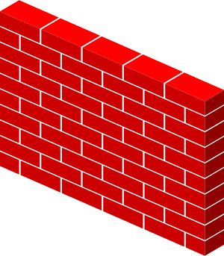
What is Tor?
Users
Destinations
Tor is a popular system for anonymous, censorship-resistant Internet communication.
Connection-oriented bidirectional communication
Makes arbitrary TCP connections
Standard SOCKS interface for applications
Major application: Tor Browser

Slide 5
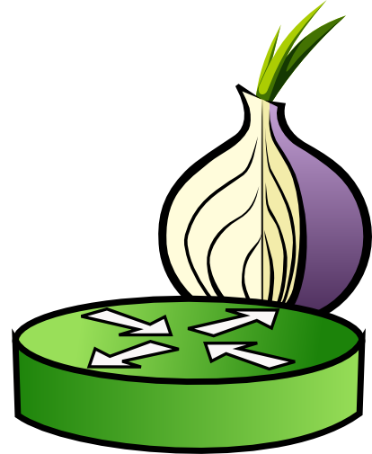
How does Tor work?
Unencrypted
Users
Relays
Destinations
Circuit
Stream
Key
Tor is based on onion routing.

Slide 6
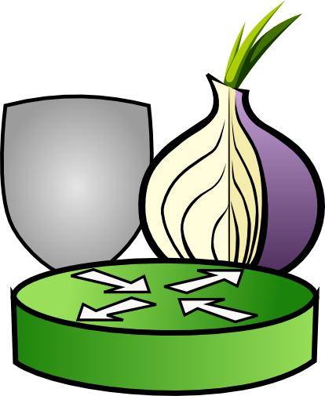
How does Tor work?
Guard
Users
Relays
Destinations
Circuit
Stream
Key
A client creates all circuits through the same guard.

Slide 7
How does Tor work?
Double-onion services
Users
Relays
Circuit
Stream
Key
Double-onion services hide server location.

Slide 8
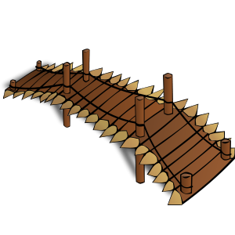
How does Tor work?
Obfuscated
Users
Relays
Destinations
Circuit
Stream
Key
Network block
Bridge
Tor bridges are private relays.
Bridges use obfuscated protocols.

Slide 9
Threat Model
Adversary is local and active.

Slide 10
Threat Model
Adversary is local and active.
Adversary may run relays

Slide 11
Threat Model
Adversary is local and active.
Adversary may run relays
Destination may be malicious

Slide 12
Threat Model
Adversary is local and active.
Adversary may run relays
Destination may be malicious
Adversary may observe some ISPs

Slide 13
Why use Tor?
Protect journalistic sources
Circumvent censorship
Investigate crimes undercover
Evade surveillance
Gather intelligence covertly
Report crimes (whistleblowing)

Slide 14
Who Uses Tor?
2–8 million daily users
~5,800 relays in 85 countries
~200 Gbps aggregate traffic

Slide 15
Who Uses Tor?
ProPublica
http://www.propub3r6espa33w.onion/
Facebook: https://facebookcorewwwi.onion/
New York Times:
https://nytimes3xbfgragh.onion/
Cloudflare DNS:
https://dns4torpnlfs2ifuz2s2yf3fc7rdmsbhm6rw75euj35pac6ap25zgqad.onion/
CIA:
http://ciadotgov4sjwlzihbbgxnqg3xiyrg7so2r2o3lt5wz5ypk4sxyjstad.onion/
BBC News:
http://bbcnewsv2vjtpsuy.onion/

Slide 16
Tor history
1996: D. Goldschlag, M. Reed, and P. Syverson. “Hiding Routing Information”. Information Hiding Workshop.
1998: 13-node prototype at NRL, NRAD, and UMD.
2003: Tor network is deployed (12 US nodes, 1 German). R. Dingledine and N. Mathewson open-source code.
2004: R. Dingledine, N. Mathewson, and P. Syverson. “Tor: The Second-Generation Onion Router”. USENIX Security.
2006: The Tor Project, Inc. incorporated as a non-profit.
2008: Tor Browser 1.0
2010: Pluggable transports designed
2012: Open Observatory for Network Interference launched
2015: Single-onion services created
2019: Tor Browser for Android

Slide 17
Tor Today
Funding levels at $2.8 million in 2017
21 employees in 2017
Current funders
Mozilla
Open Technology Fund (US Government)
DARPA (US Government)
Swedish International Development Cooperation Agency
Media Democracy Fund
The Handshake Foundation
Fastly
US State Department (US Government)
Institute of Museum and Library Services
Team Cymru
Google Season of Docs
Craig Newmark Philanthropies
Digital Impact Alliance

Slide 18
Tor attacks and defenses

Slide 19
Network attacks on Tor
Passive traffic observation
Correlation attack
Website fingerprinting
Active traffic gathering
BGP hijack (RAPTOR)
Selective denial of service
Speed-measurement manipulation
Targeted compromise
Active traffic manipulation
Congestion attack
Flow watermarking
Latency attack
Throughput fingerprinting

Slide 20
Correlation attack
Possible when:
Adversary controls first and last relays, or
Adversary observes entry and exit ISPs

Slide 21
Correlation attack
Possible when:
Adversary controls first and last relays, or
Adversary observes entry and exit ISPs

Slide 22
Correlation attack
Possible when:
Adversary controls first and last relays, or
Adversary observes entry and exit ISPs

Slide 23
Correlation attack
Possible when:
Adversary controls first and last relays, or
Adversary observes entry and exit ISPs

Slide 24
Website fingerprinting attack
Possible when:
Adversary controls first relay, or
Adversary observes entry ISP

Slide 25
Website fingerprinting attack
Possible when:
Adversary controls first relay, or
Adversary observes entry ISP

Slide 26
Website fingerprinting attack
Possible when:
Adversary controls first relay, or
Adversary observes entry ISP

Slide 27
Website fingerprinting attack
Possible when:
Adversary controls first relay, or
Adversary observes entry ISP

Slide 28
Website fingerprinting attack
I recognize that traffic pattern
Possible when:
Adversary controls first relay, or
Adversary observes entry ISP

Slide 29
BGP hijack (RAPTOR)
Autonomous System (AS)
AS9
AS link
AS6
AS7
AS8
AS1
AS2
AS3
AS4
AS5
Virtual overlay link
MAPIT Project | 29

Slide 30
BGP hijack (RAPTOR)
Autonomous System (AS)
AS9
I connect to AS5.
AS link
AS6
AS7
AS8
AS1
AS2
AS3
AS4
AS5
Virtual overlay link
MAPIT Project | 30

Slide 31
BGP hijack (RAPTOR)
Autonomous System (AS)
AS9
AS link
AS6
AS7
AS8
AS1
AS2
AS3
AS4
AS5
Virtual overlay link
AS7 uses BGP hijack to deanonymize the connection.
MAPIT Project | 31

Slide 32
Path-selection defenses for Tor
Popular idea: choose Tor paths to avoid adversaries
N. Feamster and R. Dingledine, “Location diversity in anonymity networks,” in WPES 2004.
M. Edman and P. Syverson, “AS-awareness in Tor path selection,” in ACM CCS 2009.
M. Akhoondi, C. Yu, and H. V. Madhyastha, “LASTor: A low-latency AS-aware Tor client,” in IEEE S&P 2012.
R. Nithyanand, O. Starov, P. Gill, A. Zair, and M. Schapira, “Measuring and mitigating AS-level adversaries against Tor,” in NDSS 2016.
A. Barton and M. Wright, “DeNASA: Destination-naive as-awareness in anonymous communications,” in PETS 2016.
A. Johnson, R. Jansen, A. Jaggard, J. Feigenbaum, and P. Syverson, “Avoiding the man on the wire: Improving Tor's security with trust-aware path selection”, In NDSS 2017.
Y. Sun, A. Edmundson, N. Feamster, M. Chiang, and P. Mittal, “Counter-RAPTOR: Safeguarding Tor against active routing attacks,” In IEEE S&P 2017.
F. Rochet and O. Pereira, “Waterfilling: Balancing the Tor network with maximum diversity,” in PETS 2017.
Z. Li, S. Herwig, and D. Levin, “Detor: Provably avoiding geographic regions in Tor,” USENIX Security 2017.

Slide 33
Path-selection defenses for Tor
Popular idea: choose Tor paths to avoid adversaries
N. Feamster and R. Dingledine, “Location diversity in anonymity networks,” in WPES 2004.
M. Edman and P. Syverson, “AS-awareness in Tor path selection,” in ACM CCS 2009.
M. Akhoondi, C. Yu, and H. V. Madhyastha, “LASTor: A low-latency AS-aware Tor client,” in IEEE S&P 2012.
R. Nithyanand, O. Starov, P. Gill, A. Zair, and M. Schapira, “Measuring and mitigating AS-level adversaries against Tor,” in NDSS 2016.
A. Barton and M. Wright, “DeNASA: Destination-naive as-awareness in anonymous communications,” in PETS 2016.
A. Johnson, R. Jansen, A. Jaggard, J. Feigenbaum, and P. Syverson, “Avoiding the man on the wire: Improving Tor's security with trust-aware path selection”, In NDSS 2017.
Y. Sun, A. Edmundson, N. Feamster, M. Chiang, and P. Mittal, “Counter-RAPTOR: Safeguarding Tor against active routing attacks,” In IEEE S&P 2017.
F. Rochet and O. Pereira, “Waterfilling: Balancing the Tor network with maximum diversity,” in PETS 2017.
Z. Li, S. Herwig, and D. Levin, “Detor: Provably avoiding geographic regions in Tor,” USENIX Security 2017.

Slide 34
DeNASA: Destination-Naïve AS Awareness
DeNASA: g-select algorithm
Identify Suspect ASes frequently capable of correlation attacks
AS3356
AS1299
Do not choose guard g if a Suspect AS exists between client and g

Slide 35
DeNASA
❌
$$\operatorname{Pr}\left(g_{1}\right)=\frac{1}{4}$$
$$\operatorname{Pr}\left(g_{1}\right)=0$$
AS3356
$$g_{1}$$
✅
$$\operatorname{Pr}\left(g_{2}\right)=\frac{1}{4}$$
$$\operatorname{Pr}\left(g_{2}\right)=\frac{1}{3}$$
AS48
Suspect-Free
$$g_{2}$$
Suspect-Free
✅
$$\operatorname{Pr}\left(g_{3}\right)=\frac{1}{2}$$
$$\operatorname{Pr}\left(g_{3}\right)=\frac{2}{3}$$
$$g_{3}$$

Slide 36
Research challenges and opportunities

Slide 37
Challenges to path-selection defenses
Information leakage increases over time
Multiple path-selection criteria
Multiple adversary types (e.g. relays, ASes)
Multiple security goals (e.g. anonymity, unlinkability)
Performance (e.g. load balancing)

Slide 38
Challenges to path-selection defenses
Information leakage increases over time
Multiple path-selection criteria
Multiple adversary types (e.g. relays, ASes)
Multiple security goals (e.g. anonymity, unlinkability)
Performance (e.g. load balancing)

Slide 39
DeNASA leaks information
❌
❌
$$\operatorname{Pr}\left(g_{1}\right)=0$$
AS3356
$$g_{1}$$
AS1299
✅
❌
AS3356
$$\operatorname{Pr}\left(g_{2}\right)=0$$
AS48
Suspect-Free
AS88
$$g_{2}$$
Suspect-Free
✅
✅
Suspect-Free
$$\operatorname{Pr}\left(g_{3} \right|\text{AS}48)=\frac{2}{3}$$
$$\operatorname{Pr}\left(g_{3}\right)=1$$
$$\operatorname{Pr}\left(g_{3} \right|\text{AS}88)=1$$
$$g_{3}$$

Slide 40
DeNASA leaks information
$$\operatorname{Pr}\left(g_{3} \right| \text{AS}48)=2/3$$
$$\operatorname{Pr}\left(g_{3} \right|\text{AS}88)=1$$
$$\text{Pr}\text{(}\text{AS}48 \left|{ g}_{3}\right)=\sim 40\%$$
$$\text{Pr}\text{(}\text{AS}88 \left|{ g}_{3}\right)=\sim 60\%$$
Leak can worsen over time!
$$\text{Pr}\text{(}\text{AS}48 | G_{1}∧G_{2}∧…∧G_{N})≪\text{Pr}\text{(}\text{AS}88 | G_{1}∧G_{2}∧…∧G_{N})$$

Slide 41
DeNASA attack
How might an adversary learn a user’s guards
and perform this attack?

Slide 42
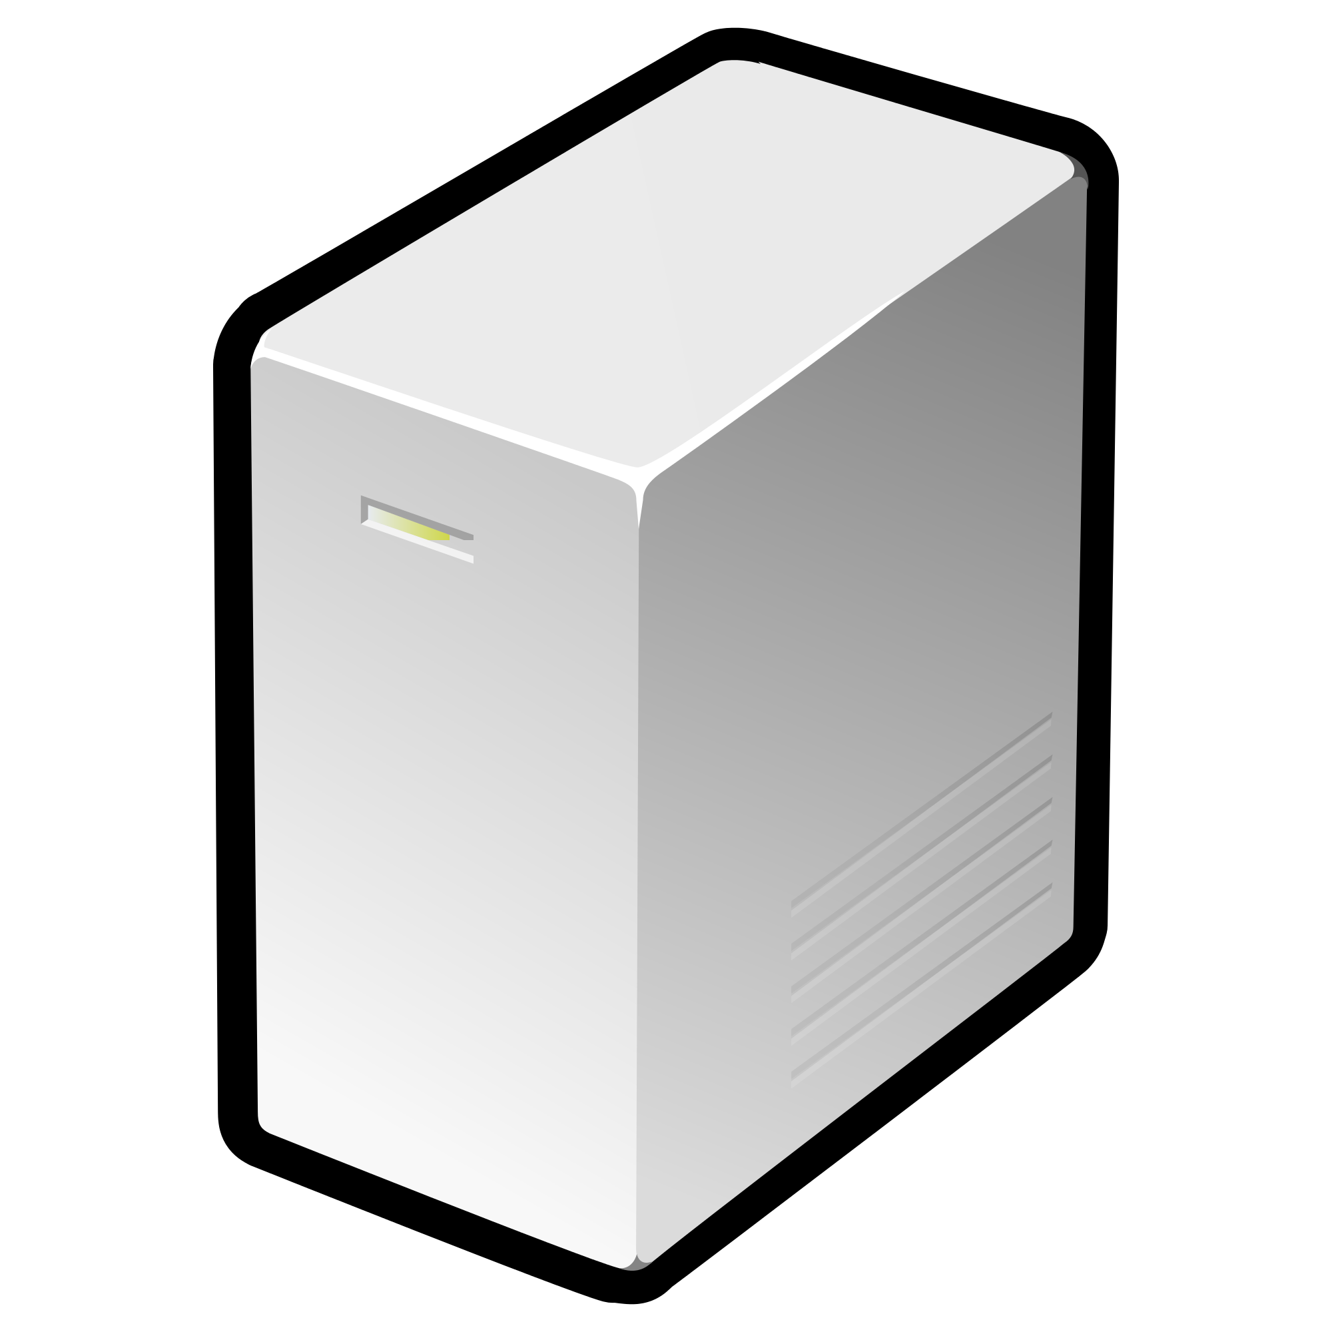
DeNASA attack
$$m_{1}$$
$$g_{1}$$
$$e_{1}$$
$$m_{2}$$
<batman>
$$g_{2}$$
AS ???
Web Forum
$$m_{3}$$
$$g_{3}$$
$$e_{2}$$
$$m_{4}$$

Slide 43
DeNASA attack
$$m_{1}$$
$$g_{1}$$
$$e_{1}$$
$$m_{2}$$
<batman>
$$g_{2}$$
AS ???
Web Forum
$$m_{3}$$
$$g_{3}$$
$$e_{2}$$
$$m_{4}$$

Slide 44
DeNASA attack
Day 1
$$m_{1}$$
$$g_{1}$$
$$e_{1}$$
$$m_{2}$$
<batman>
$$g_{2}$$
AS ???
Web Forum
$$m_{3}$$
$$g_{3}$$
$$e_{2}$$
$$m_{4}$$

Slide 45
DeNASA attack
Day 2
$$m_{1}$$
$$g_{1}$$
$$e_{1}$$
$$m_{2}$$
<batman>
$$g_{2}$$
AS ???
Web Forum
$$m_{3}$$
$$g_{3}$$
$$e_{2}$$
$$m_{4}$$

Slide 46
DeNASA attack
Day 3
The pseudonymous client is using $g_{1}!$
$$m_{1}$$
$$g_{1}$$
$$e_{1}$$
$$m_{2}$$
<batman>
$$g_{2}$$
AS ???
Web Forum
$$m_{3}$$
$$g_{3}$$
$$e_{2}$$
$$m_{4}$$

Slide 47
DeNASA attack
Day 4
$$m_{1}$$
$$g_{1}$$
$$e_{1}$$
$$m_{2}$$
<batman>
$$g_{2}$$
AS ???
Web Forum
$$m_{3}$$
$$g_{3}$$
$$e_{2}$$
$$m_{4}$$

Slide 48
DeNASA attack
Day 5
$$m_{1}$$
$$e_{1}$$
$$m_{2}$$
<batman>
$$g_{2}$$
AS ???
Web Forum
$$m_{3}$$
$$g_{3}$$
$$e_{2}$$
$$m_{4}$$

Slide 49
DeNASA attack
Day 6
The pseudonymous client is now using $g_{3}!$
$$m_{1}$$
$$e_{1}$$
$$m_{2}$$
<batman>
$$g_{2}$$
AS ???
Web Forum
$$m_{3}$$
$$g_{3}$$
$$e_{2}$$
$$m_{4}$$

Slide 50
DeNASA attack
The adversary then computes posterior distribution:
$$\text{Pr}\text{(}{AS}_{1} | g_{1}∧g_{3})$$
$$\text{Pr}\text{(}{AS}_{2} | g_{1}∧g_{3})$$
$$…$$
$$\text{Pr}\text{(}{AS}_{n} | g_{1}∧g_{3})$$

Slide 51
DeNASA attack
Experimental Methodology
Simulate clients from four vulnerable client ASes
Run 100 simulations per client AS
Assume adversary makes up to six guard observations
Measure client’s anonymity after observations using posterior entropy
Assume uniform prior
$$−\sum_{i=1}^{n}{Pr⁡({AS}_{i}}| g_{1}∧ … ∧g_{k})∙\log_{2}{\operatorname{Pr}\left({AS}_{i} \right|g_{1}∧ … ∧g_{k})}$$

Slide 52
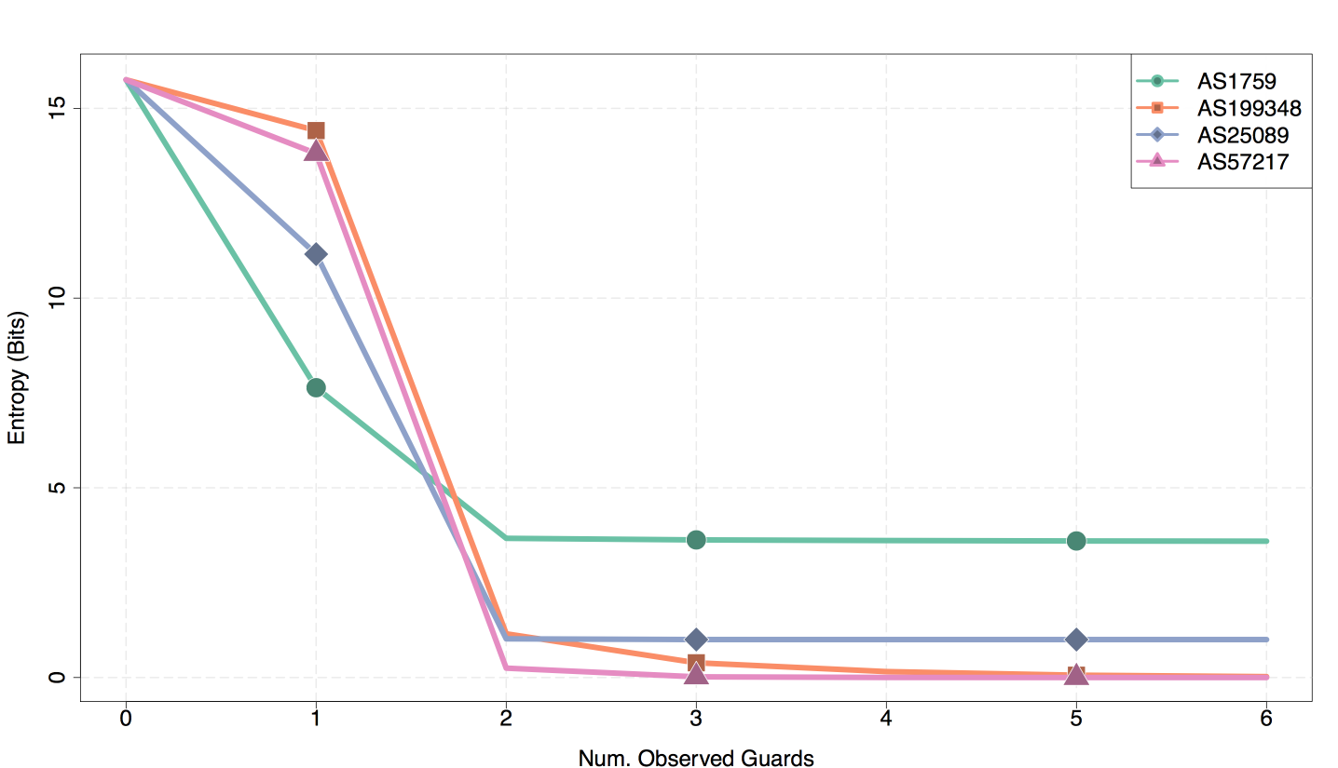
DeNASA attack

Slide 53
Challenges to path-selection defenses
Information leakage increases over time
Multiple path-selection criteria
Multiple adversary types (e.g. relays, ASes)
Multiple security goals (e.g. anonymity, unlinkability)
Performance (e.g. load balancing)

Slide 54
Guard Placement Attack
Several proposed systems are vulnerable to malicious guard placement.

Slide 55
Guard Placement Attack
Several proposed systems are vulnerable to malicious guard placement.
Example: Place guard near client, reducing transit ASes and vulnerability to BGP hijack.

Slide 56
Guard Placement Attack
$$σ\left(A,C,s\right)={\frac{1}{|C|}\sum_{c∈C}{p_{A}(c,s)}}$$
Client location c, Attack strategy s
s is location-bandwidth pairs of malicious guards

Slide 57
Guard Placement Attack
$$σ\left(A,C,s\right)={\frac{1}{|C|}\sum_{c∈C}{p_{A}(c,s)}}$$
Probability that c selects a malicious guard using algorithm A

Slide 58
Guard Placement Attack
$$σ\left(A,C,s\right)={\frac{1}{|C|}\sum_{c∈C}{p_{A}(c,s)}}$$
Average success probability over all attacked client locations C

Slide 59
Guard Placement Attack
$$σ\left(A,C,s\right)={\frac{1}{|C|}\sum_{c∈C}{p_{A}(c,s)}}$$
Attack success metric

Slide 60
Guard Placement Attack
$$\max_{s∈S}{σ\left(A,C,s\right)}$$
Attack goal is to maximize average success probability

Slide 61
Guard Placement Attack
Number of Guards | Avg Success Probability (%) | Max Success Probability (%)
1 | 0.522 | 4.896
2 | 0.555 | 54.16
5 | 0.535 | 58.64
10 | 0.544 | 62.32
20 | 0.531 | 62.32
Vanilla Tor | 0.216 | 0.216
Untargeted attack on DeNASA using 40,000 total weight (0.216% of guard weight), varying the number of guards

Slide 62
Research opportunities
Information leakage increases over time
Different privacy applied to guard selection can limit the rate of leakage (Hanley et al.).
Can we limit total leakage?
Multiple path-selection criteria
Limit selection of a guard relative to its size/cost (Wan et al.).
How can we integrate solutions designed for different criteria?

Slide 63
References
Yixin Sun, Anne Edmundson, Laurent Vanbever, Oscar Li, Jennifer Rexford, Mung Chiang, and Prateek Mittal. “RAPTOR: Routing Attacks on Privacy in Tor”. In USENIX Security 2015.
Armon Barton and Matt Wright. “DeNASA: Destination-naive as-awareness in anonymous communications”. In Proceedings on Privacy Enhancing Technologies (PoPETs 2016).
Ryan Wails, Yixin Sun, Aaron Johnson, Mung Chiang, and Prateek Mittal. “Tempest: Temporal Dynamics in Anonymity Systems”. In Proceedings on Privacy Enhancing Technologies (PoPETs 2018).
Gerry Wan, Aaron Johnson, Ryan Wails, Sameer Wagh, and Prateek Mittal. “Guard Placement Attacks on Path Selection Algorithms for Tor”. In Proceedings on Privacy Enhancing Technologies (PoPETs 2019).
Hans Hanley, Yixin Sun, Sameer Wagh, and Prateek Mittal. "DPSelect: A Differential Privacy Based Guard Relay Selection Algorithm for Tor." Proceedings on Privacy Enhancing Technologies (PoPETs 2019).

