Slide 1
Stormy: Statistics in Tor by Measuring Securely Ryan Wails (U.S. Naval Research Lab) Aaron Johnson (U.S. Naval Research Lab) Daniel Starin (Perspecta Labs) Arkady Yerukhimovich (George Washington U.) S. Dov Gordon (George Mason University)
November 8th, 2019
CICS Seminar, University of Massachusetts Amherst

Slide 2
Overview
Tor background
Measuring Tor
Stormy overview
Stormy details
Results
Conclusions

Slide 3
Tor background

Slide 4
What is Tor?
Users
Destinations
Tor is a popular system for anonymous, censorship-resistant Internet communication.
Connection-oriented bidirectional communication
Makes arbitrary TCP connections
Standard SOCKS interface for applications
Major application: Tor Browser

Slide 5
How does Tor work?
Unencrypted
Users
Relays
Destinations
Circuit
Stream
Key
Tor is based on onion routing.

Slide 6
How does Tor work?
Double-onion services
Users
Relays
Circuit
Stream
Key
Double-onion services hide server location.

Slide 7
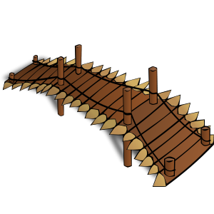
How does Tor work?
Obfuscated
Users
Relays
Destinations
Circuit
Stream
Key
Network block
Bridge
Tor bridges are private relays.
Bridges use obfuscated protocols.

Slide 8
Why use Tor?
Protect journalistic sources
Circumvent censorship
Investigate crimes undercover
Evade surveillance
Gather intelligence covertly
Report crimes (whistleblowing)

Slide 9
Who Uses Tor?
2–8 million daily users
~5,800 relays in 85 countries
~200 Gbps aggregate traffic

Slide 10
Measuring Tor

Slide 11
Tor Measurement
Measuring Tor benefits users
Determine anonymity set size (e.g. how many users)
Identify performance problems (e.g. common failures)
Inform policymakers (e.g. what is Tor used for)
Monitor for misuse (e.g. SSH brute-force over Tor)

Slide 12
Tor Measurement
Measuring Tor risks privacy
Deanonymizing individual connections
Storing sensitive data at relays risks leaks from compromise
Revealing “interesting” users (e.g. from censored locations)
Revealing private onion services

Slide 13
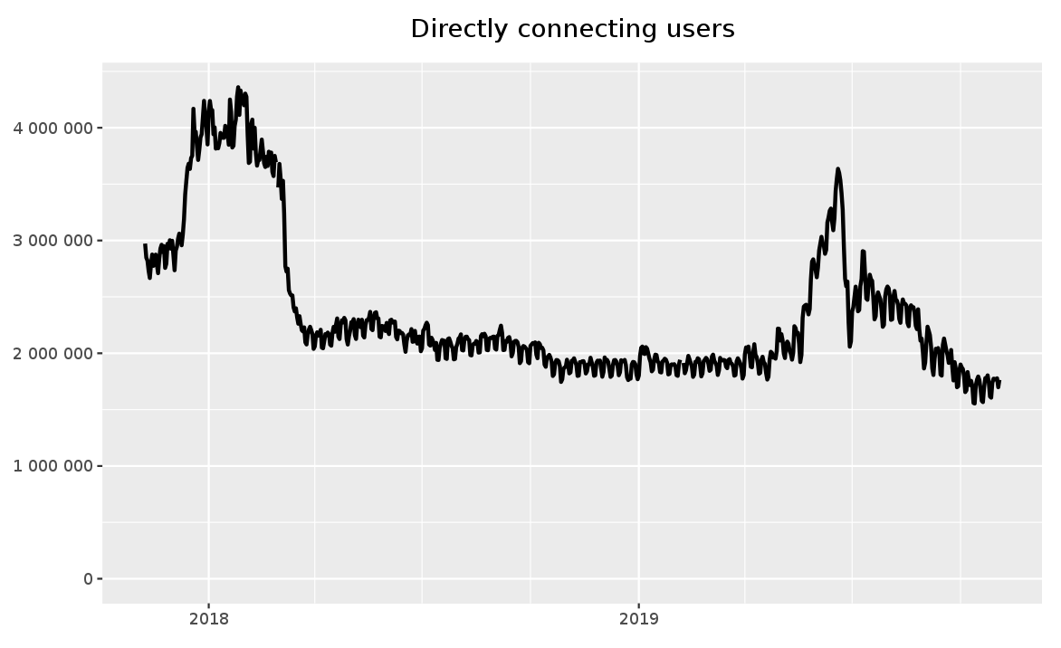
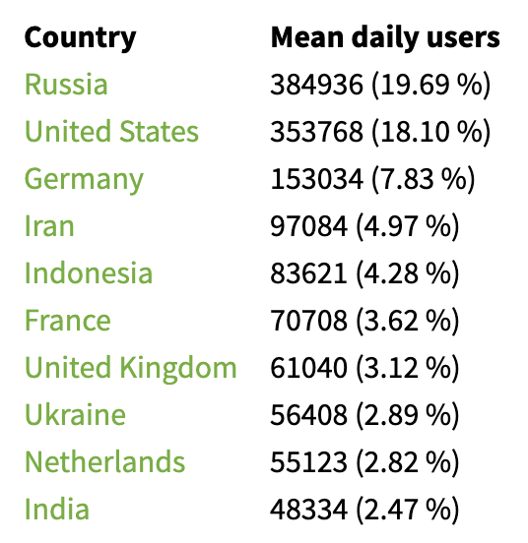
Tor Measurement
Current Tor statistics are gathered by relays.
https://metrics.torproject.org/
Examples:
Number of daily users
Top 10 countries by users

Slide 14
Tor Measurement
Current methods for private statistics | Limitations
Per-relay rounded statistics | Poor privacy
Per-relay noisy statistics (local differential privacy) | Excess noise
Secure addition (PrivCount, CCS’16) | Not robust to malicious inputs, Linear computations only
Input validation (Prio, NSDI’17) | Requires a priori knowledge of reasonable inputs
Shuffle-based counting (HisTorε, NDSS’17; PSC, CCS’17) | Inefficient Limited to counts

Slide 15
Tor Measurement
Current methods for private statistics | Limitations
Per-relay rounded statistics | Poor privacy
Per-relay noisy statistics (local differential privacy) | Excess noise
Secure addition (PrivCount, CCS’16) | Not robust to malicious inputs, Linear computations only
Input validation (Prio, NSDI’17) | Requires a priori knowledge of reasonable inputs
Shuffle-based counting (HisTorε, NDSS’17; PSC, CCS’17) | Inefficient Limited to counts
Use Secure Multiparty Computation (MPC)!

Slide 16
MPC for measurement
x₁
MPC
x₂
f(x₁, x₂, x₃)
x₃
Secure Multiparty Computation (MPC)
Compute any function f
Only reveal output (e.g. f(x₁, x₂, x₃))
Privacy and correctness in presence of adversary

Slide 17
MPC for measurement
Challenges to MPC in Tor
Fault tolerance: relays go offline
Efficiency: Bandwidth and computation are limited
Scalable: Cope with network growth
Trust assumptions
Directory Authorities: majority honest
Tor bandwidth: adversary has small fraction

Slide 18
Stormy overview

Slide 19
Stormy Overview
Statistics in Tor by Measuring Securely
Tor relays use MPC to compute any function
Secure, efficient, fault-tolerant
Uses Tor’s existing trust assumptions
Developed new input protocol
Identified two useful computations
Median
Count distinct
Implemented and evaluated the system

Slide 20
Stormy Overview
Stormy

Slide 21
Stormy Overview
Stormy
x₁
x₂
x₃
Relays make observations.

Slide 22
Stormy Overview
Stormy
x₁
x₂
f₂(x₁, x₂, x₃)
x₃
f₁(x₁, x₂, x₃)
Relays make observations.
Statistics are computed from observations.

Slide 23
Stormy Overview
Stormy
x₁
x₂
f₂(x₁, x₂, x₃)
x₃
f₁(x₁, x₂, x₃)
Relays make observations.
Statistics are computed from observations.
Process repeats each epoch.

Slide 24
Stormy Deployment Models
Authority Model
Authorities run MPC (~5)
Need one honest
High reliability machines
High bandwidth (~1 Gbps)
Relay Model
Relays run MPC (~7000)
Most bandwidth honest (75%)
Relays may go offline
Relay bandwidth (25%)

Slide 25
Stormy MPC Protocols
MPC protocol properties
Binary circuits
Multiparty
Preprocessing model
Offline phase: need circuit size, compute “offline material”
Online phase: need circuit and inputs, compute function
Security properties
Abort without agreement
Dishonest majority
Malicious security

Slide 26
Stormy Composition: Authority Model
x₁
x₂
x₃
Authority Model
Authorities do offline and online computations
Any abort causes all epoch’s computations to abort

Slide 27
Stormy Composition: Relay Model
Offline material
Inputs
Outputs
Relay Model
Each epoch, many committees are sampled
Committees generate offline material in parallel
One committee gets inputs and raw material, produces outputs
New committees are activated when relays fail

Slide 28
MPC for measurement
Challenges to MPC in Tor
Fault tolerance: relays go offline
Select extra committees to keep in reserve
Non-interactive input protocol
Efficiency: Bandwidth and computation are limited
Use small committees to minimize cost
Scalable: Cope with network growth
Relay Model uses bandwidth of entire network
Trust assumptions
Authority Model requires a single honest party
Relay Model requires an honest fraction of bandwidth

Slide 29
Stormy details

Slide 30
Stormy MPC Protocols
MPC with MACs (e.g. SDPZ, TinyOT)
𝜎: Statistical security parameter (40)
𝜅: Computational security parameter (256)
𝛥$∈𝔽$₂𝜎: Global MAC key
[x]: additive secret-sharing of x among committee
⟦x⟧: ([x], [𝛥x])
n parties performing computation
MPC protocols
Offline
$ΠRand$: Outputs ⟦r⟧ for r $\text{←} 𝔽$₂
$ΠTriples$: Outputs ⟦a⟧,⟦b⟧,⟦c⟧ for a,b ← $𝔽$₂ , ab = c
Online
$ΠInpu\text{t}\text{: }\text{Takes} \text{x}\text{i} \text{from} \text{input} \text{party}\text{, }\text{outputs}\text{ ⟦}\text{x}\text{i}\text{⟧}$
$ΠOnline\text{: }\text{Evaluates} \text{function} \text{on} \text{inputs}$
[WRK17]*
Novel
[BLN+15]
*Slight modification needed for security in Relay Model.

Slide 31
Stormy offline Protocols
WRK [Wang, Ranellucci, Katz; CCS 2017]
$Π$_{Rand}: Authenticated random bit
$Π$_{Triples}: Authenticated AND triple
Outputs ⟦r⟧ for r $\text{←} 𝔽$₂
One random authenticated bit needed per input bit
Cheap computation via OT extension
Communication main cost: 2(n−1)$σ$ bits sent per party (e.g. 240 bytes)
Outputs ⟦a⟧,⟦b⟧,⟦c⟧ for a,b ← $𝔽$₂ , ab = c
One authenticated AND triple needed per AND gate
Cheap computation via OT extension
Communication main cost: 5(n−1)$\left(σ+κ\right)$ bits sent per party (e.g. 4,440 bytes)

Slide 32
Stormy online Protocols
TinyOT [Burra et al.; 2015/472]
Stormy
$Π$_{Input}: Authenticate inputs
$Π$_{Online}: Compute function
$\text{Takes} \text{x}\text{i} \text{from} \text{input} \text{party}\text{, }\text{outputs}\text{ ⟦}\text{x}\text{i}\text{⟧}$
Cheap computation by using offline material
Communication cost for input party ~2n bits sent per party per input bit
$\text{Evaluates} \text{function} \text{on} \text{inputs} \text{x}$
Computes XOR and AND
Uses rounds equal to AND depth
Cheap computation by using offline material
Low communication cost: ~2 bits sent per party per AND gate

Slide 33
Stormy input sharing
TinyOT input sharing
Input party P_{in} chooses r_{i} $\text{←} 𝔽$₂
P_{in} and committee C generate ⟦r_{i}⟧
P_{in} with input x_{i} broadcasts 𝛿 = x_{i}+r_{i} to C
C locally computes ⟦x_{i}⟧ = ⟦r_{i}⟧+ 𝛿
Problems
P_{in} isn’t part of online computation in Stormy
P_{in} may be able to cause an abort
P_{in} must perform interactive protocol
P_{in} may go offline, should exclude input only in that case

Slide 34
Stormy input sharing
$$ΠInpu\text{t}$$
Committee C generates ⟦r_{i}⟧.
Input party P_{in} chooses blinding values s_{i} $\text{←} 𝔽$₂.
P_{in} creates checksum y = Σ_{i}𝜒_{i}s_{i}, 𝜒_{i} $\text{←} 𝔽$₂𝜎.
P_{in} sends [s_{i}], [s_{i}+x_{i}], [𝜒_{i}], and y to C.
C computes ⟦s_{i}⟧ from ⟦r_{i}⟧ and [s_{i}].
C opens 𝜒_{i} and uses y to perform a MAC check on ⟦s_{i}⟧.
On failure, open [s_{i}], blame P_{in} or C.
Else, open 𝛿_{i} = [s_{i}+x_{i}] to locally compute ⟦x_{i}⟧ = ⟦s_{i}⟧+ 𝛿_{i}.
Properties
Non-interactive
Little communication from input parties
Can exclude inputs of failed relays (must use “accountable messaging” protocol)
Relays sending inputs can’t cause computation to abort

Slide 35
Stormy: Relay Model
Complete protocol:
Relays agree on participants and random string
Relays organize themselves into triple and computation committees
Committees produce offline material
Relays share input with computation committee
Computation committee computes output
Relay failures cause activation of inactive committees

Slide 36
Relay Model Randomness Generation
Complete protocol:
Relays agree on participants and random string
Relays organize themselves into triple and computation committees
Committees produce offline material
Relays share input with computation committee
Computation committee computes output
Relay failures cause activation of inactive committees

Slide 37
Relay Model Randomness Generation
1 Gbps
250 Mbps
50 Mbps
1 Gbps
500 Mbps
100 Mbps
Identity, address of each relay
Bandwidth of each relay
Random string $r=0100110101001...$
Directory Authority
Consensus Doc

Slide 38
Relay Model Committee Election
Complete protocol:
Relays agree on participants and random string
Relays organize themselves into triple and computation committees
Committees produce offline material
Relays share input with computation committee
Computation committee computes output
Relay failures cause activation of inactive committees

Slide 39
Relay Model Committee Election
1 Gbps
250 Mbps
50 Mbps
1 Gbps
500 Mbps
100 Mbps
$$34\%$$
$$34\%$$
$$17\%$$
$$9\%$$
$$3\%$$
$$2\%$$
Parties chosen (with replacement) according to bandwidth
For $n$ parties, assuming p honest fraction, failure probability is $(1−p)^{n}$

Slide 40
Relay Model Committee Election
Computation Committee
Triple Committee
Triple Committee
Triple Committee
Triple Committee
Parties chosen (with replacement) according to bandwidth
For $n$ parties, assuming p honest fraction, failure probability is $(1−p)^{n}$
For 1,008 committees and p=0.75, n=$25$ suffices for honest party in all committees with probability > 1-2⁻⁴⁰

Slide 41
Relay Model Offline Generation
Complete protocol:
Relays agree on participants and random string
Relays organize themselves into triple and computation committees
Committees produce offline material
Relays share input with computation committee
Computation committee computes output
Relay failures cause activation of inactive committees

Slide 42
Relay Model Triple Generation
Computation Committee
$Π$_{Rand}
$$\text{⟦}\text{r}\text{1}\text{⟧}$$
$$\text{⟦}\text{r}\text{2}\text{⟧}$$
$$…$$
$$\text{⟦}\text{r}\text{b}\text{⟧}$$
Computation committee produces random bits offline.

Slide 43
Relay Model Triple Generation
Computation Committee
Triple Committee
$Π$_{Triples}
Transfer
$$\text{⟦}\text{a}\text{1}\text{⟧},\text{⟦}\text{b}\text{1}\text{⟧},\text{⟦}\text{c}\text{1}\text{⟧}$$
$$\text{⟦}\text{a}\text{1}\text{⟧},\text{⟦}\text{b}\text{1}\text{⟧},\text{⟦}\text{c}\text{1}\text{⟧}$$
$$\text{⟦}\text{a}\text{2}\text{⟧},\text{⟦}\text{b}\text{2}\text{⟧},\text{⟦}\text{c}\text{2}\text{⟧}$$
$$\text{⟦}\text{a}\text{2}\text{⟧},\text{⟦}\text{b}\text{2}\text{⟧},\text{⟦}\text{c}\text{2}\text{⟧}$$
$$…$$
$$…$$
$$\text{⟦}\text{a}\text{t}\text{⟧},\text{⟦}\text{b}\text{t}\text{⟧},\text{⟦}\text{c}\text{t}\text{⟧}$$
$$\text{⟦}\text{a}\text{t}\text{⟧},\text{⟦}\text{b}\text{t}\text{⟧},\text{⟦}\text{c}\text{t}\text{⟧}$$
Triple committees produce triples offline and transfer them to active computation committee.

Slide 44
Relay Model Triple Generation
Complete protocol:
Relays agree on participants and random string
Relays organize themselves into triple and computation committees
Triple committees produce and transfer triples
Relays share input with computation committee
Computation committee computes output
Relay failures cause activation of inactive committees.

Slide 45
Relay Model Triple Generation
Complete protocol:
Relays agree on participants and random string
Relays organize themselves into triple and computation committees
Triple committees produce and transfer triples
Relays share input with computation committee
Computation committee computes output
Relay failures cause activation of inactive committees.

Slide 46
Relay Model Triple Generation
Complete protocol:
Relays agree on participants and random string
Relays organize themselves into triple and computation committees
Triple committees produce and transfer triples
Relays share input with computation committee
Computation committee computes output
Relay failures cause activation of inactive committees.

Slide 47
Stormy: Relay Model
Triple Committee
Triple Committee
Triple Committee
Triple Committee
Triple Committee
Triple Committee
Triple Committee
Triple Committee
Active
Inactive

Slide 48
Stormy: Relay Model
Triple Committee
Triple Committee
Triple Committee
Triple Committee
Triple Committee
Triple Committee
Triple Committee
Triple Committee
Active
Inactive

Slide 49
Stormy: Relay Model
Triple Committee
Triple Committee
Triple Committee
Triple Committee
Triple Committee
Triple Committee
Triple Committee
Triple Committee
Active
Inactive

Slide 50
Stormy: Relay Model
Triple Committee
Triple Committee
Triple Committee
Triple Committee
Triple Committee
Triple Committee
Triple Committee
Triple Committee
Active
Inactive

Slide 51
Results

Slide 52
Tor Computations
Median
Simple robust aggregation
32-bit values
Batcher sort: 17.6e6 AND gates, AND depth 3,003*, 224,000 input bits*
Count distinct sketches
Low space and circuit complexity
Count up to 4.3 billion
4.1% error
LogLog: 1.81e6 AND gates, AND depth 52, 1.8 million input bits*
*7,000 relay inputs
Notes:
off
- in: sb
- tri: 9*4(m-1)sL
on
- in: b
- tri: 2L
s = 40
n = 7000
m = 5
c = 1 (bandwidth in Gbps)
t = 0.1 (one-way latency in seconds)
Med:
- in: 224,000
- AND: 17,600,000
- AND depth: 3,003
- Total offline comm: (40*(224_000) + 9*4*4*40*(17_600_000)) = 101.38 Gb = 12.673 GB
- Total offline time: 101.38 seconds = 1.69 minutes
- Throughput: 852.24 / day
- Total online time: 3_003 * 0.1 = 300.3 seconds = 5.01 minutes
s = 40
n = 7000
M = 5
Error: 5.8%
Log:
- in: 6,160,000,000
- AND: 870,000
- AND depth: 20
- Total offline comm: (40 * 6_160_000_000 + 9*4*4*40*870_000) = 251.4 Gb = 31.43 GB
- Total online time: 251.4 seconds = 4.19 minutes
- Throughput: 343.68 / day
- Total online time: 20 * 0.1 = 2.0 seconds

Slide 53
Implementation
Implemented protocols in C++
Simulated protocol execution in Shadow
Simulated committee election and network evolution over 24 hours in custom discrete-event simulator
Notes:
off
- in: sb
- tri: 9*4(m-1)sL
on
- in: b
- tri: 2L
s = 40
n = 7000
m = 5
c = 1 (bandwidth in Gbps)
t = 0.1 (one-way latency in seconds)
Med:
- in: 224,000
- AND: 17,600,000
- AND depth: 3,003
- Total offline comm: (40*(224_000) + 9*4*4*40*(17_600_000)) = 101.38 Gb = 12.673 GB
- Total offline time: 101.38 seconds = 1.69 minutes
- Throughput: 852.24 / day
- Total online time: 3_003 * 0.1 = 300.3 seconds = 5.01 minutes
s = 40
n = 7000
M = 5
Error: 5.8%
Log:
- in: 6,160,000,000
- AND: 870,000
- AND depth: 20
- Total offline comm: (40 * 6_160_000_000 + 9*4*4*40*870_000) = 251.4 Gb = 31.43 GB
- Total online time: 251.4 seconds = 4.19 minutes
- Throughput: 343.68 / day
- Total online time: 20 * 0.1 = 2.0 seconds

Slide 54
Experimental Setup
Authority Model
5 authorities
1 Gbps bandwidth each
50 ms latency
Relay Model
25-member committees (327 active TCs on average)
Relay’s bandwidth divided among its committees
(CC avg BW: 10.752 Mbps, TC avg BW: 6.144 Mbps)
250 ms latency
40-bit statistical, 256-bit computational security
Adversary assumed < 25% bandwidth
7,000 relay inputs
Notes:
off
- in: sb
- tri: 9*4(m-1)sL
on
- in: b
- tri: 2L
s = 40
n = 7000
m = 5
c = 1 (bandwidth in Gbps)
t = 0.1 (one-way latency in seconds)
Med:
- in: 224,000
- AND: 17,600,000
- AND depth: 3,003
- Total offline comm: (40*(224_000) + 9*4*4*40*(17_600_000)) = 101.38 Gb = 12.673 GB
- Total offline time: 101.38 seconds = 1.69 minutes
- Throughput: 852.24 / day
- Total online time: 3_003 * 0.1 = 300.3 seconds = 5.01 minutes
s = 40
n = 7000
M = 5
Error: 5.8%
Log:
- in: 6,160,000,000
- AND: 870,000
- AND depth: 20
- Total offline comm: (40 * 6_160_000_000 + 9*4*4*40*870_000) = 251.4 Gb = 31.43 GB
- Total online time: 251.4 seconds = 4.19 minutes
- Throughput: 343.68 / day
- Total online time: 20 * 0.1 = 2.0 seconds

Slide 55
Stormy Performance Results
 |  | Median |  |  | Count Distinct
 |  | Time | Data Sent |  | Time | Data Sent
 |  |  | TC | CC |  | TC | CC
Authority Model | Offline | 9.5 min |  | 26 GiB | 1.1 min |  | 3.0 GiB
 | Online | 5.3 min |  | 21 MiB | 1.6 min |  | 302 MiB
Relay Model | Offline | 40 min | 28 GiB | 430 MiB | 8.7 min | 2.9 GiB | 700 MiB
 | Online | 28 min |  | 99 MiB | 2.0 min |  | 61 MiB
Stormy performance extrapolated from per-protocol experiments. Relay Model communication is for a 1Gbps relay.
For median, every 24 hours we can compute:
151 in Authority Mode or 36 in Relay Mode
Assuming perfect pipelining of online phase
For count distinct, every 24 hours we can compute:
533 in Authority Mode or 134 in Relay Mode
Assuming no pipelining

Slide 56
Conclusions and Future Work
Conclusions
Demonstrated MPC over thousands of parties (entire Tor network)
Committee-based approach to maximize bandwidth utilization
Bandwidth-based security model for MPC in Tor
New non-interactive input protocol
Future Work
Identifiable abort
Differentially private statistics
Applications beyond statistics
Notes:
off
- in: sb
- tri: 9*4(m-1)sL
on
- in: b
- tri: 2L
s = 40
n = 7000
m = 5
c = 1 (bandwidth in Gbps)
t = 0.1 (one-way latency in seconds)
Med:
- in: 224,000
- AND: 17,600,000
- AND depth: 3,003
- Total offline comm: (40*(224_000) + 9*4*4*40*(17_600_000)) = 101.38 Gb = 12.673 GB
- Total offline time: 101.38 seconds = 1.69 minutes
- Throughput: 852.24 / day
- Total online time: 3_003 * 0.1 = 300.3 seconds = 5.01 minutes
s = 40
n = 7000
M = 5
Error: 5.8%
Log:
- in: 6,160,000,000
- AND: 870,000
- AND depth: 20
- Total offline comm: (40 * 6_160_000_000 + 9*4*4*40*870_000) = 251.4 Gb = 31.43 GB
- Total online time: 251.4 seconds = 4.19 minutes
- Throughput: 343.68 / day
- Total online time: 20 * 0.1 = 2.0 seconds

